Slide 1
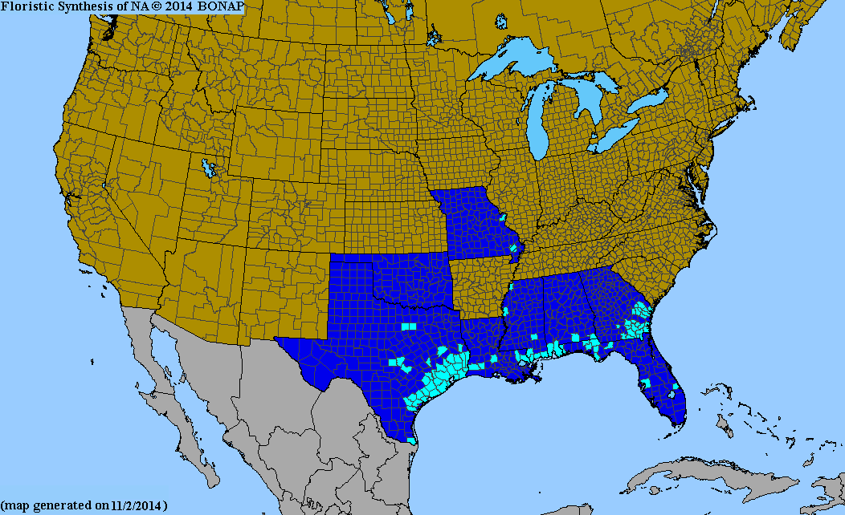
Deep-rooted Sedge
Cyperus entrerianus
Genus- cosmopolitan distribution- mostly tropical/subtropical
Growth Pattern
Invasive Pathways- 1st Record Cameron County- Rice field weed
Highly Prolific- upwards to 1 million viable seeds
Ability to store energetic reserves
C4 photosynthesis
General thoughts

Slide 2
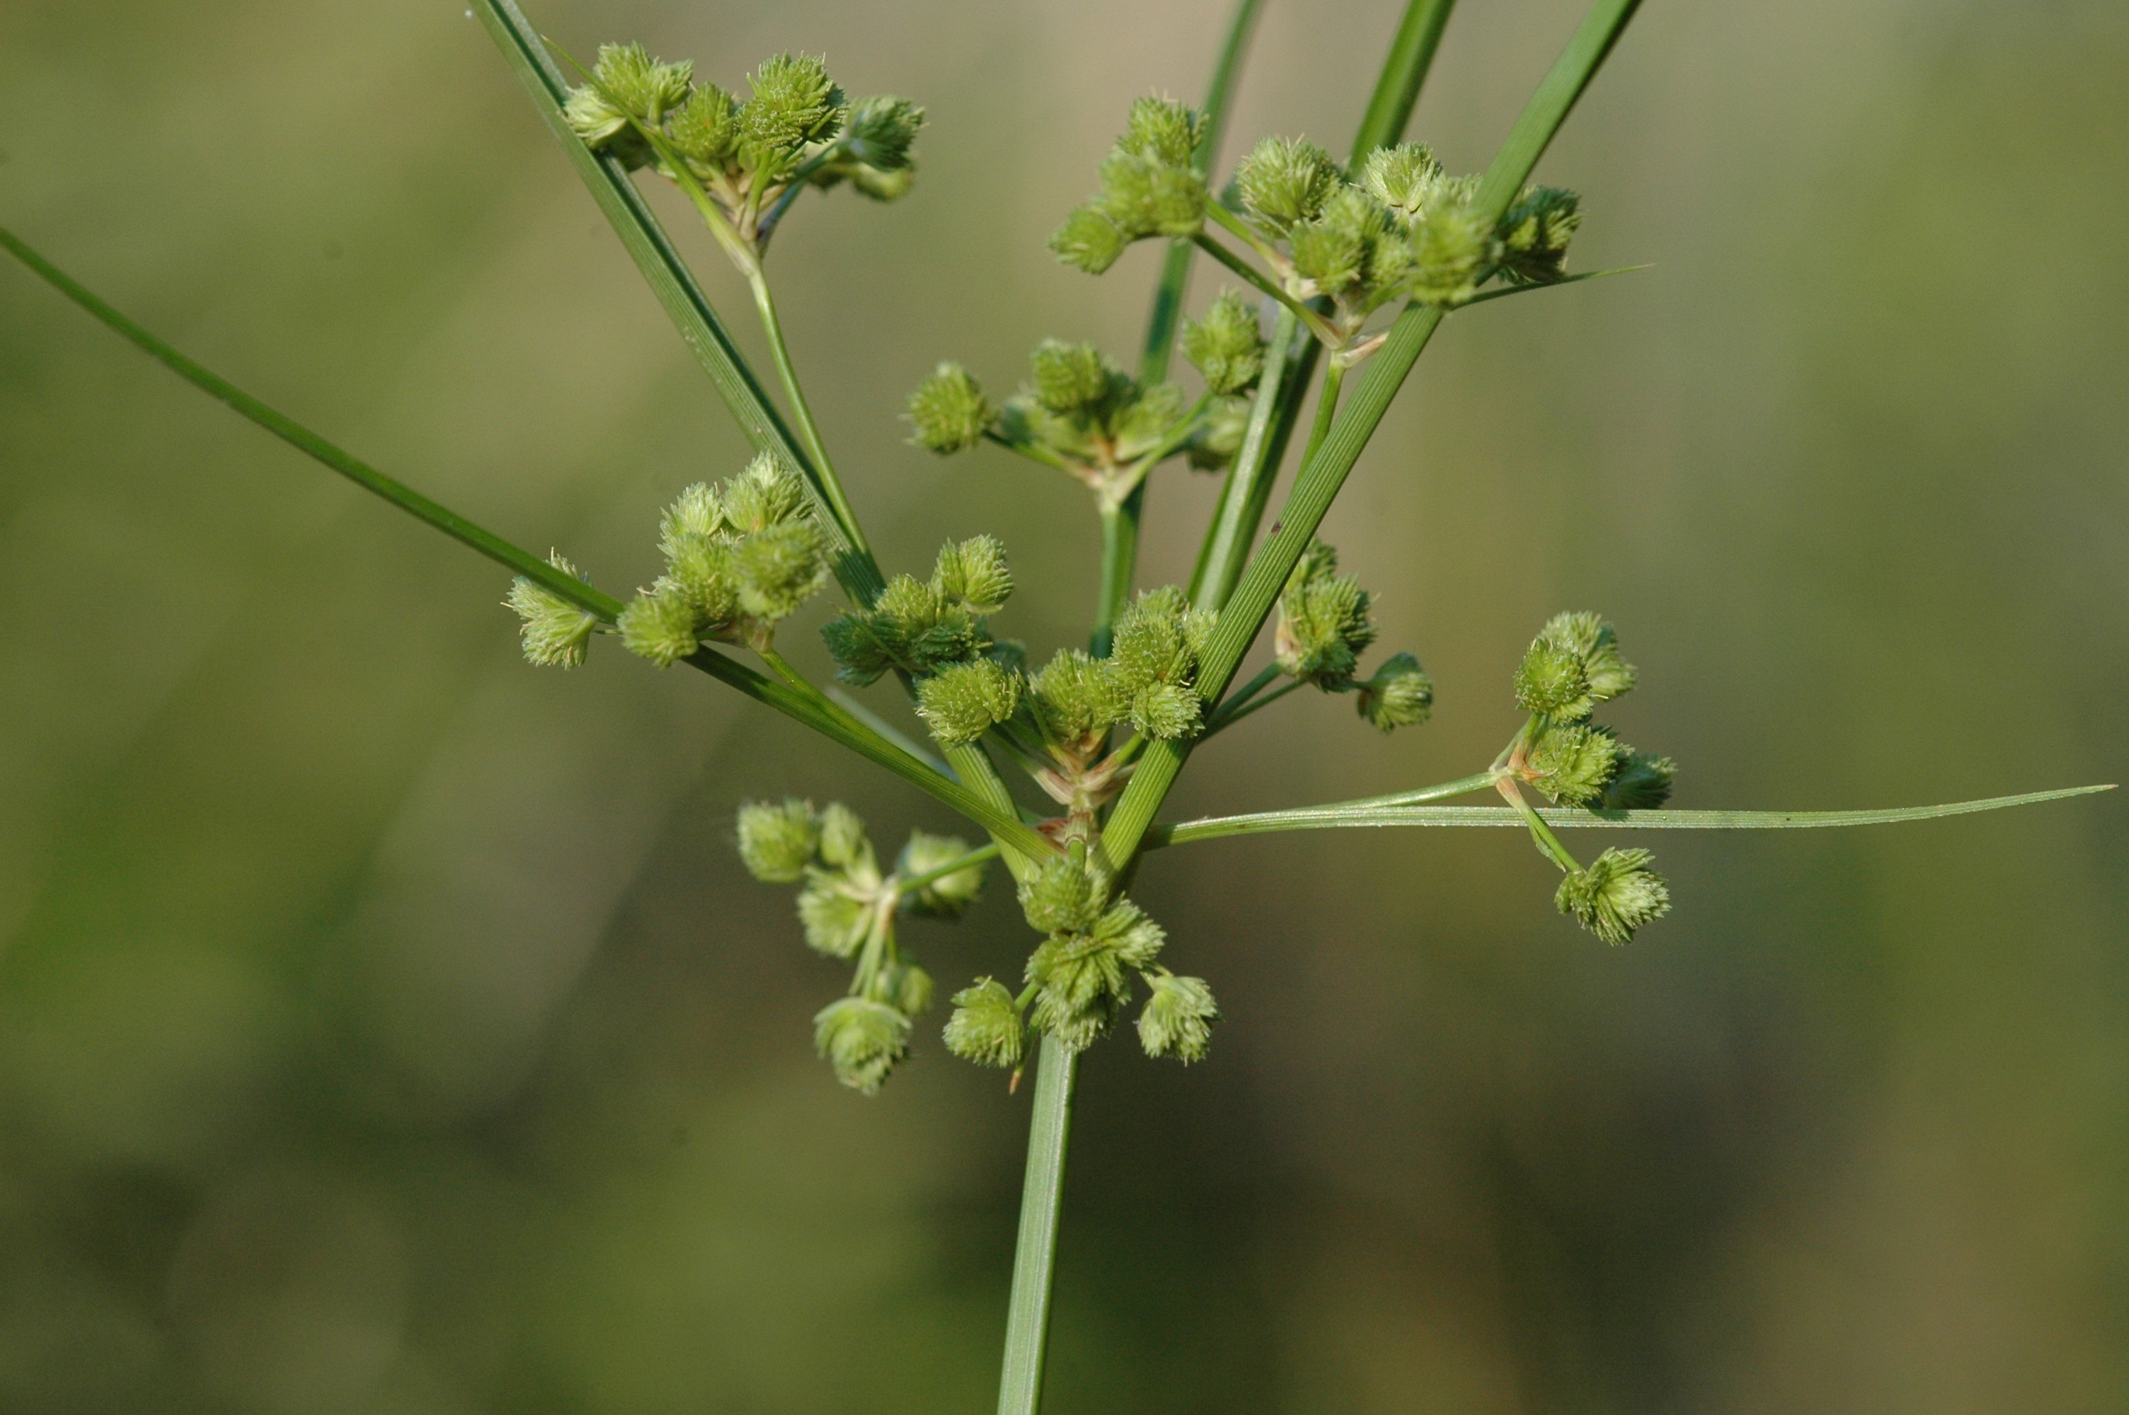
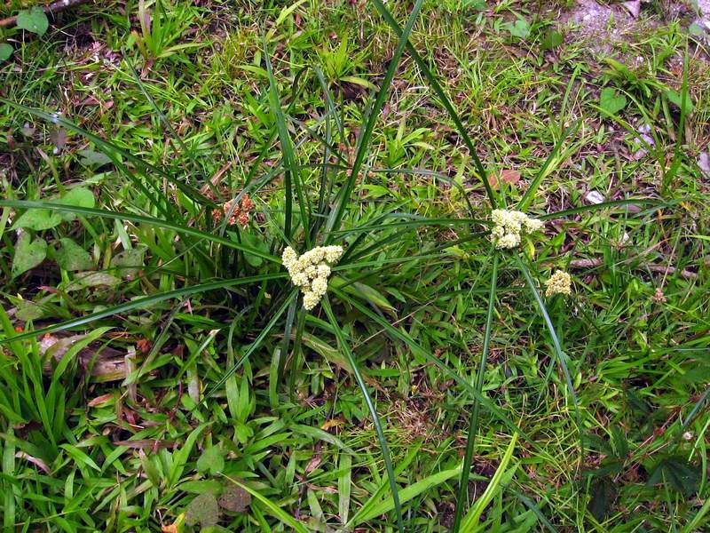
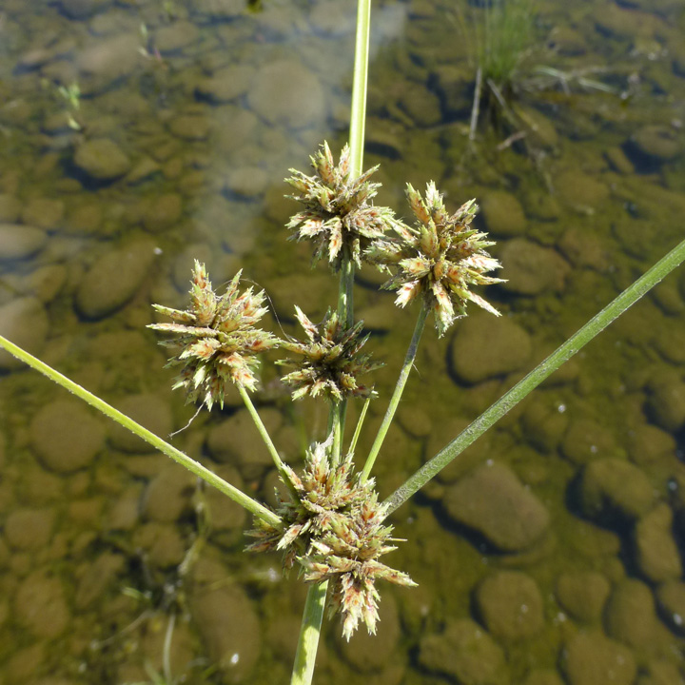
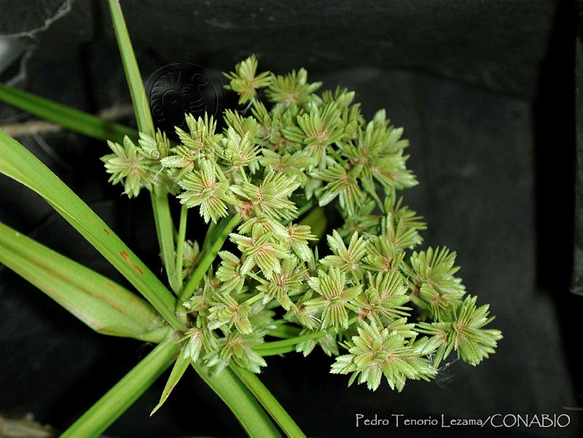
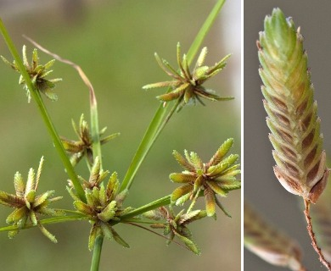

Slide 3
Control
Herbivory- to my knowledge nothing eats it
Mechanical Control- attempt to suppress seed production
Fire response observations
Herbicides
  Glyphosate- minimal success, spot treatment, stunting
  Permit/Sedgehammer (halosulfuron-methyl)- Good control, expensive, did not impact Andropogon
  Weedmaster (2-4,D + dicamba)- Aaron some success
  Grazon P+D (2,4,D + picloram)- I have not used
  Monosodium Methanearsonate (MSMA)- I have not used

Slide 4
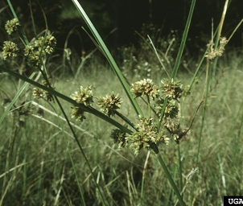
General Management Thoughts
Site goals and density of species
Often localized to disturbed areas
Preventing spread

