Slide 1
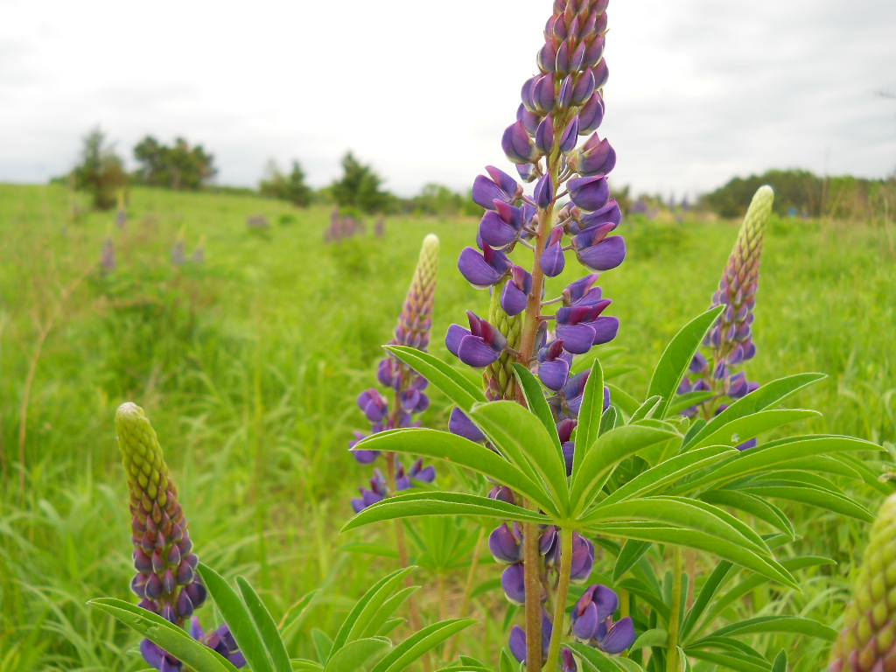


---SOIL INDICATORS PRIMER---Putting Grasslands Back to Work

Slide 2
AEI White Paper and Supporting Research
1. We reviewed 100 years of field and lab soil measures & indicators.
2. We tested Soil Health Institute’s proposed indicators
3. We learned of great confusion in published soil indicators:
Variable sampling depth, attempts to translate plot scale academic research to heterogenous landscapes; the use of erroneous assumptions that soil (and parameters) are randomly distributed over the landscape—not true.
Poor alignment between ecosystem health measurements and soil indicators!
Poor statistical relationships between soil science “indicators”, and long established ecological systems health indicators.
No internal relationships among Soil Health Institute indicators.
4. As a result we proposed a new suite of indicators that were most aligned and useful from our studies:
  Biodiversity—soil genomics + other life
  Water– H & H, infiltration
  Carbon-TC, SOC, and TIC to 1 m depth
  Overall Ecosystem Health

Slide 3
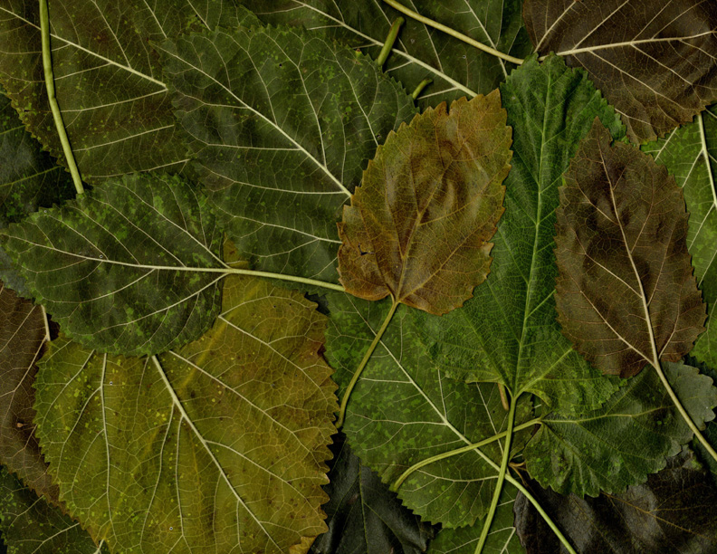
What we learned
Biodiversity examples

Slide 4
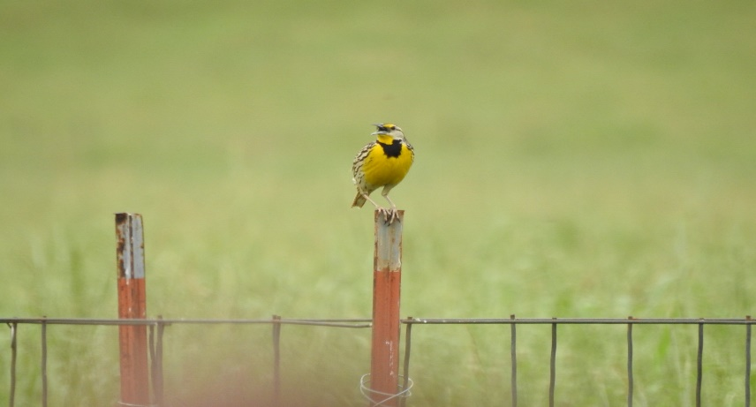
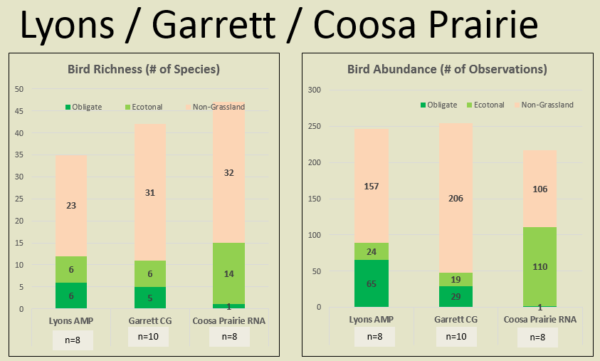
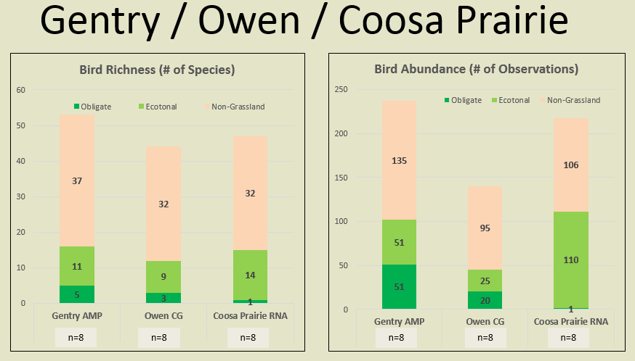
Breeding Birds
Summary
Highest grassland breeding bird species richness and populations under AMP Grazing.
Eastern Meadowlark

Slide 5
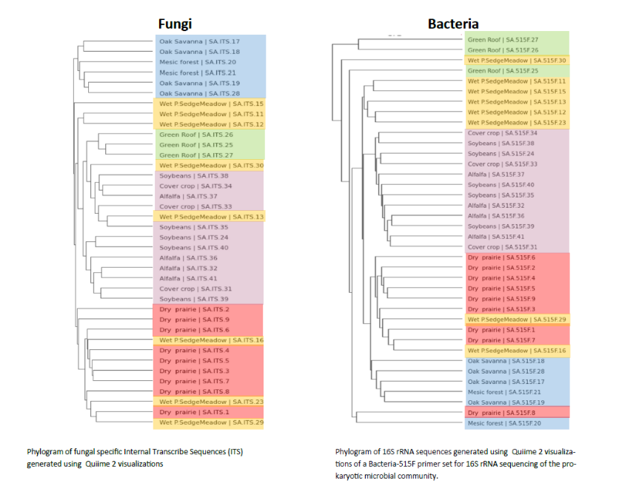
Thank you

Slide 6
What we learned
Water infiltration examples

Slide 7
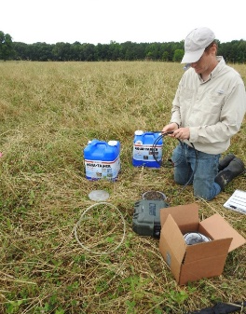
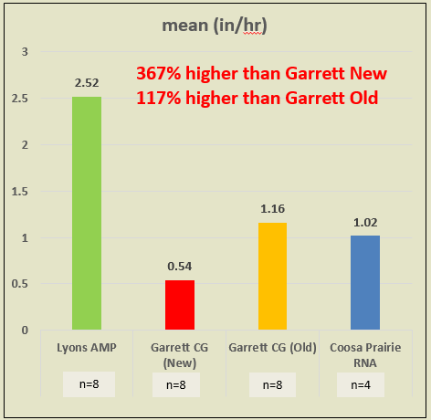
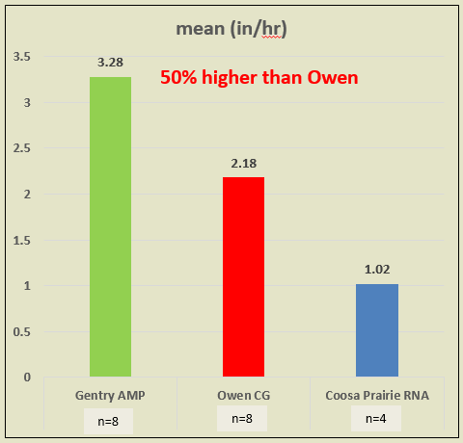
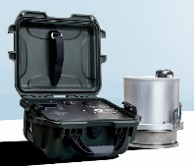
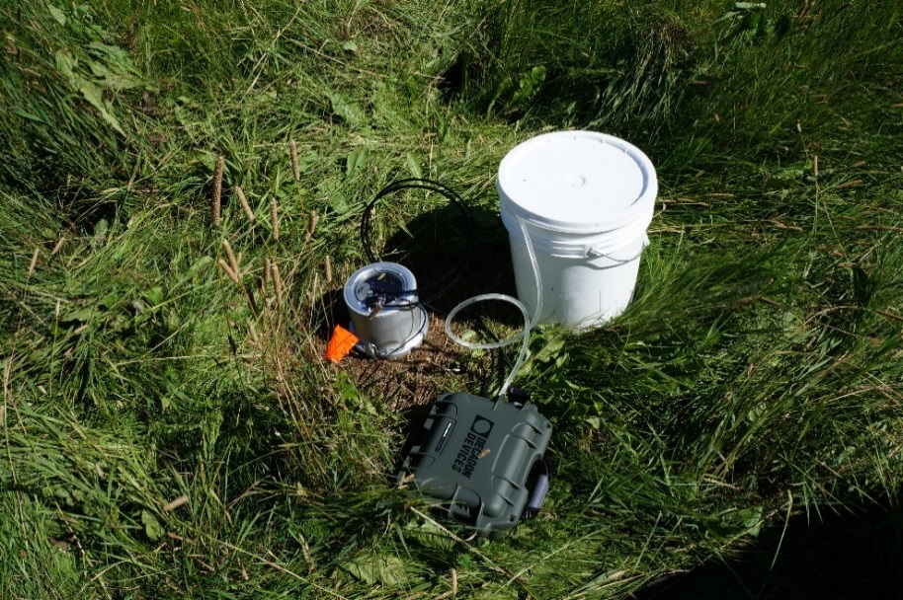
Water Infiltration
Jacksonville, AL
Ft Payne, AL
AMP --20-100% higher infiltration rates.
Perspective — For every 1% increase, this translates into ~60,000 gallons-acre/year of increased infiltrated water.
Little River benefits from cool spring fed ground water, not surface water runoff.

Slide 8
What we learned
Soil carbon examples

Slide 9
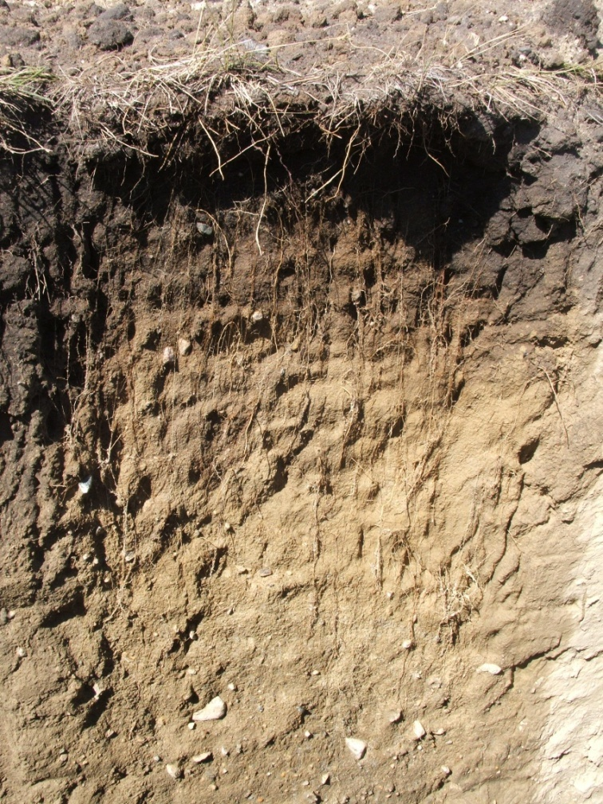
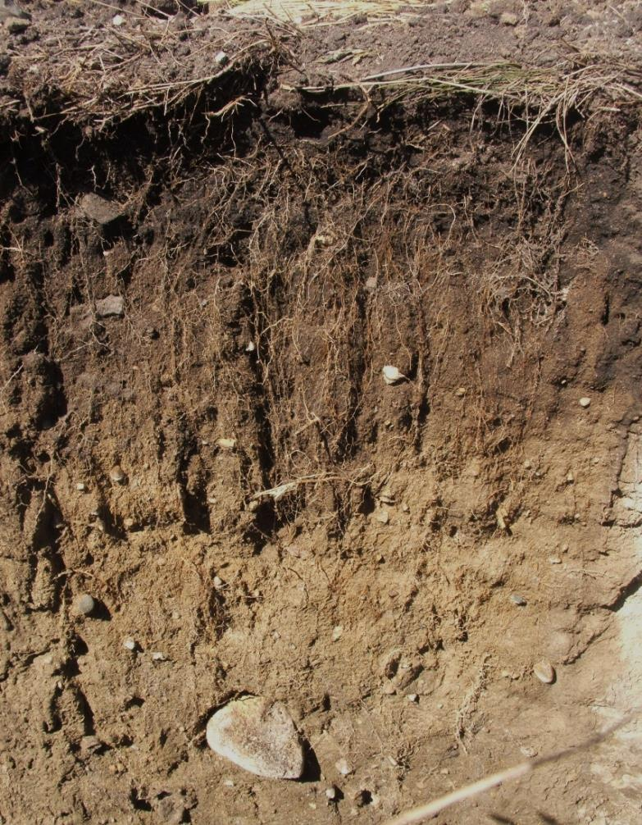
HC Grazing
AMP Grazing
Measured Increases
Sandy Loam +1.3 cm/hr
Clay Loam +27 cm/hr

Slide 10
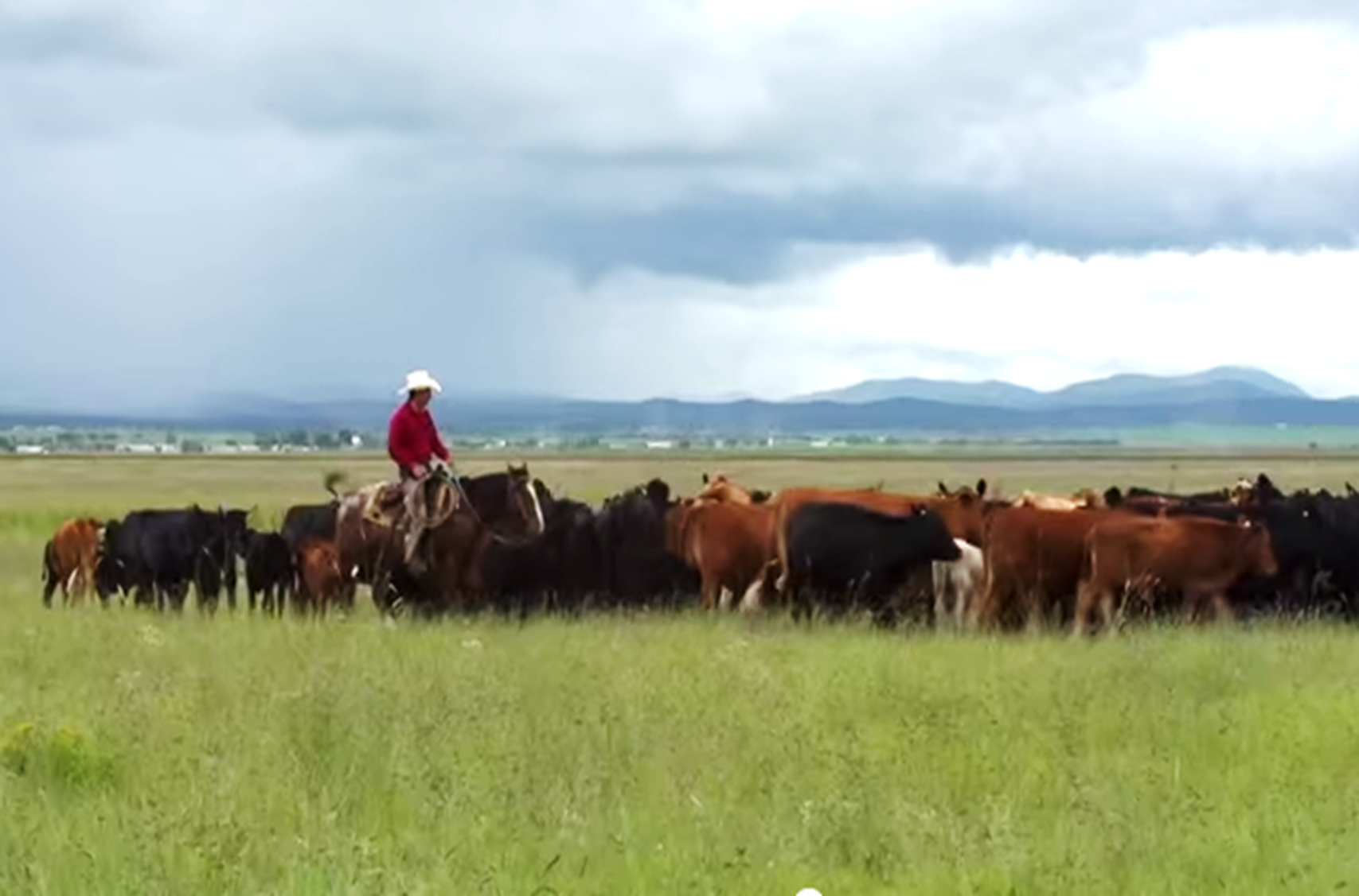
Increasing Soil Carbon Using
Regenerative Agriculture and Adaptive Multi-Paddock (AMP) Grazing
Overview of findings, research needs, and the 1 Million Metric Tons pilot
White House OSTP
Washington, D.C., 5th April 2016
Richard Teague, Texas A&M AgriLife Research
Steven Apfelbaum, Applied Ecological Services, Inc.
& Project Meadowlark Team Members

Slide 11
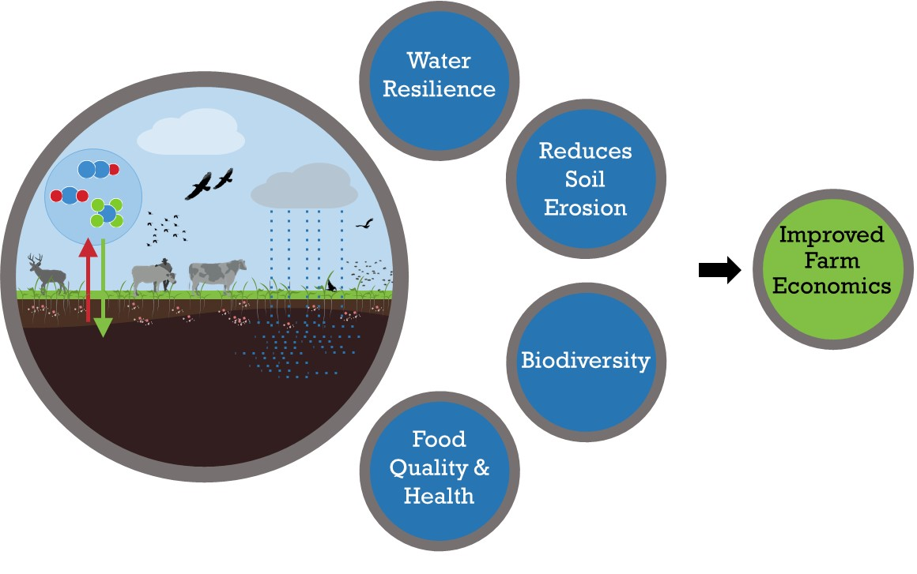
Hypotheses: AMP Grazing Improves Ranch Economics

Slide 12
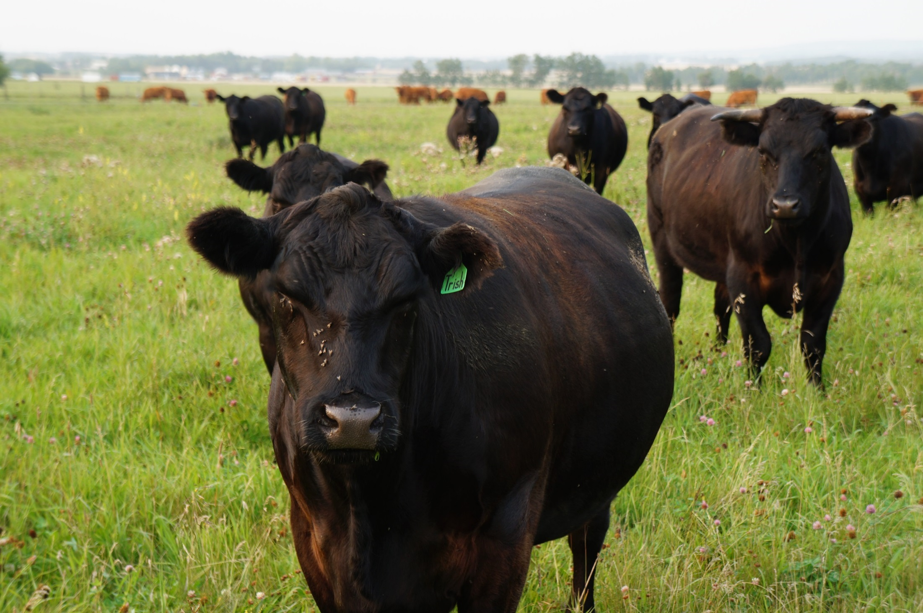
Adaptive Multi-Paddock (AMP) Grazing Studies

Slide 13
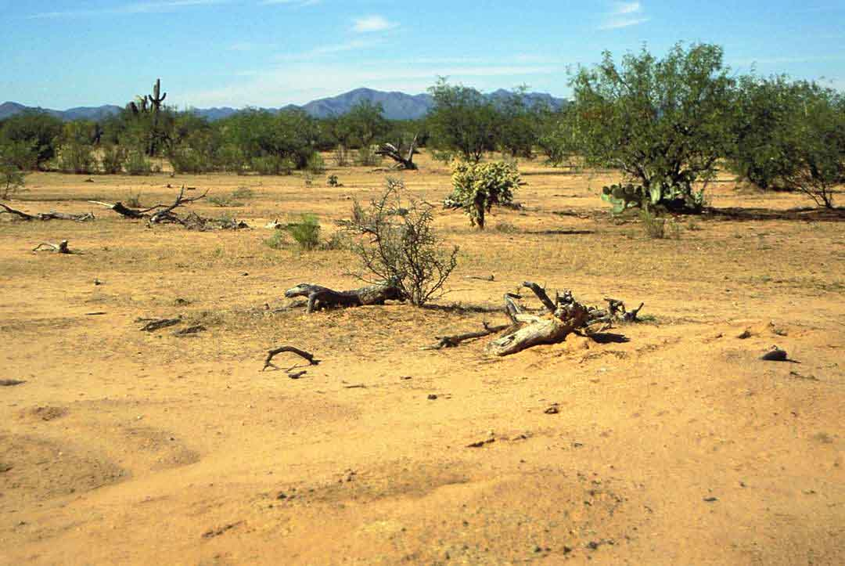
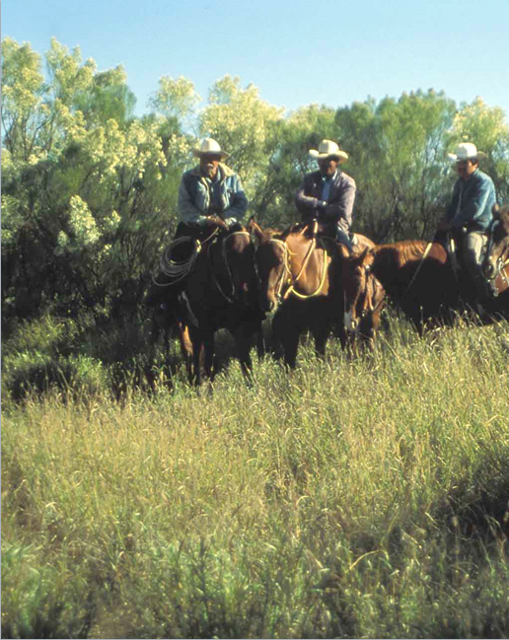
North America: Semi-Arid Rangeland
H2O
CO2
H2O
CO2
Continuous grazing
AMP grazing
Notes:
What caused this?

Slide 14
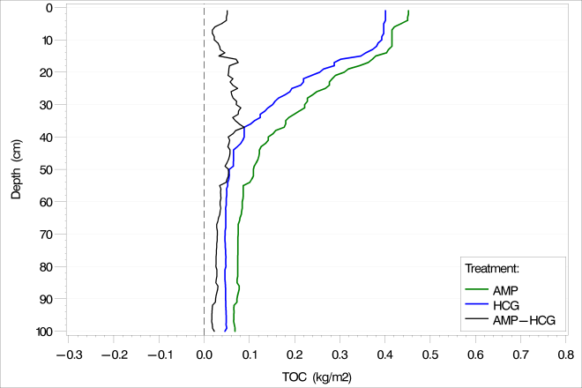
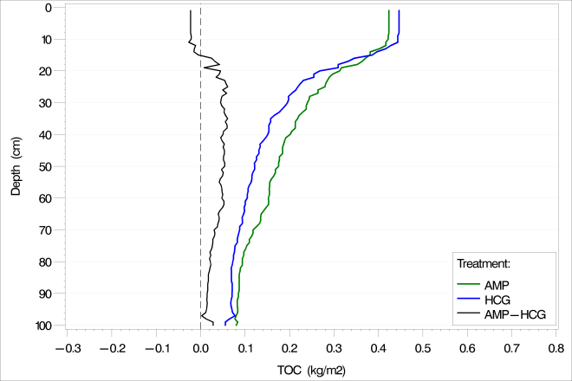
AMP Grazing Changes Carbon Pools
Planted pastures
Native grasses

Slide 15
AMP Grazing Changes Carbon Pools
Planted pastures
Native grasses
MORE CARBON DEEPER

Slide 16
What we learned
Overall Ecosystem Health examples

Slide 17
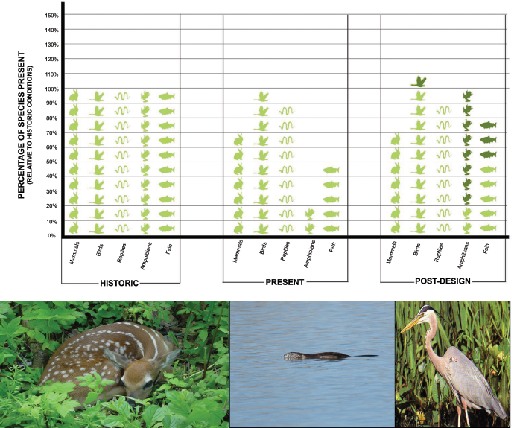
From Our Projects---Ecosystem Improvements
Notes:
17

Slide 18
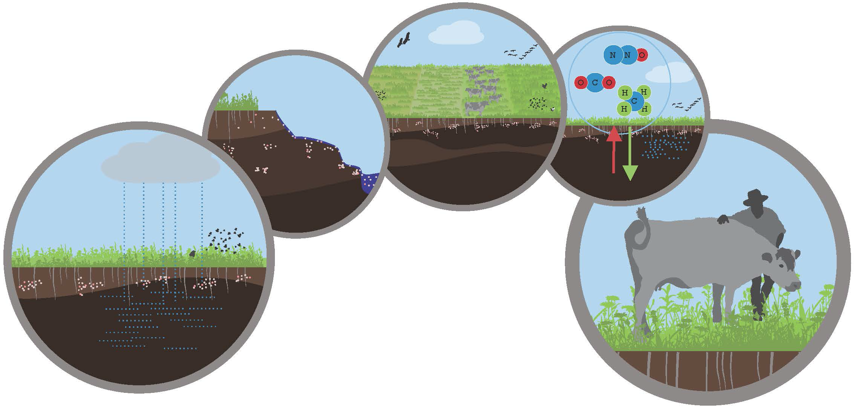
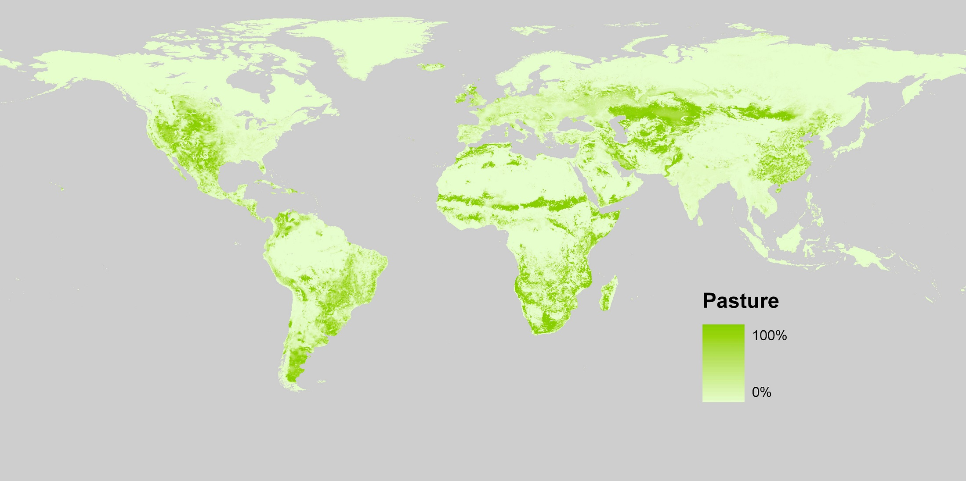
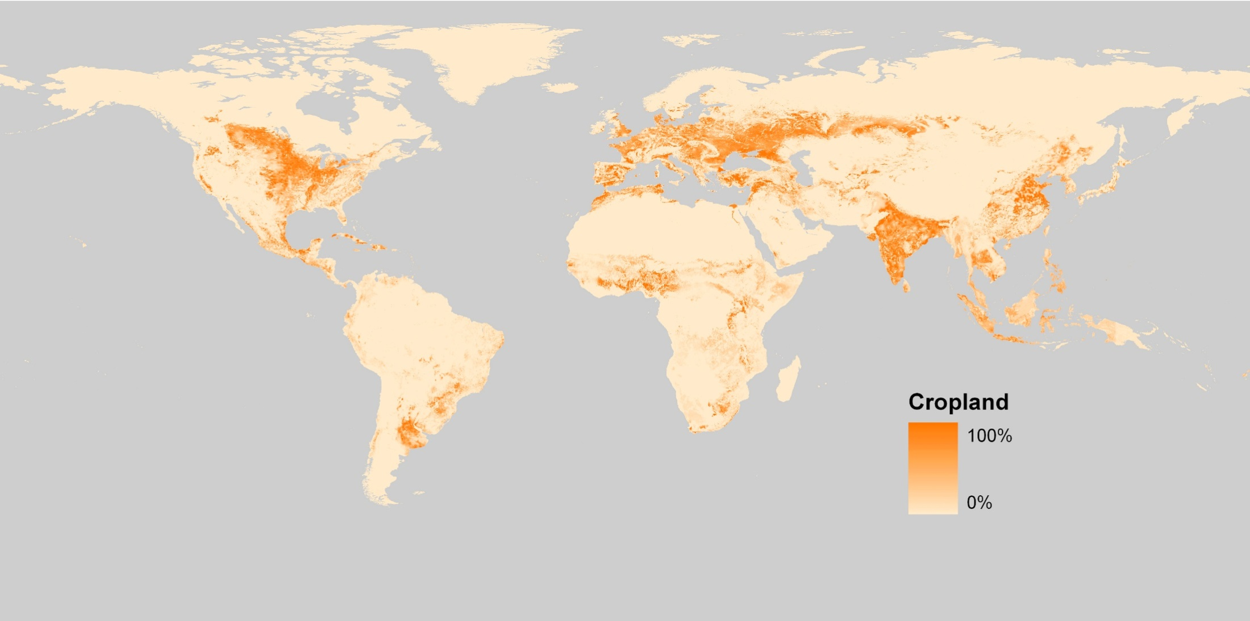
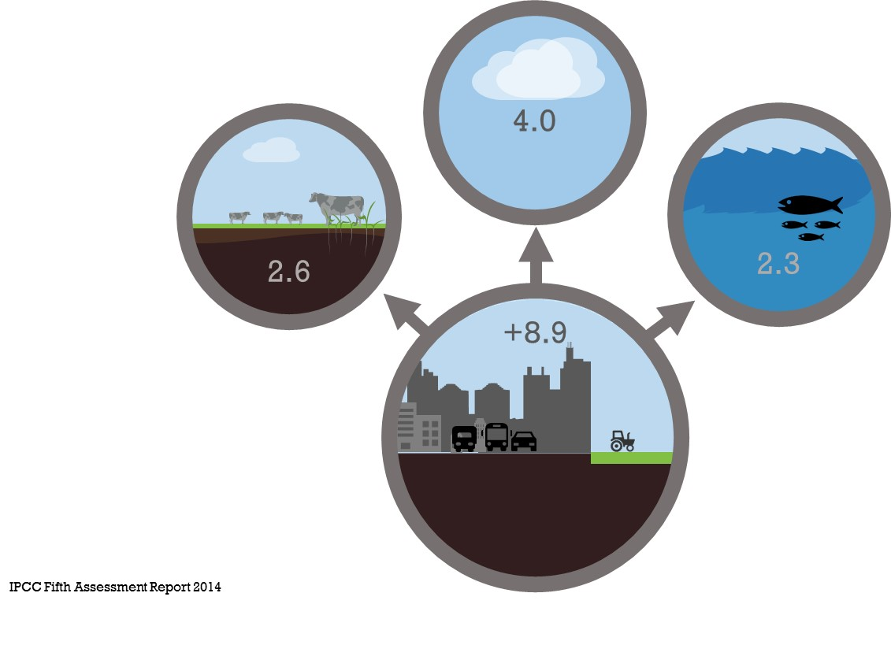
Hypothesis:
“Carbon rich soil is healthy soil, beneficial for the entire ecosystem and planet”
5 bln ha
grasslands and croplands
Excessive atmospheric Co2 belongs back in the soil

Slide 19
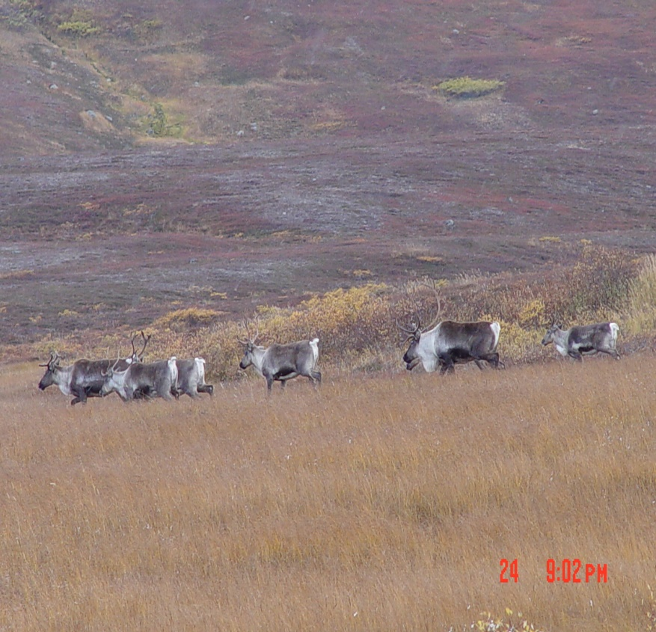
AMP vs Continuous Grazing
AMP (Adaptive Multi-Paddock) Grazing--- Emulates the way bison, caribou grazed--- fast movement over a landscape followed by appropriate long recovery period.
Continuous Grazing--- Livestock have nearly year round access to the same land with minimum rotation or recovery period for the plants.
OVERGRAZING occurs with excessive PLANT EXPOSURE TO GRAZERS and inadequate PLANT RECOVERY TIME

Slide 20
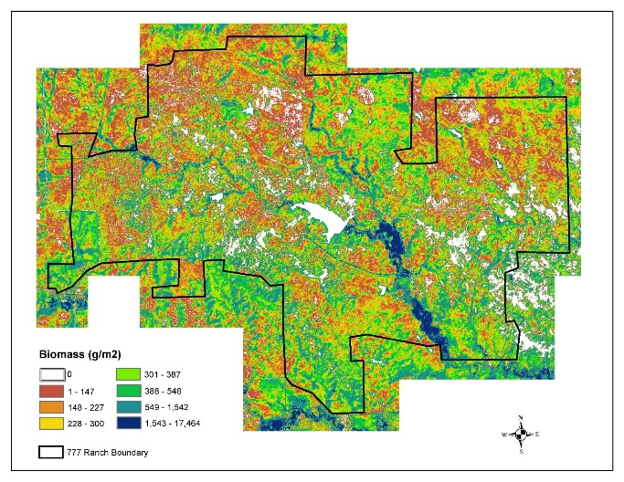
777 Bison Ranch Biomass

Slide 21
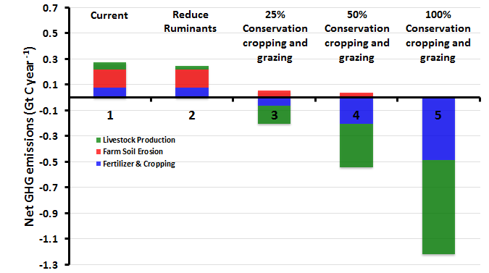
Net Emissions with Regenerative Cropping and AMP Grazing Practices
Teague et al. 2016

Slide 22
After restoration begins, what indicators are detectable?
Biological System Response
Bio-Physical Response
TIME
Cover crops
Erosion control
.5 yrs
Annual, biennial, short lived perennial weeds
Reduced runoff
Generalist insects
1-2 yrs
Matrix plant community
2-5 yrs
Infiltration
Birds/Small Mammals, Herptiles
(2-5 yrs)
5-10 yrs
Soil carbon
Diverse plant communities
40+ years
Shift to Fungal genomics

Slide 23
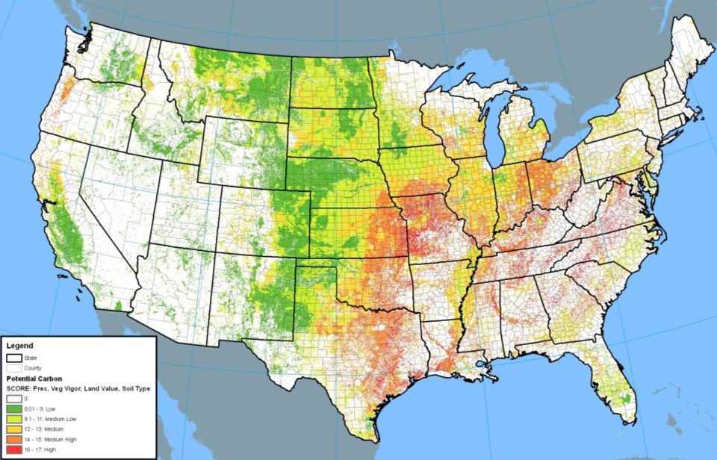
Potential for Soil Organic Carbon Growth
“Soil Carbon Fingerprint” of the historic interplay between geology, climate, vegetation, soil microbiota, macrofauna (and humans)
Source: Applied Ecological Services, Inc.
Generated from data from Nationalatlas.gov)
(Precipitation, Vegetation Vigor, Land Value, Soil Texture Types)

Slide 24
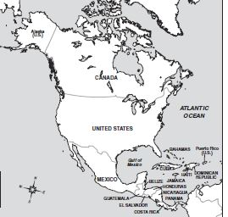
Soil Carbon Durability (Years)
Semi-arid: Palouse
Unglaciated
Soil Depth | Average Carbon Age (yrs)
.1 m | 30-60
1m | 47,000
2m | 120k-130k
3m | >200k
Arid West, New Mexico
Wisconsin glacial till plain
Uplands Peat
Soil Depth (m) | Average Carbon age (yrs)
.1 | 100-300
.1 to 1 | 500-2k
1-2 | >30k
>2 | >200k
Soil Depth | Average Carbon Age (yrs)
.1 m | 100-200
.2 m | 30,000+
>.2-.5 m | 3-5 million
Soil Depth (m) | Average Carbon Age (yrs)
.1 | 100-200
.1 to 1 | 1500-12k
>2 | >80k
Soil Depth (m) | Average Carbon Age (yrs)
.1 | 100-200
1-2 | 1500-12k
>2 | >12k
Retallack, 2013
Monger, C. NMSU
Futuma, UM
Estimated

Slide 25
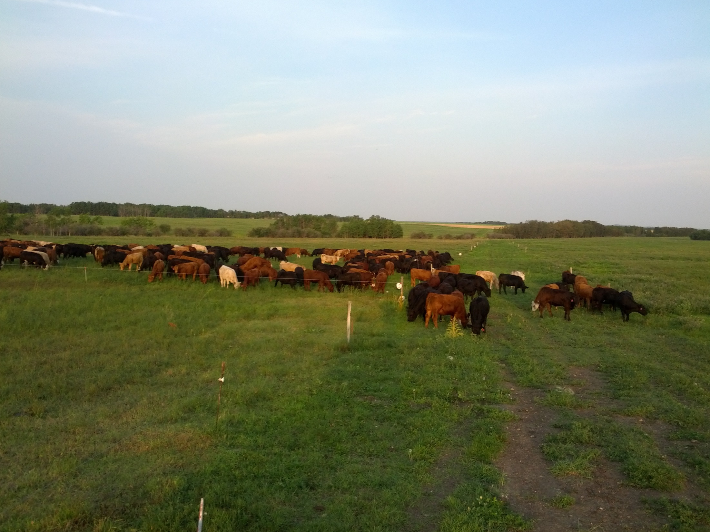

Thank you

