Slide 1
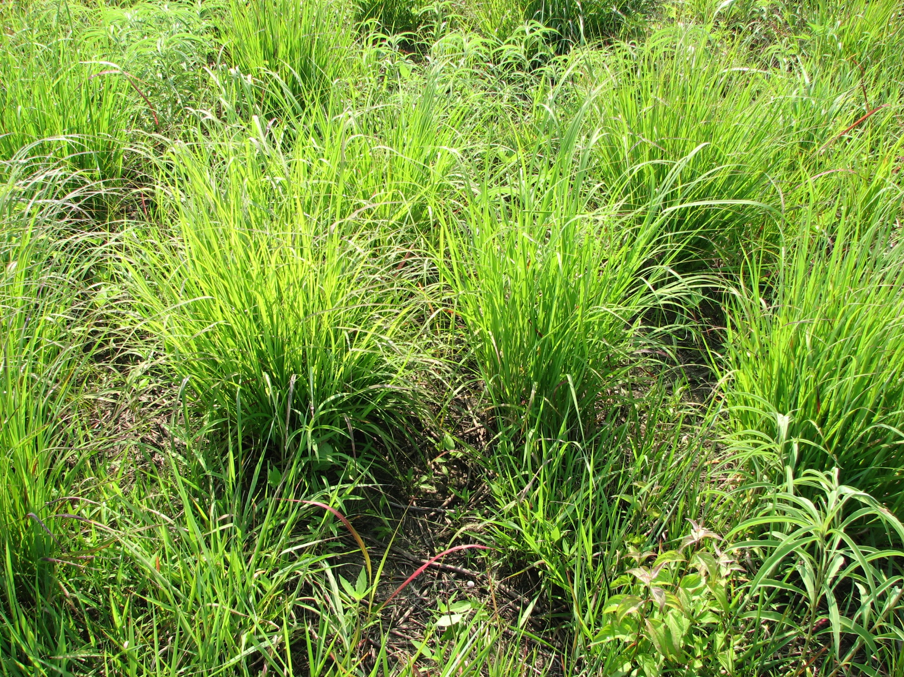
Controlling Perennial Non-Native Grass:
Johnson Grass, Bahia Grass, and Bermuda Grass
Tim Siegmund
Private Lands Program Leader
WL Division - TPWD
Tim Siegmund, TPWD

Slide 2
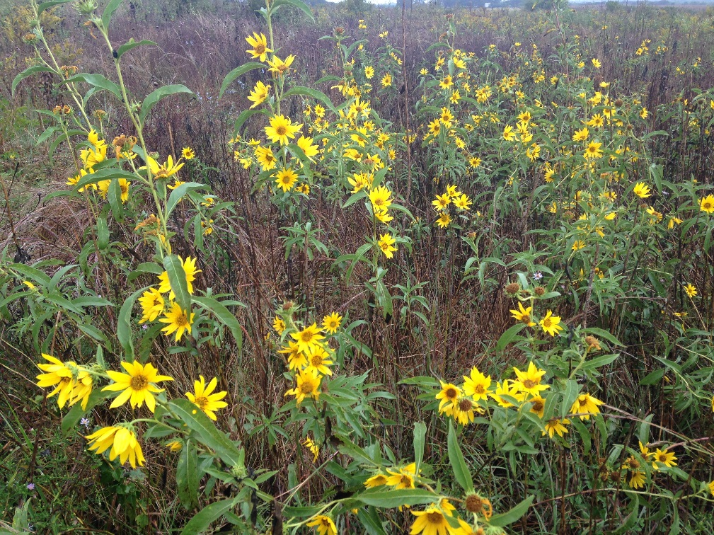
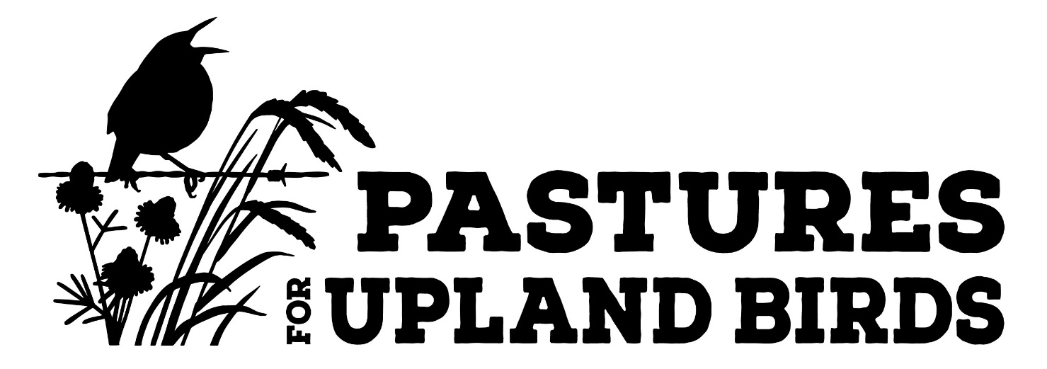
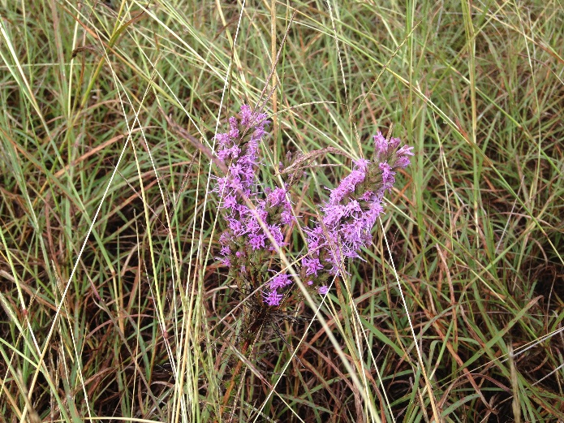
Pastures for Upland Birds Program (PUB)
Eliminate Non-Native Pasture Grasses
Establish Native Plant Community
Foster Habitat for Native Species (Pollinators, Birds, Mammals)

Slide 3
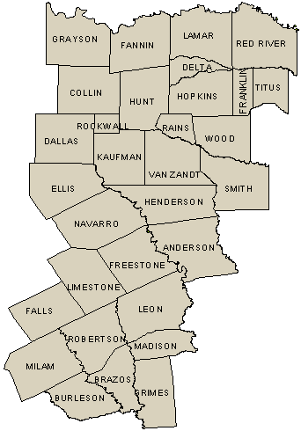
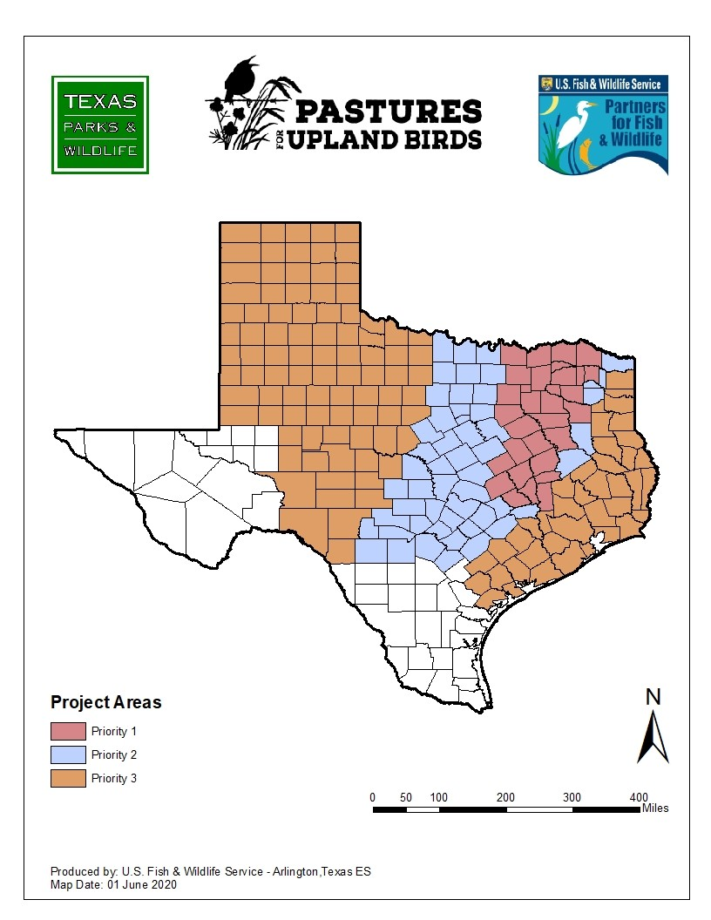
PUB Focus Area

Slide 4
Selective Treatments
Kill the Bad; Save the Good
Side Effects
  Tolerance of non-target species
  Value of oversprayed species
  Costs
    Multiple trips
    Multiple purchases
    Ancillary equipment

Slide 5
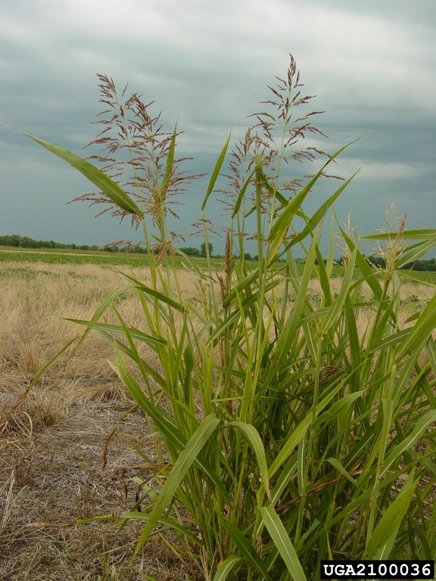
Johnson Grass
Can function as Perennial
Also as annual invader from robust seed bank
Heavy infestations will require multiple treatments
Selective herbicide use to protect valuable species and reduce competition from Johnson Grass

Slide 6
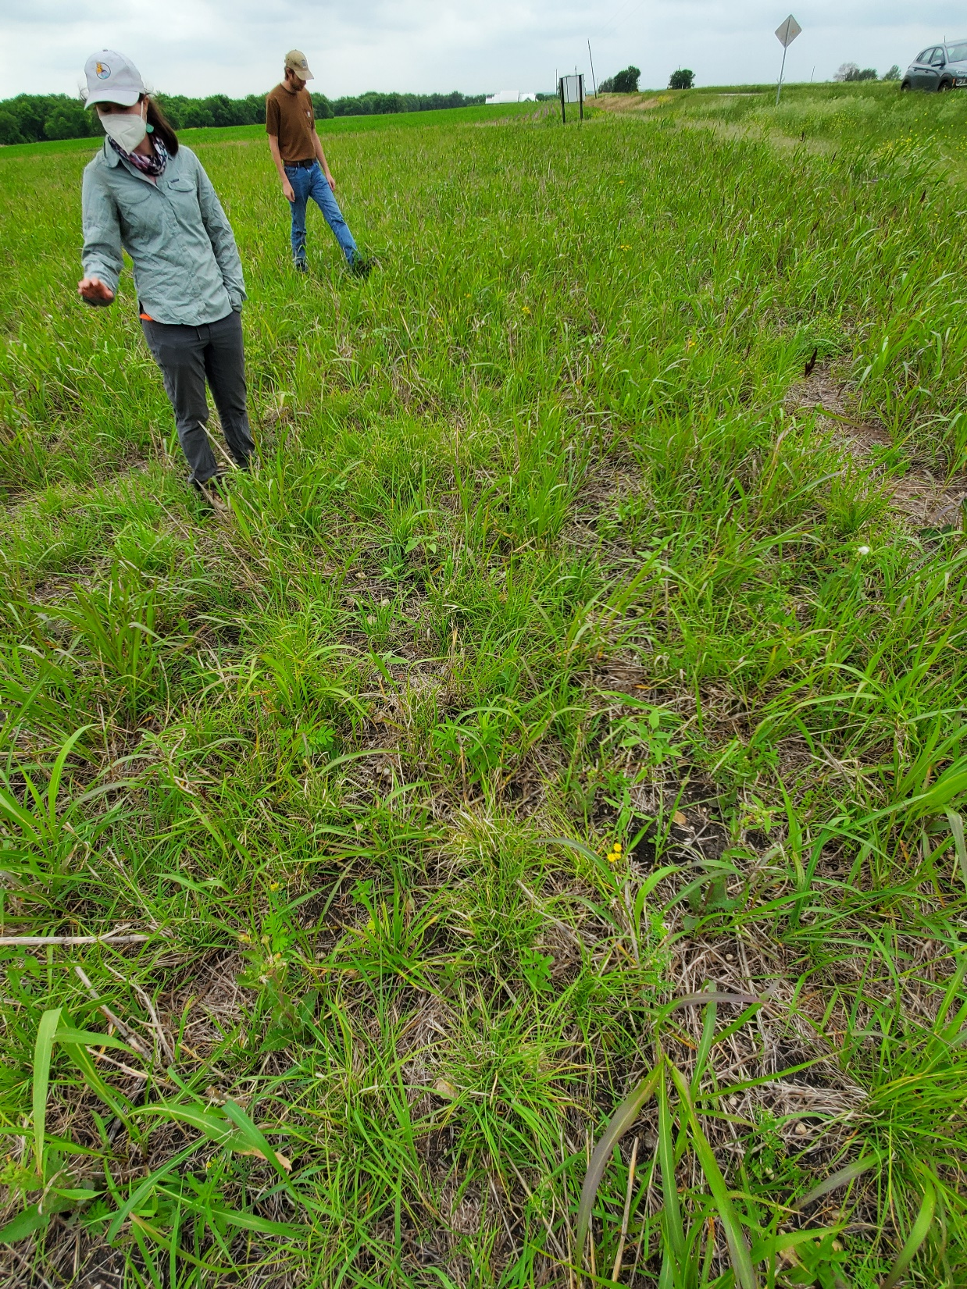
* 4 oz per acre Plateau (Imazapic)
6 months post planting
* Photo 12 months after planting

Slide 7
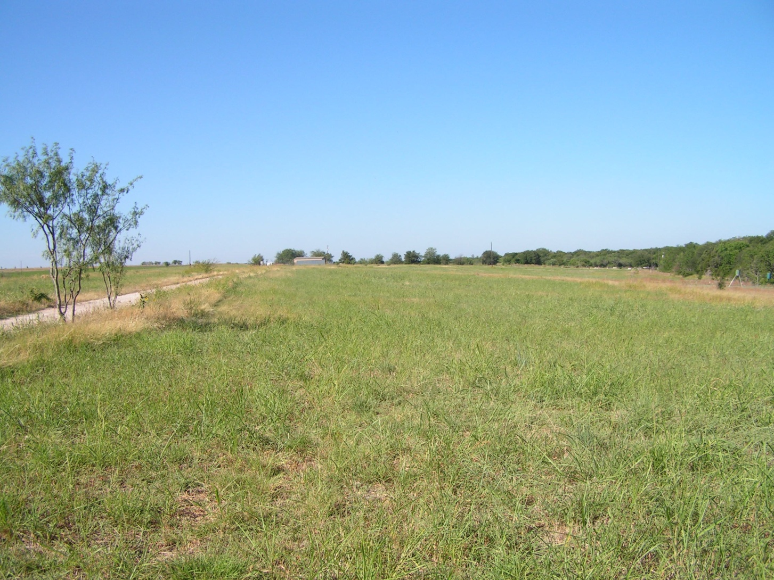
March 2012

Slide 8
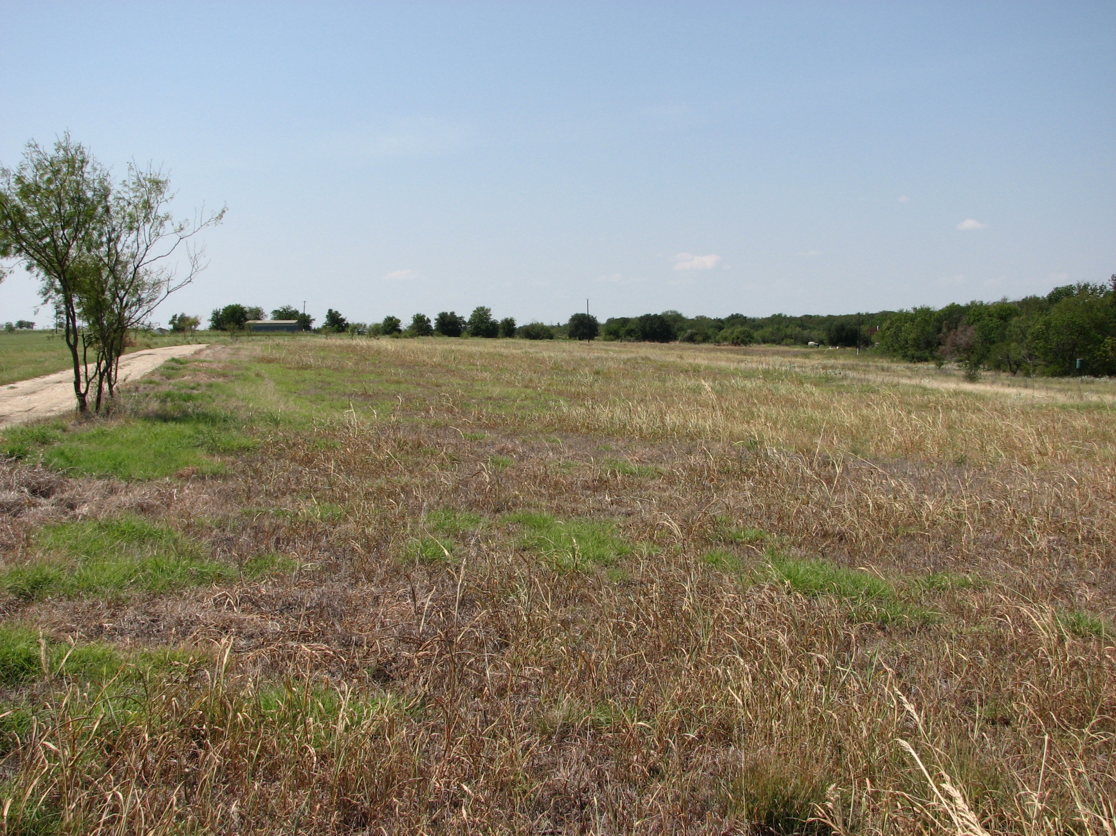
August 2012

Slide 9
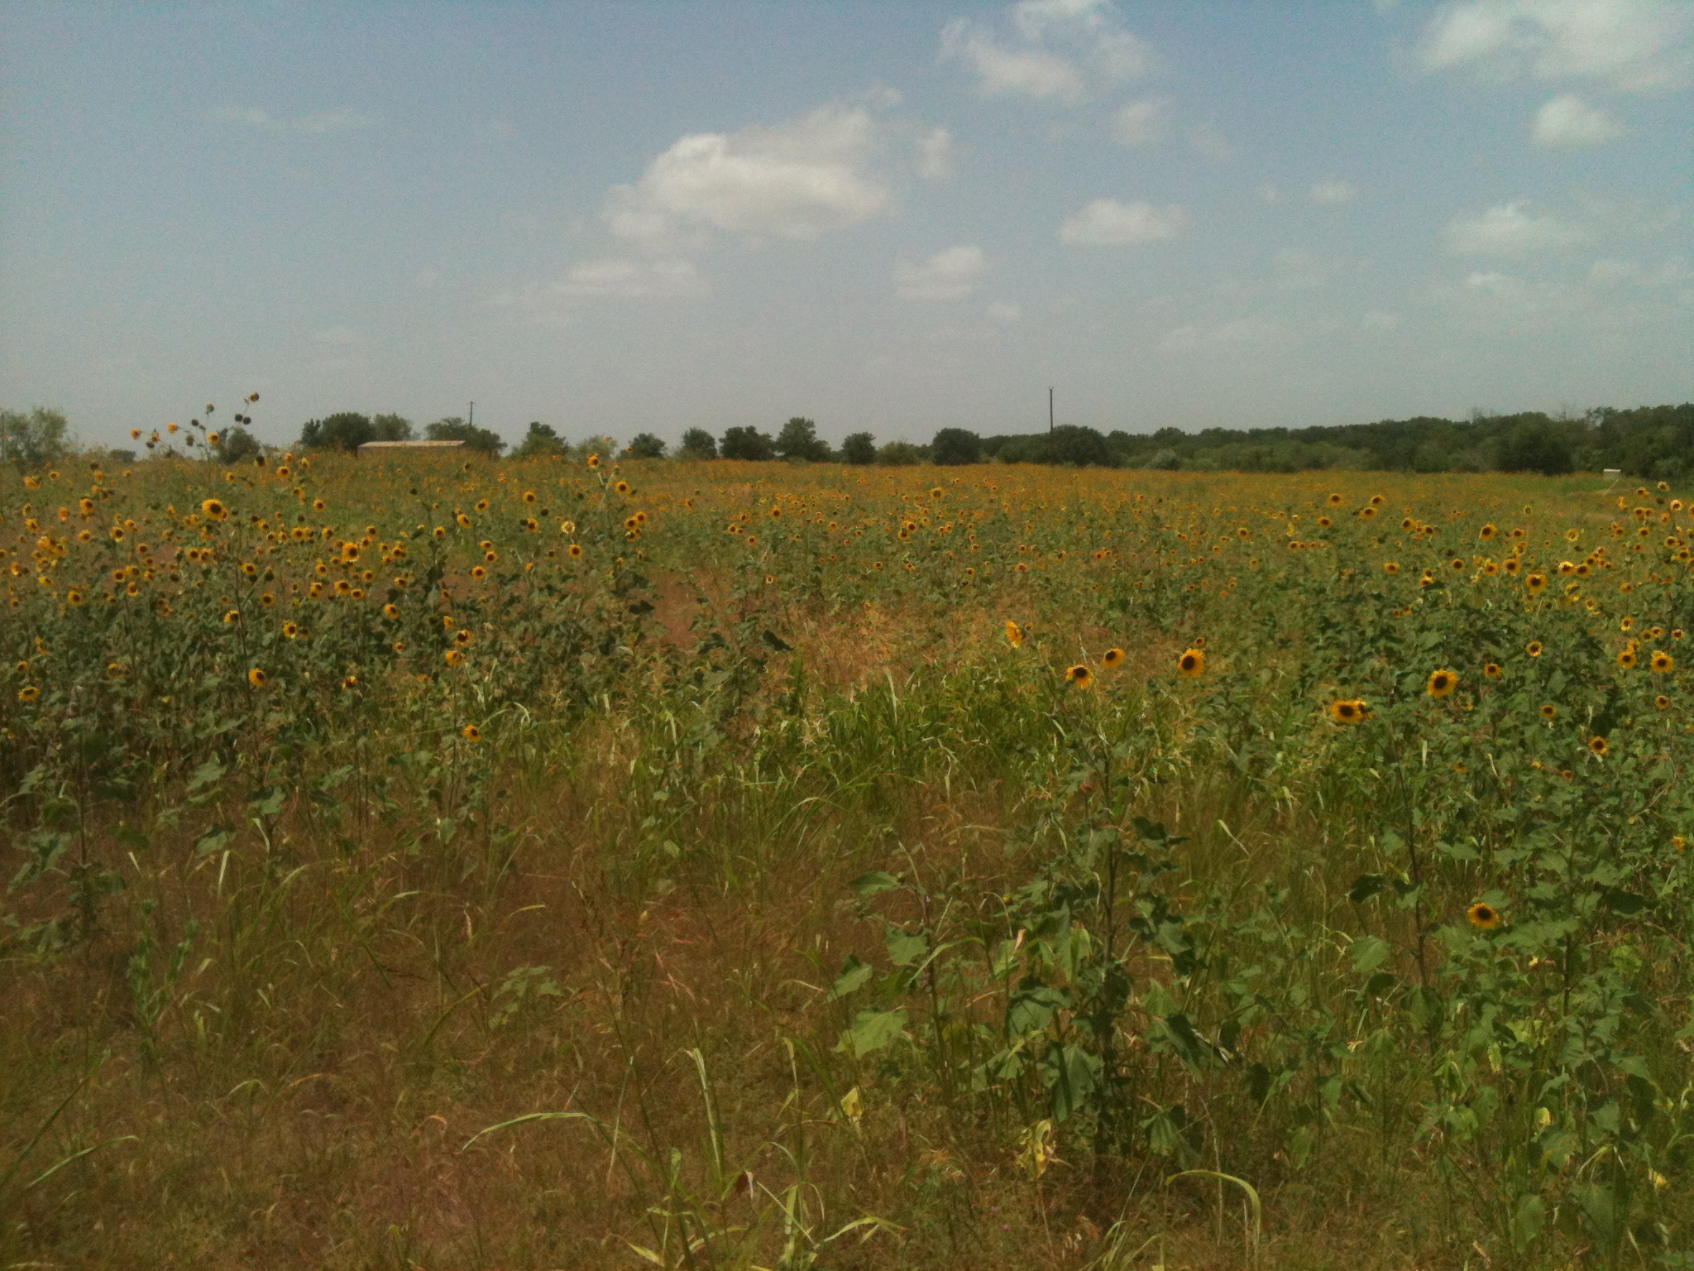
June 2013

Slide 10
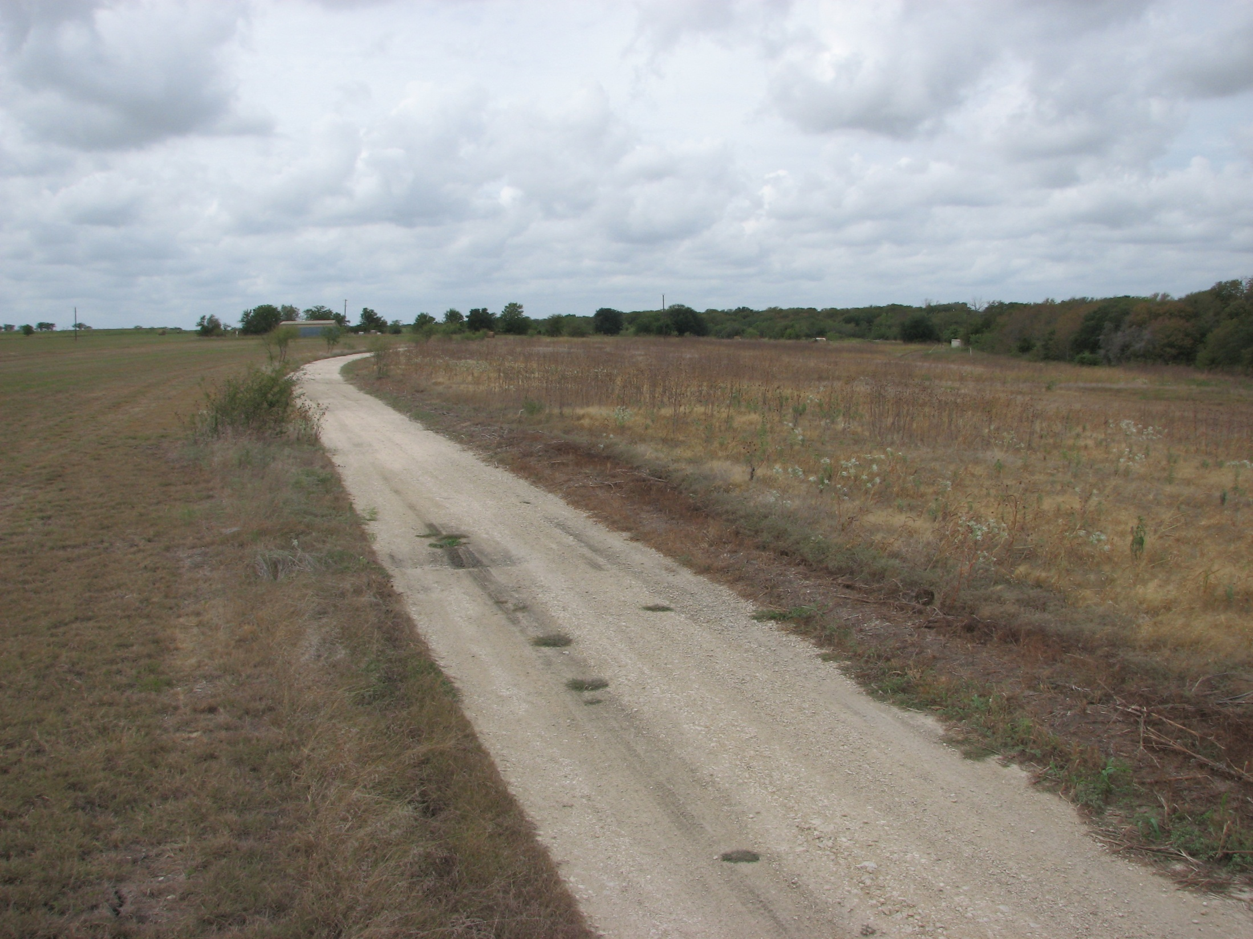
September 2013

Slide 11
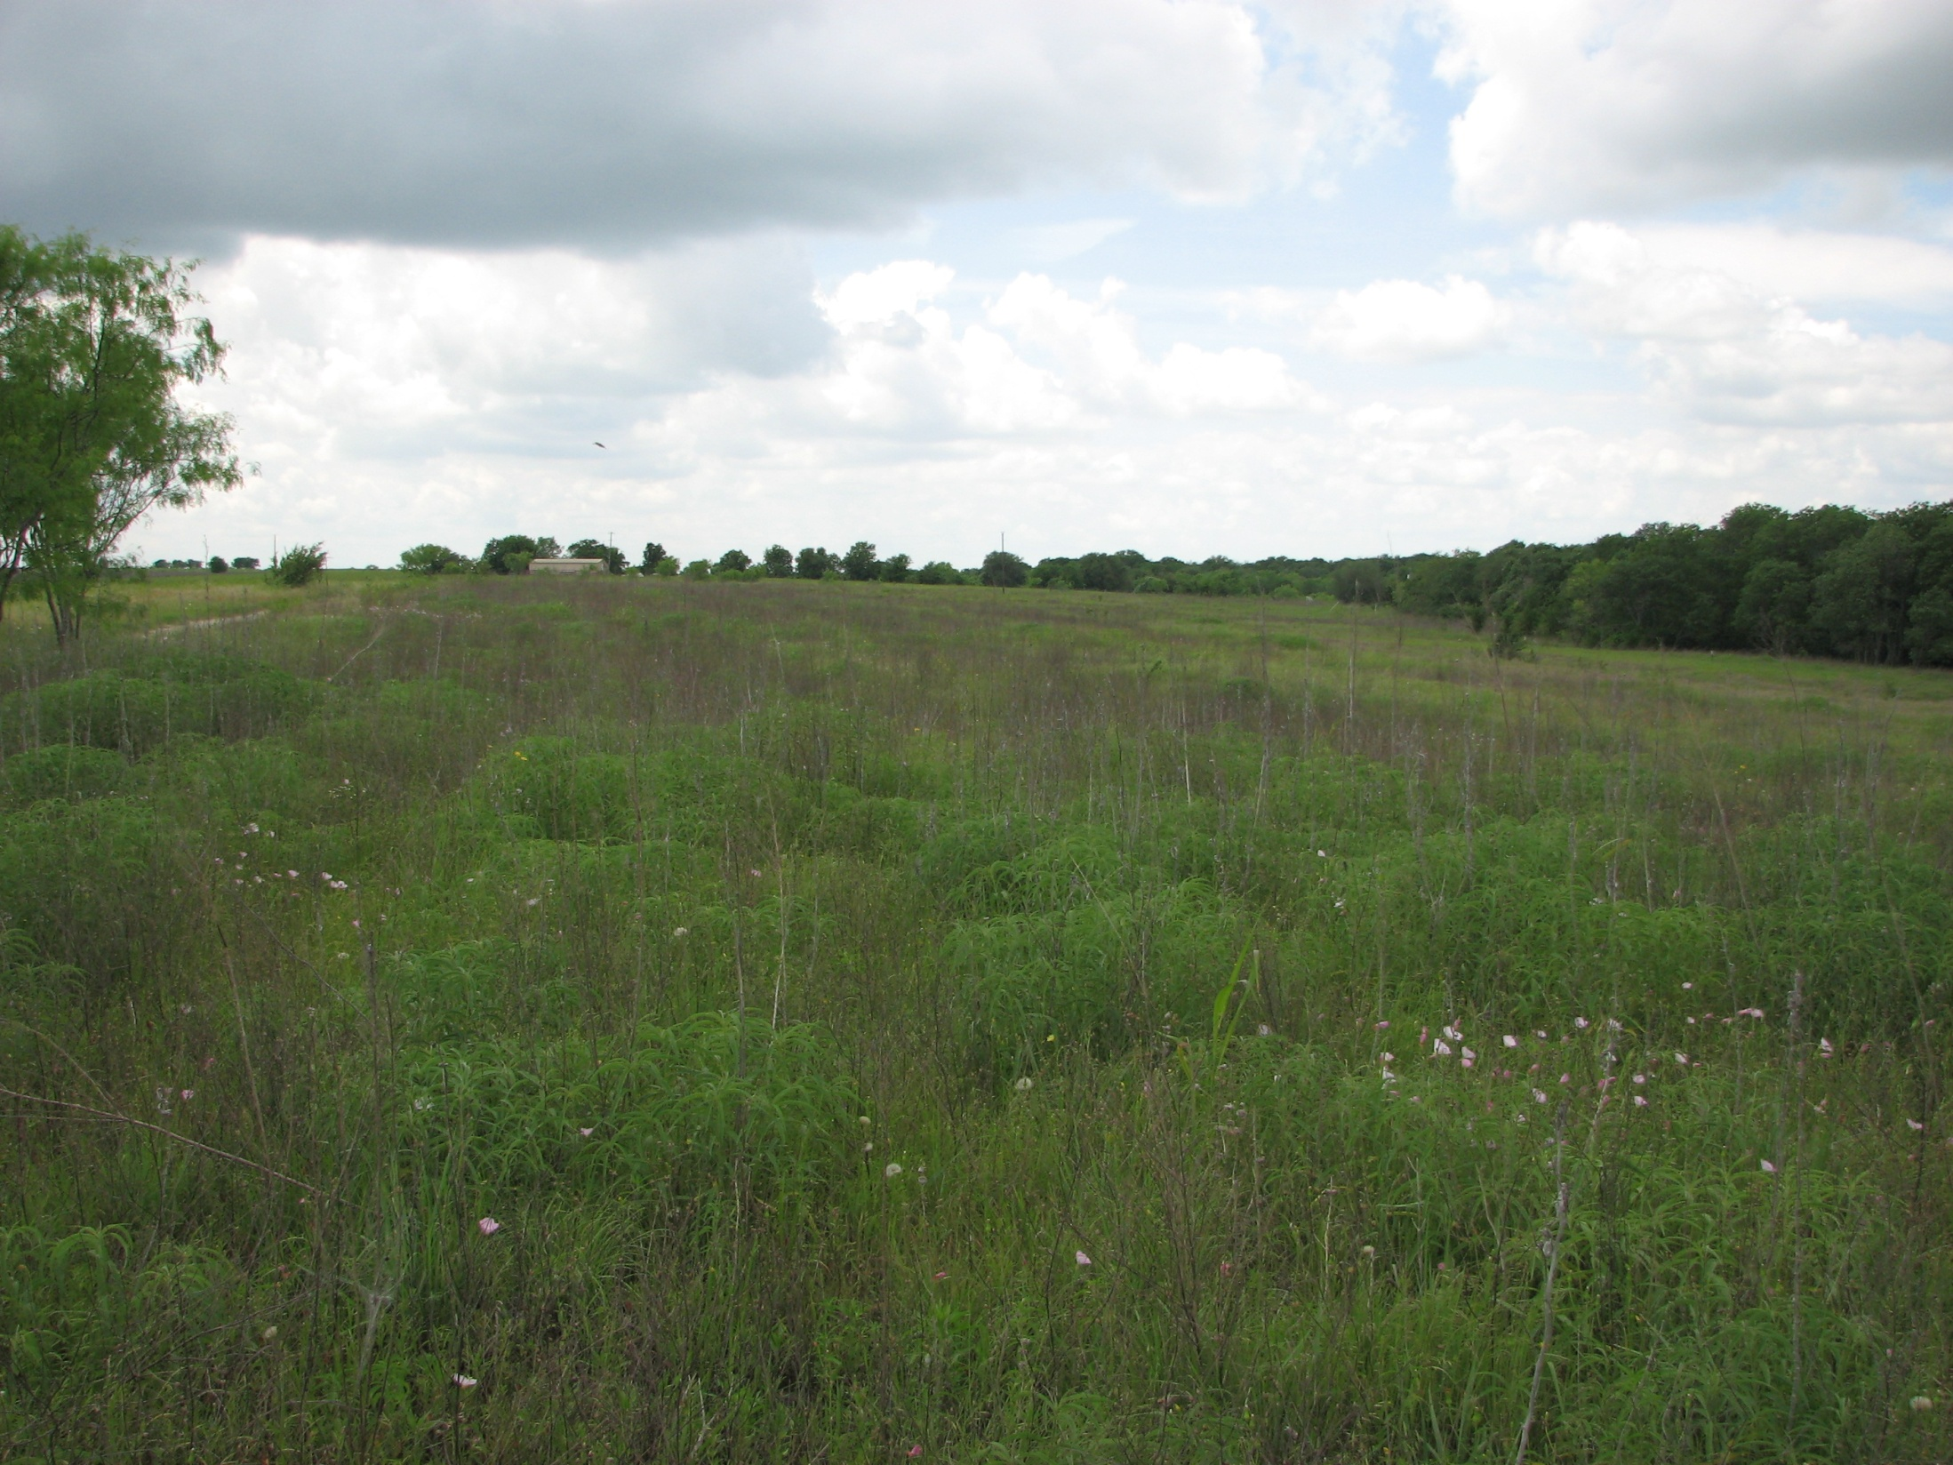
May 2015

Slide 12
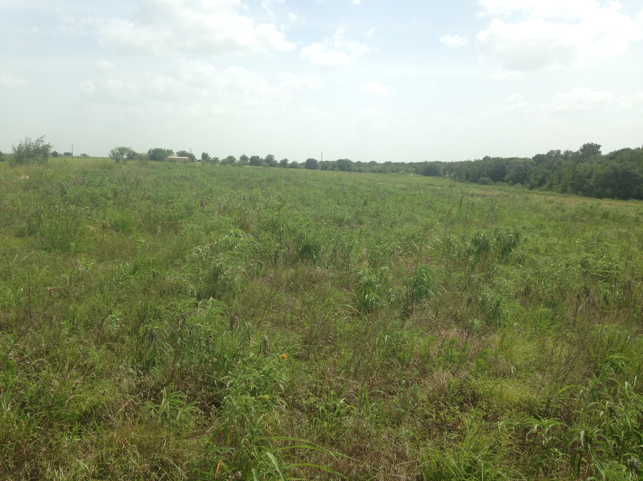
July 2015

Slide 13
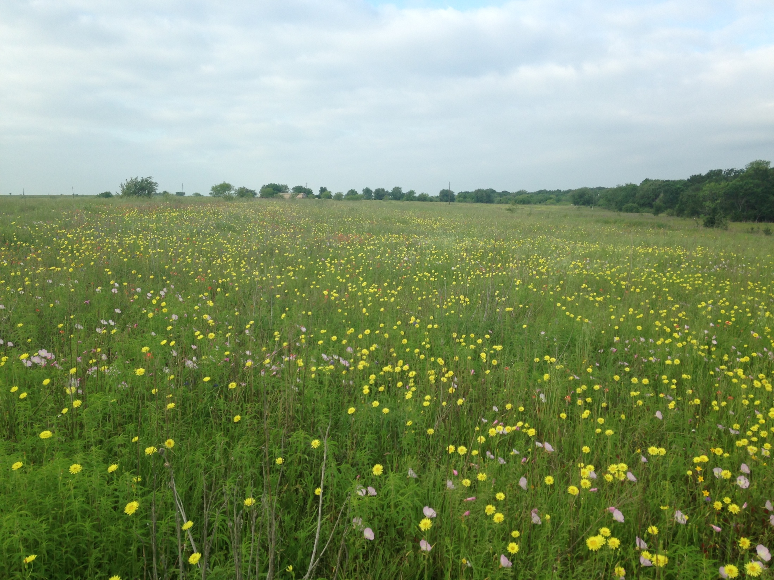
April 2016

Slide 14
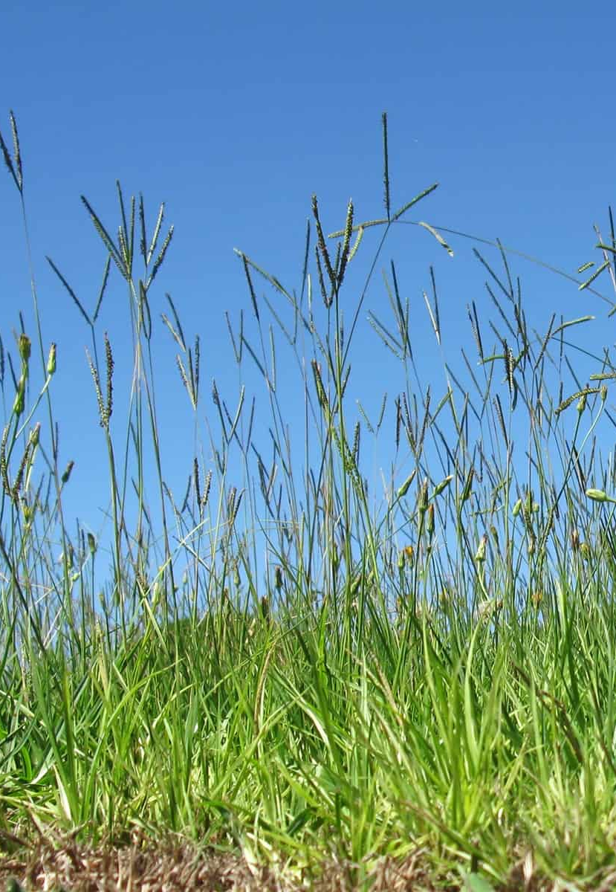
Bahia Grass
Perennial sod forming grass native to South America
Typically found on nutrient poor, sandy soils
Often mixed with other invasives
Will spread by seed and stolons
Glyphosate alone will often leave you with new seedlings from seed bank
60% Metsulfuron methyl products have proven very effective against “Pensacola” variety bahia grass

Slide 15
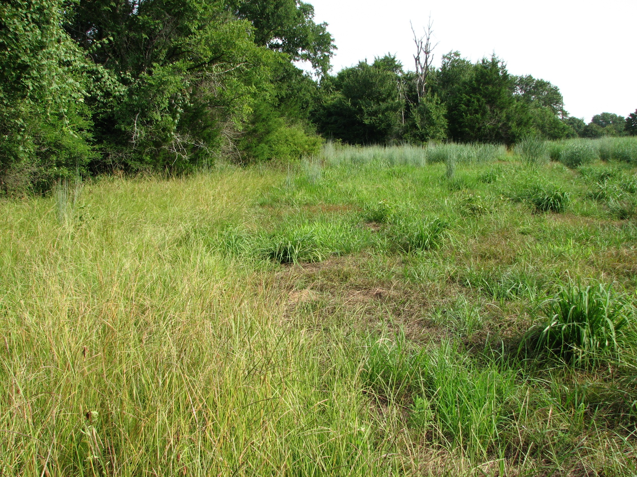
Cimmaron Plus application 0.4 oz/acre

Slide 16
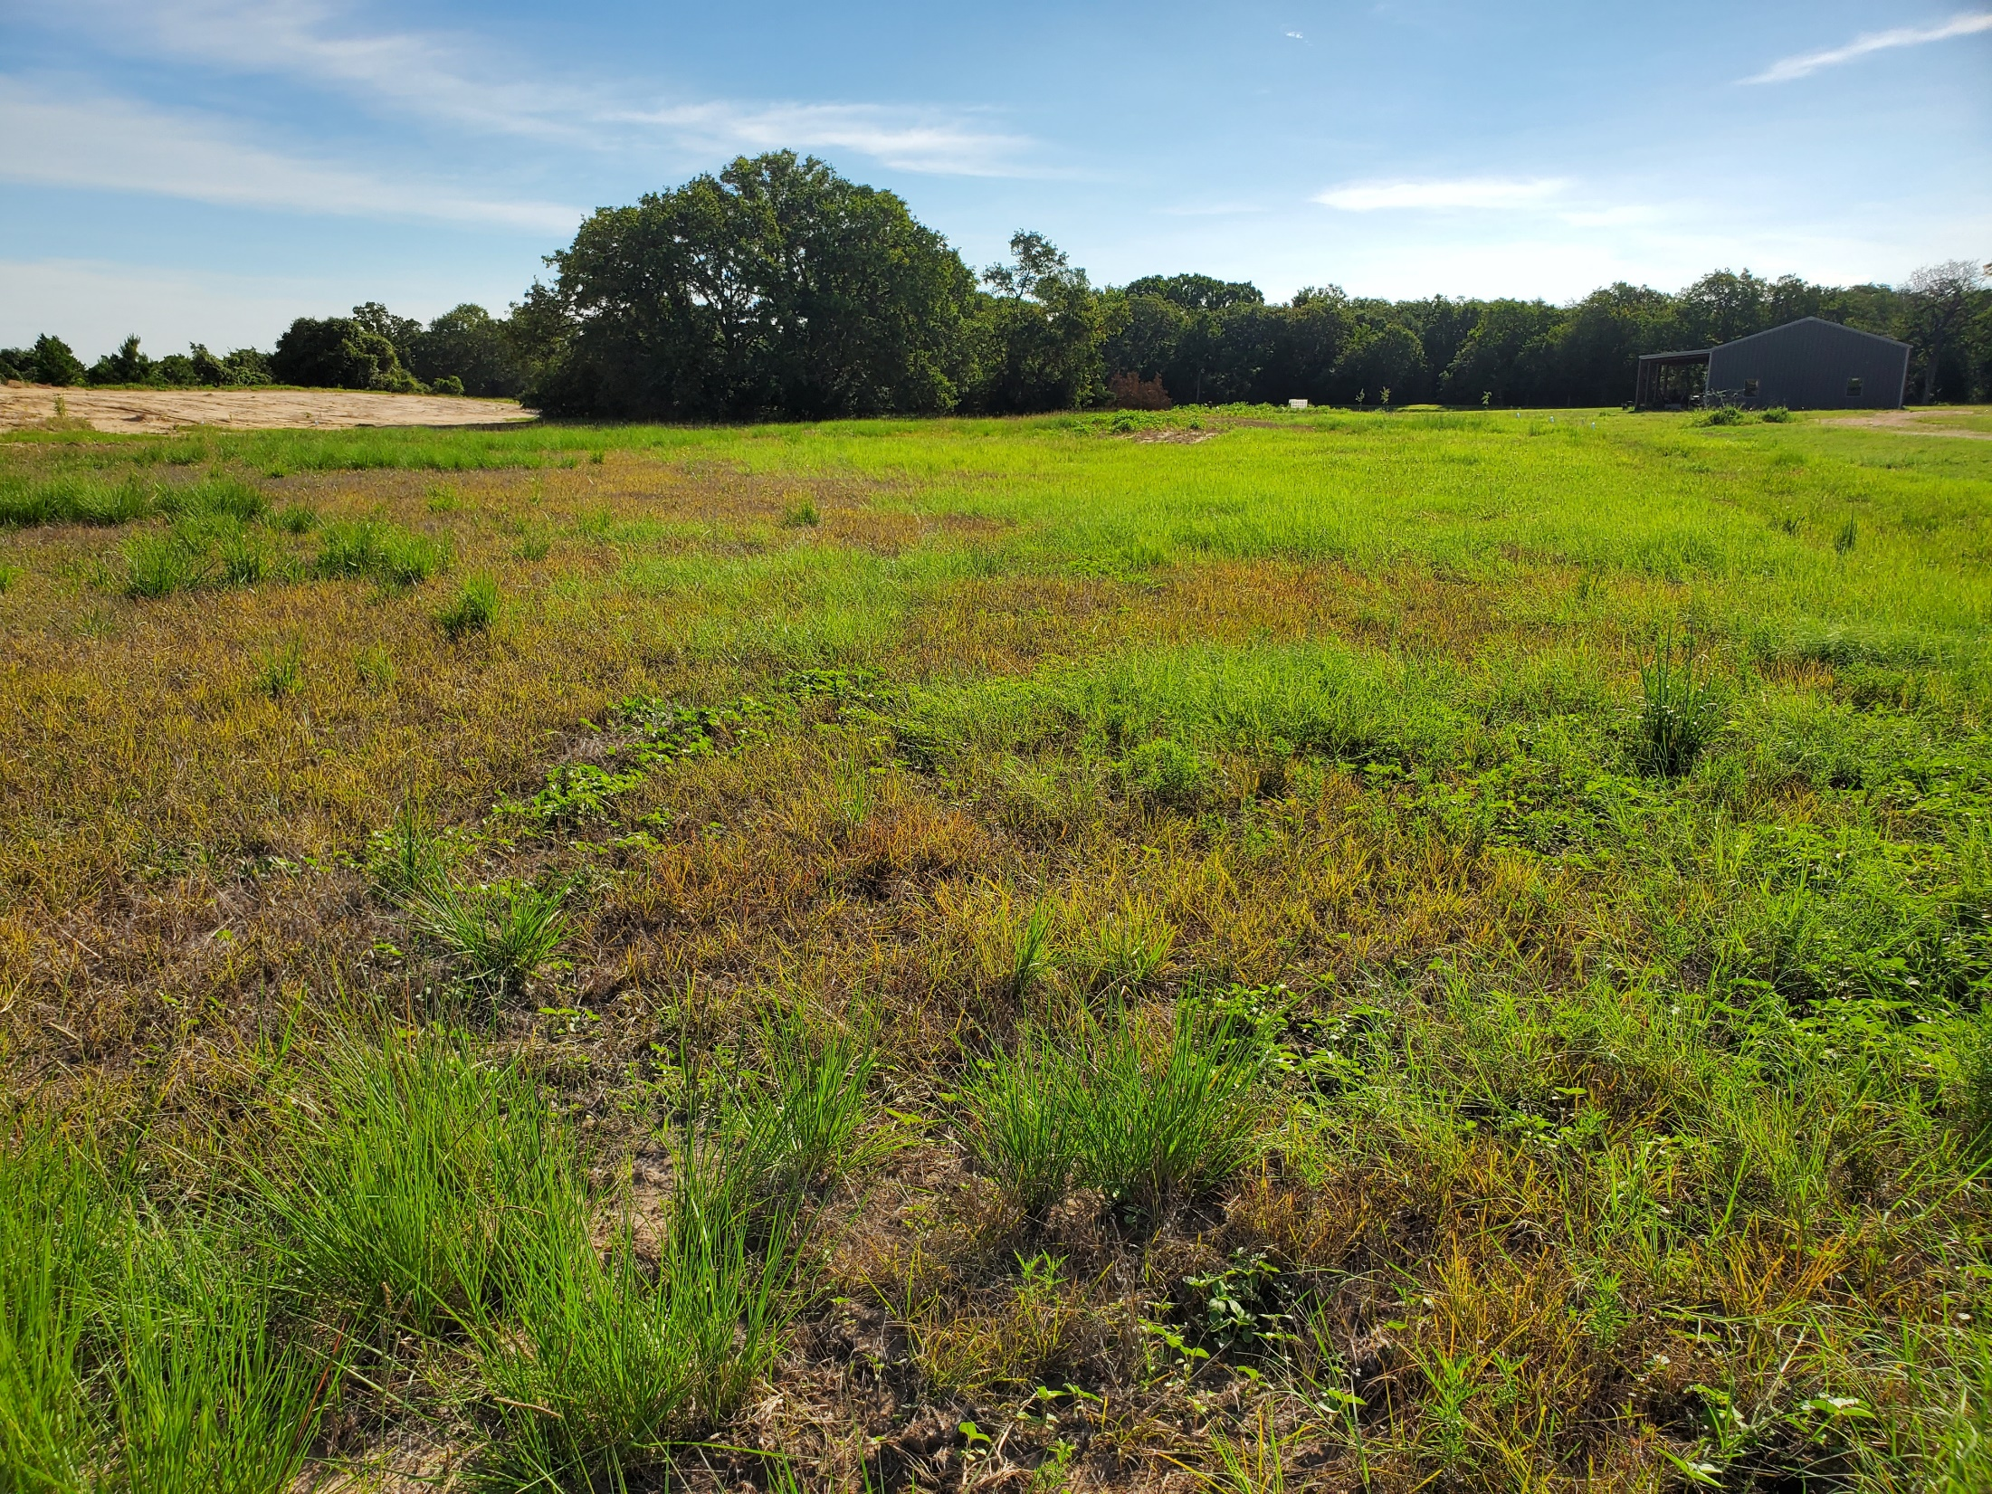
Escort XP
application 0.4 oz/acre

Slide 17
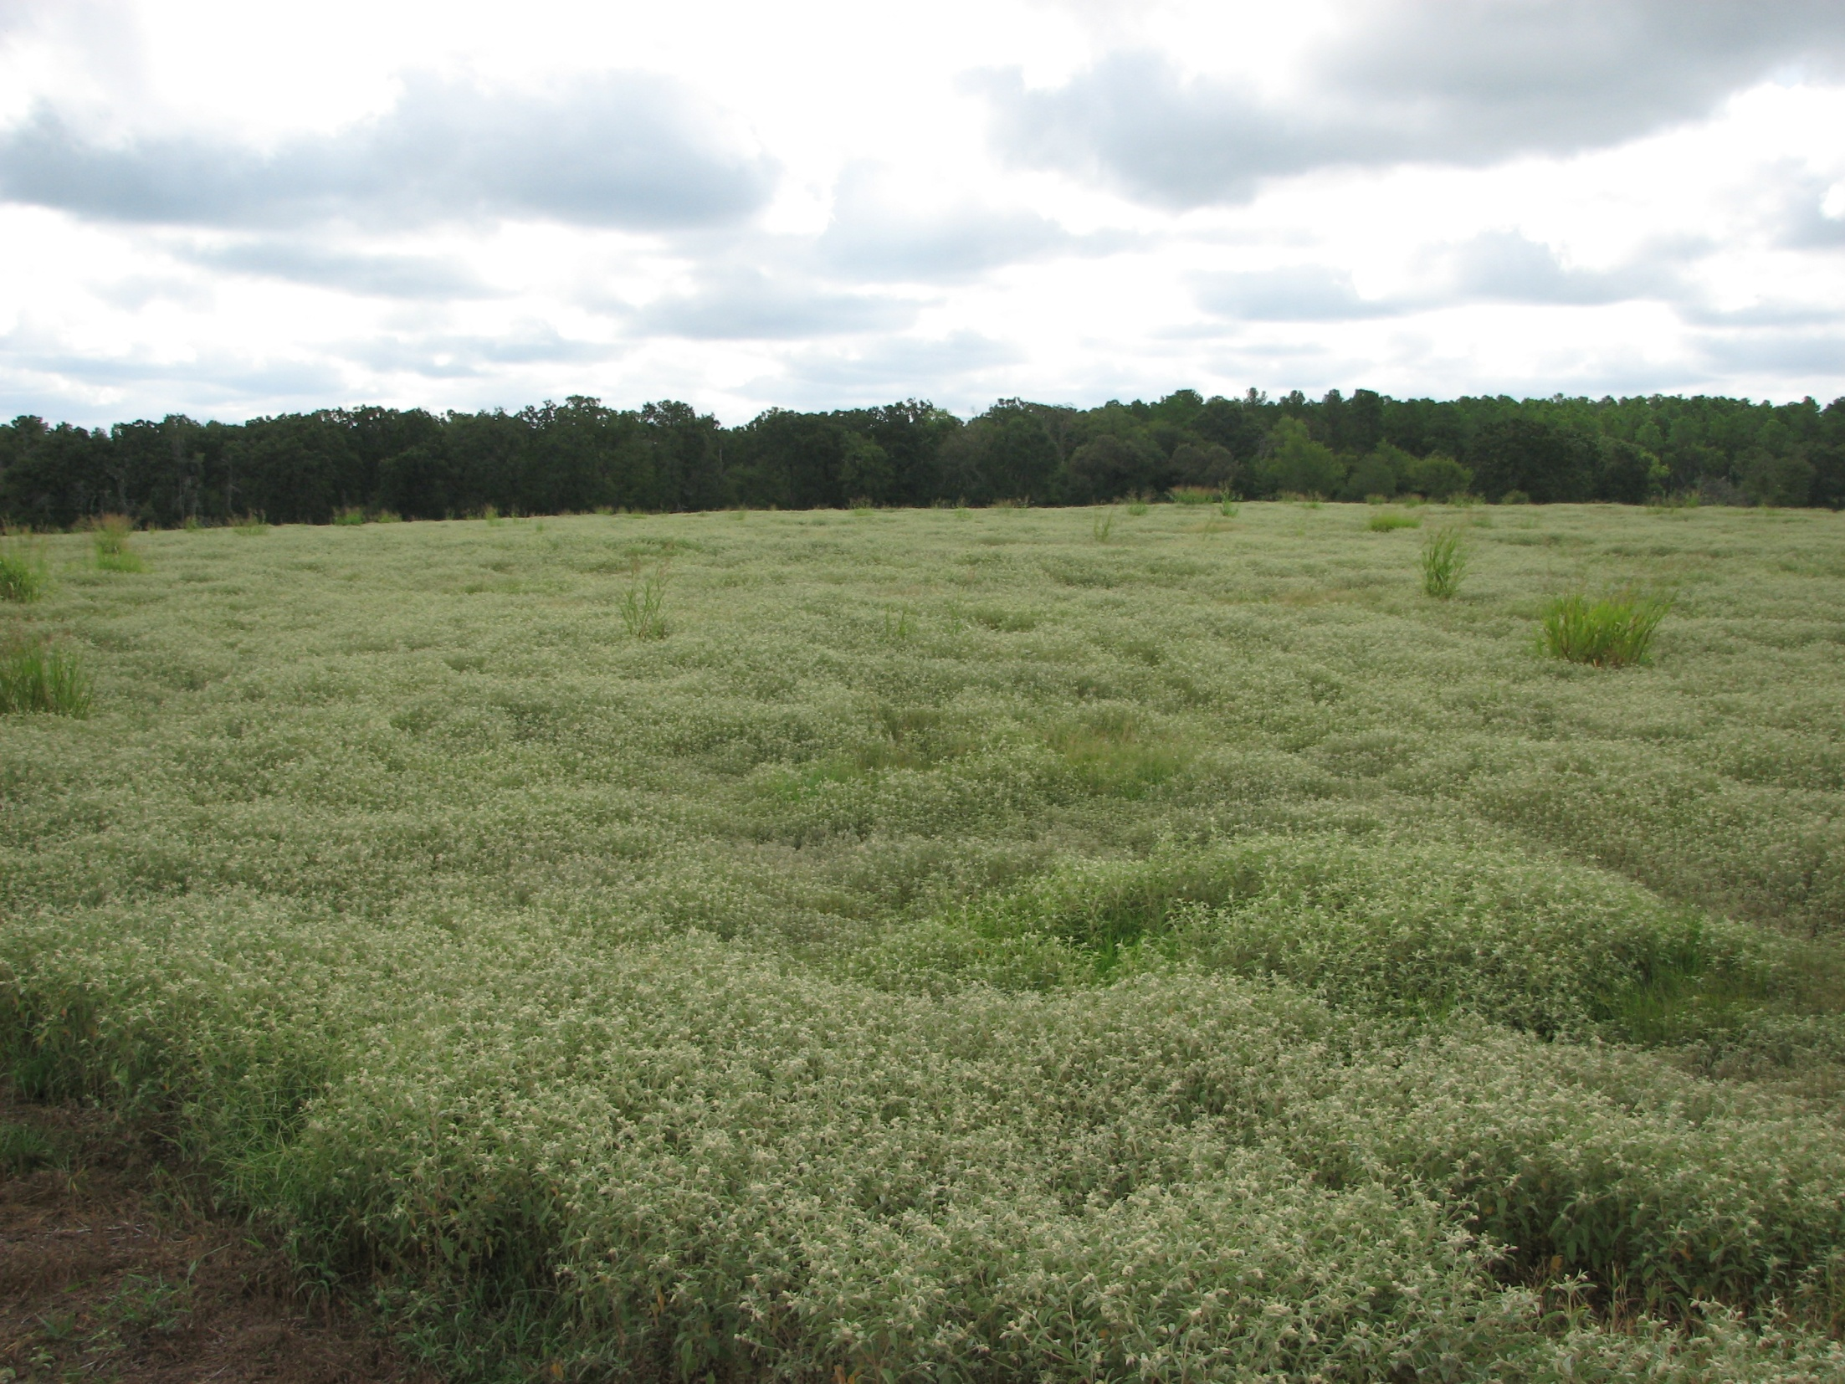
August 2013

Slide 18
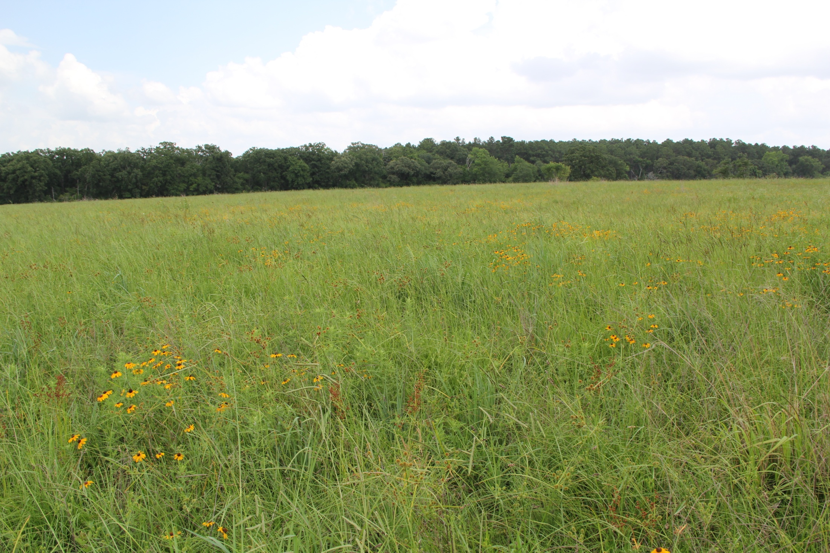
June 2014

Slide 19
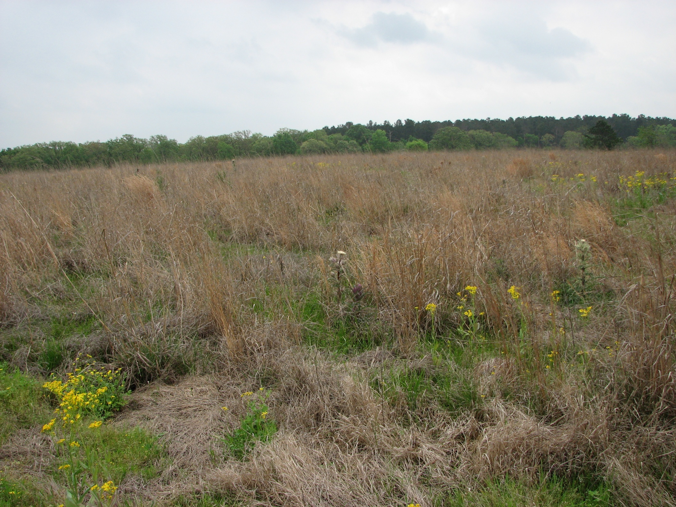
April 2015

Slide 20
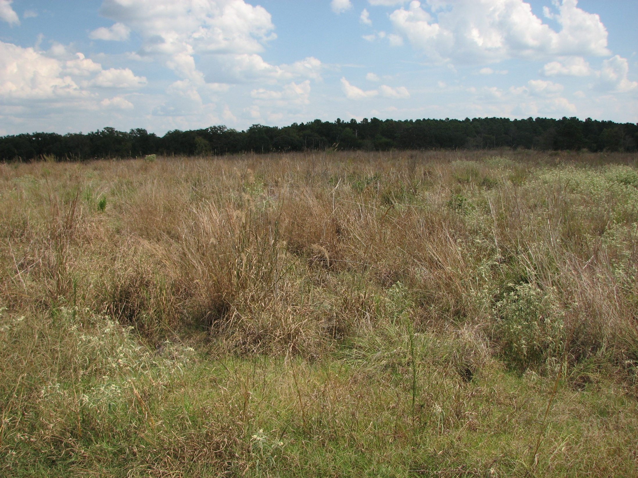
September 2015

Slide 21
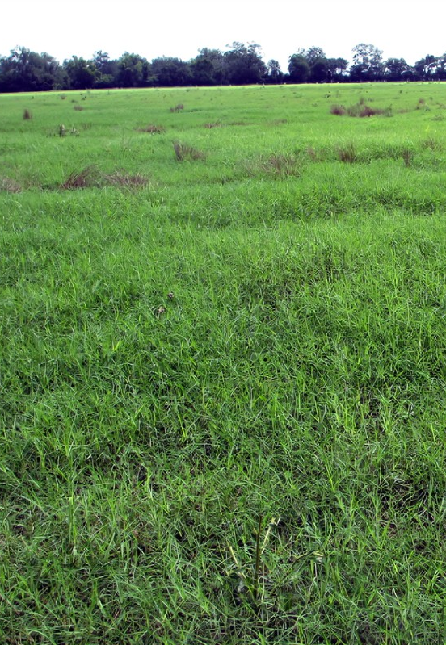
Bermuda Grass
Perennial Sod forming spreads by stolons and rhizomes in improved varieties; common Bermuda by seed
Persists in wet areas and clay soil sites are harder to control
Must conduct multiple applications

Slide 22
Cool Season Competition
Rye Grass
Japanese Brome
Malta star thistle, musk thistle
Burr clover
Bastard cabbage
The list goes on
Die easily, low rate glyphosate application
1-2 weeks prior to planting

Slide 23
Take Aways
One application will not get the job done, usually
Split applications during the growing season are almost always more effective
Entertain the use of selective herbicides
Understand the rates and timings of applications
Apply prior to seed head formation
Apply when plants are vigorously growing
No drought stress

Slide 24
What Tim Uses
Bermuda grass, Bermuda grass/bahia grass mix, mix of all the bad non-native grasses
48% glyphosate – 3.0-3.3 quarts per acre of chemical mixed with water carrier
Comes in 2.5 gallon jugs, 2 jugs per box = 5 gallons
1 box sprayed at 3 quarts per acre treats 6.67 acres
Plan at least 2 applications for the summer. One early and then one no later than 4-6 weeks before average first frost date

Slide 25
What Tim Uses
Bahia grass
Label recommend 0.3-0.5 ounces per acre when using 60% MSM
I recommend 0.4 ounces/acre of Escort XP mixed with water carrier
Comes in 8 or 16 oz container, dry flowable
8 oz container treats 20 acres, 16 oz container treats 40 acres
Best applied when bahia grass seed heads begin to rise but before the Y-shaped seed head emerges and matures
Soil active for up to 4 months after applicatio

Slide 26
What Tim Uses
Johnson grass only 48% glyphosate - 1.5-2 quarts per acre (heavier rates for heavier infestation and more mature plants)
1, 5 gallon box will treat 10 acres if sprayed at 2 quart per acre rate
Plan multiple applications for the growing season, each time it rains new seeds will germinate
Plateau (imazapic) as pre planting application to control johnson grass seedlings in new seedings (follow label rates based on your seed mix)
If desirable plants are already in the stand, consider using Platuea (imazapic) to selectively control, follow label decorations

Slide 27
What Tim Uses
Cool season non-natives
Species include annual rye grass, Japanese brome, burr clover, white clover, non-native thistles, and yellow and white sweet clover
I encourage cooperators to graze or mow these areas when they get above 6 inches tall until we are about 3 weeks out from planting.
7-10 days growth of the forage after cattle are taken off or it is mowed you can spray with 1-1.5 quarts of 48% glyphosate dependent on targeted species, the density of vegetation, and the maturity of the plants. Generally, you should wait 7- 14 days after spraying before planting your native seed mix.

Slide 28
What Tim Uses
Spot spraying
If landowners miss strips, have to avoid mottes of brush, avoid wet areas, structures, or internal fencing encourage them to spot spray non-native vegetation in those areas.
Small infestations can turn into big problems quickly if not addressed.
Almost all species listed above will need to be spot sprayed at a rate of 1-1.5% if sprayed with glyphosate. This equates to 1.9-2 ounces of glyphosate per gallon of water for a backpack sprayer, or roughly 58-60 ounces of glyphosate for a 30 gallon ATV/UTV mounted sprayer.
Some publications recommend adding ammonium sulfate for additional efficacy of glyphosate mixtures. Particularly in areas with hard water.

Slide 29
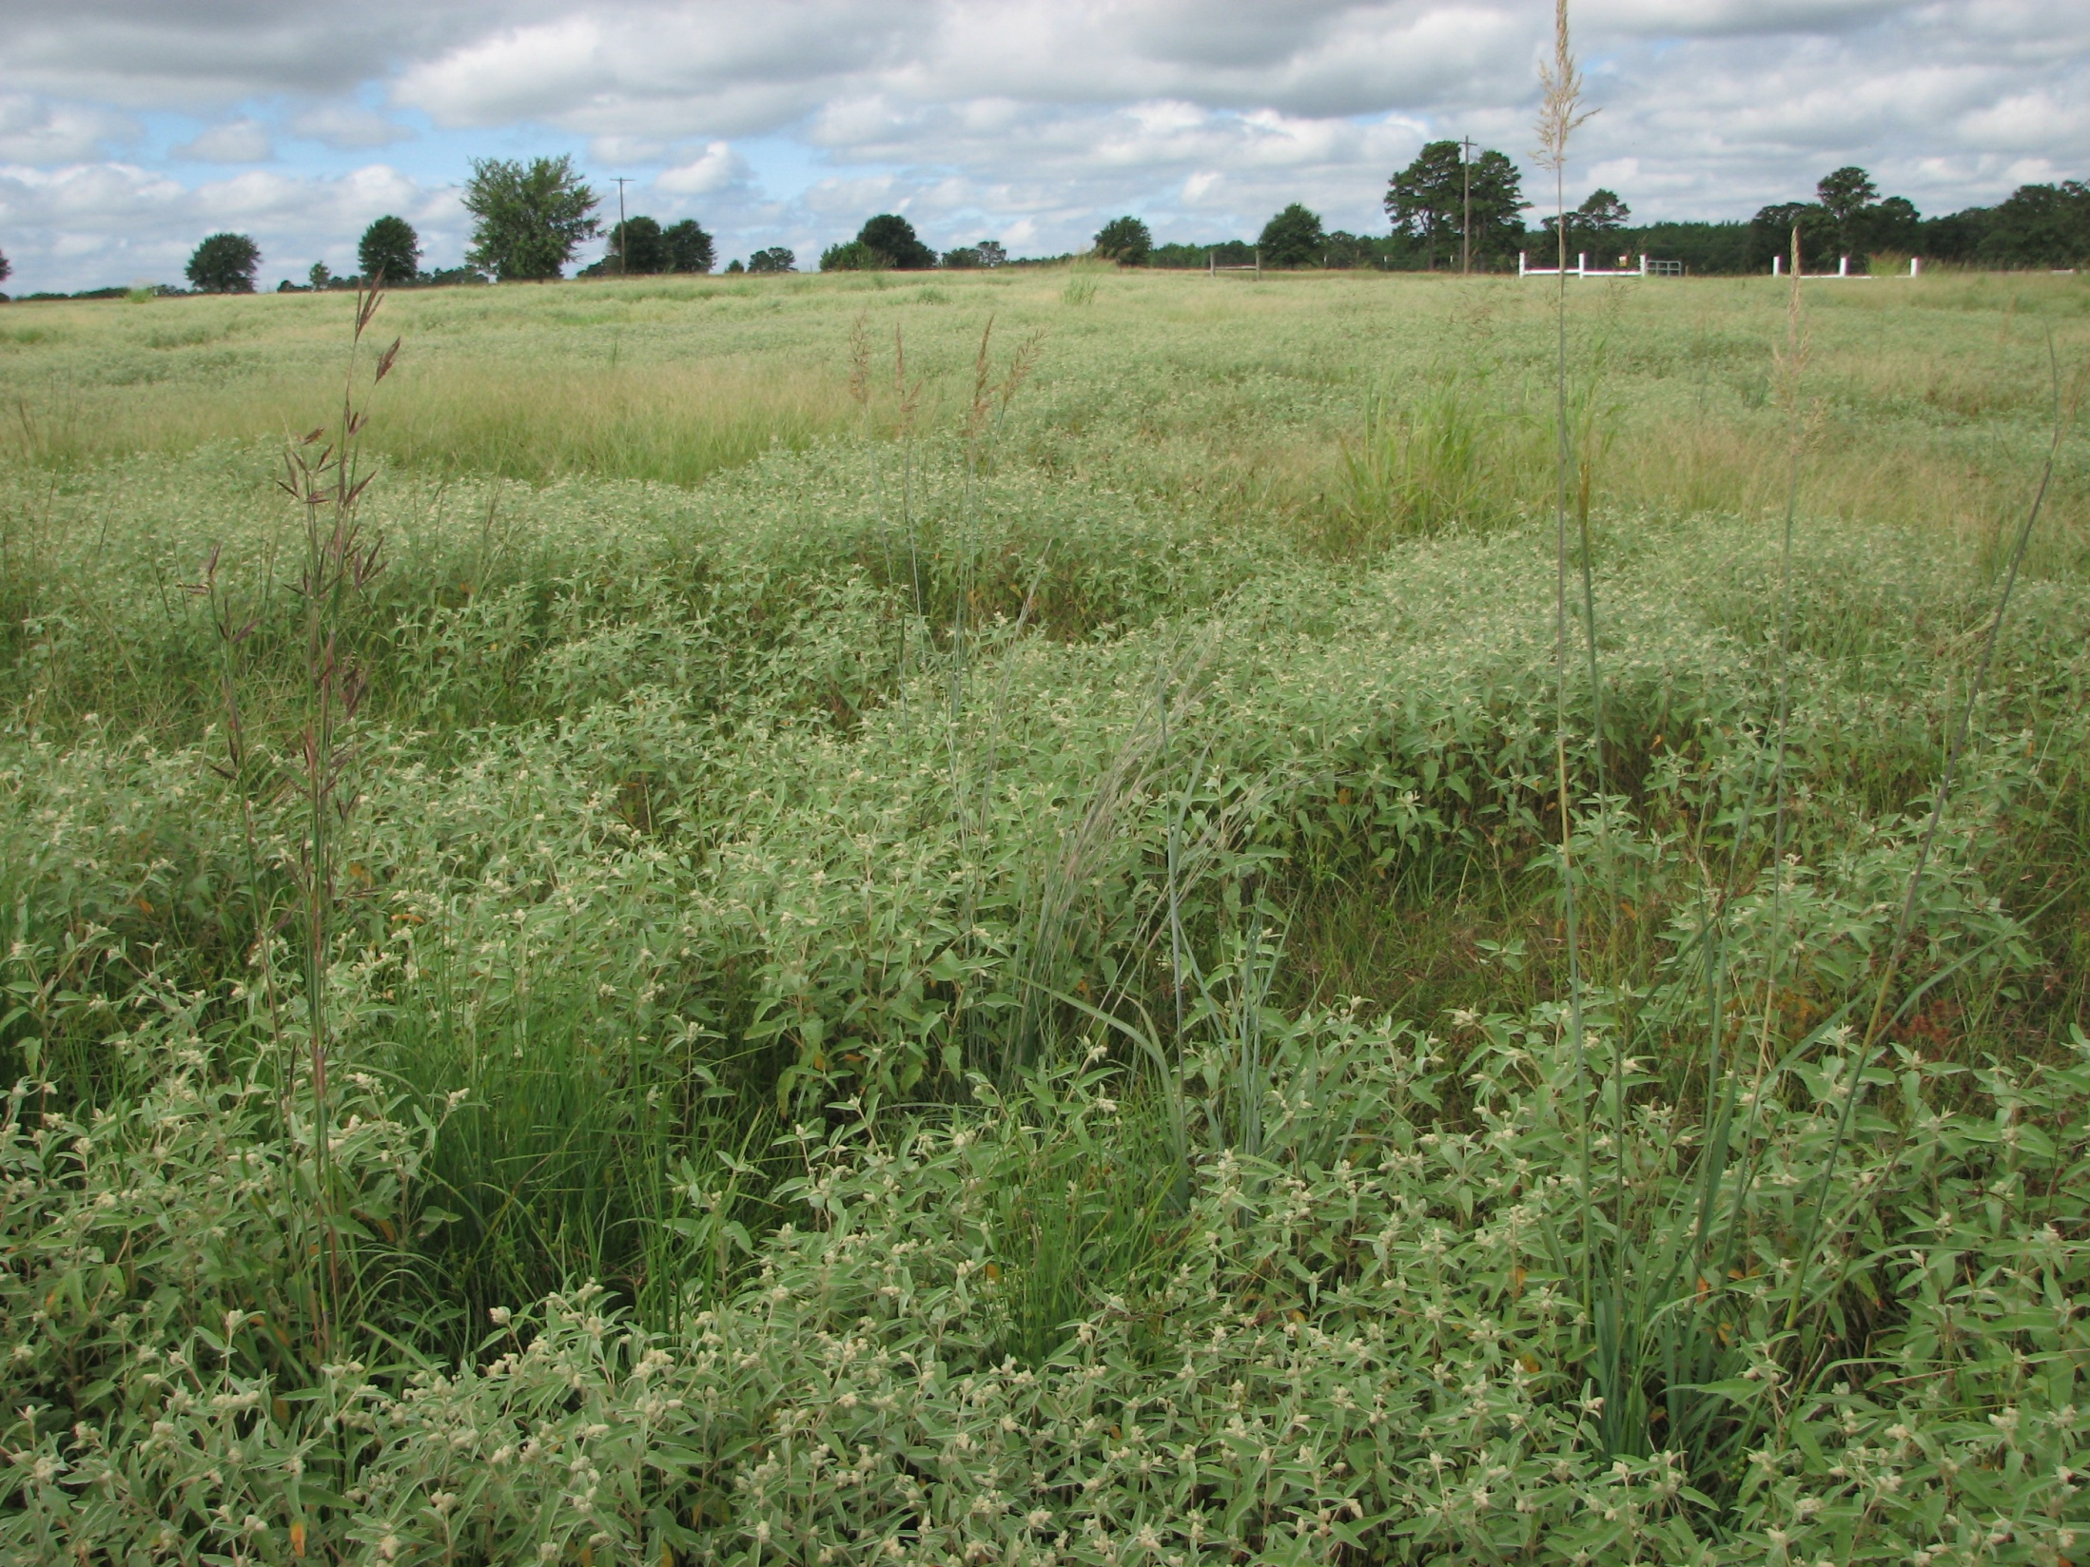
Questions?
“Never doubt that a small group of thoughtful, committed citizens can change the world. Indeed, it’s the only thing that ever has.”
Margaret Mead

