Slide 1

Prairie Restoration Funding and Programs
Will Newman
Farm Bill Coordinator
Texas Parks and Wildlife Department
Notes:
A lot of the restoration activities we have been talking about come with a potentially burdensome price tag. I am going to talk about some options for financial incentive programs that you may be able to use to help you or your landowner get over the cost hump to get your project started, conduct management, or empower you to do even more with your project.
I am not going to review the entire restoration planning process, but it is important to understand a few aspects so that we can engage with the right partners and programs to reach your intended outcome.

Slide 2
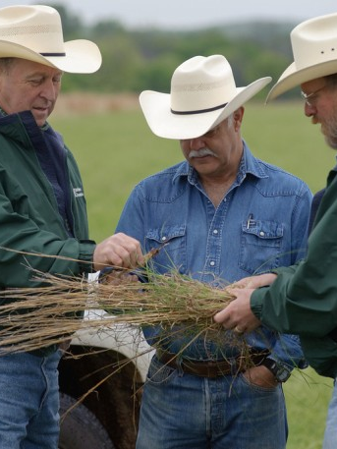
The Plan
Desired Outcome
Limitations?
Restoration Activities/Practices?
Management Options
Implementation
Notes:
Many technical guidance resources, like TPWD and NRCS can help you start to finish to determine your goals, identify resource concerns, consider your limitations, and prescribe restoration or management practices on a schedule. I encourage you to engage with these resources, in fact I encourage you to engage with several and ask them to work together to provide you the best comprehensive service. Some of these technical experts will also be your primary contacts for financial support programs.

Slide 3
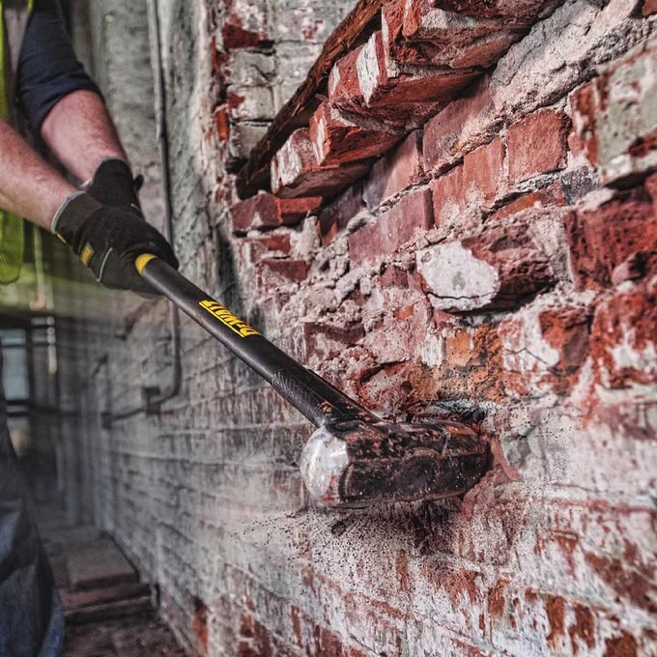


Programs = Tools in the Toolbox
Notes:
programs are tools in your tool box you can use to reach your Conservation goals. Some are specialized having limited resources to focus on specific tasks. others are powerful when used to overcome limiting factors in your restoration plan, Some situations call for delicate work with a touch up paint brush, others require a full swing with a sledge hammer.
Prairie restoration activities and management costs money. For some landowners these costs can prevent effective restoration all together, for others a financial incentive may be the encouragement they need to make a change.

Slide 4
The Team
Decision Makers
  Landowners, Producer, Agent/Land Manager
Users
  Leaser, Hunters, Tenants
Technical Guidance
  Consultant, TPWD, NRCS, FWS, Extension
Program Admin
  Farm Service Agency, NRCS, TPWD, Partners

Slide 5
Implementation
Site Preparation
Establishment
Evaluation
Early Maintenance/Stabilization
Management

Slide 6
Management
Condition Assessment
Management Activities/Practices?
Implement
Evaluate

Slide 7
Program Compatibility
Participant Eligibility
Land Eligibility
Participant Goals vs Program Goals
Ease of Use
Program Specs vs Participant Goals/Limitations
Incentives Provided
Commitment
Implementation Timeline
Notes:
Once you have a rough plan on how to reach your goals, and you have identified potential financial obstacles, you can start evaluating the various program tools available to see which ones may be a good fit for a given part of your plan.
All of these programs are voluntary. All financial assistance programs are going to involve navigating all or most of these compatibility factors.

Slide 8
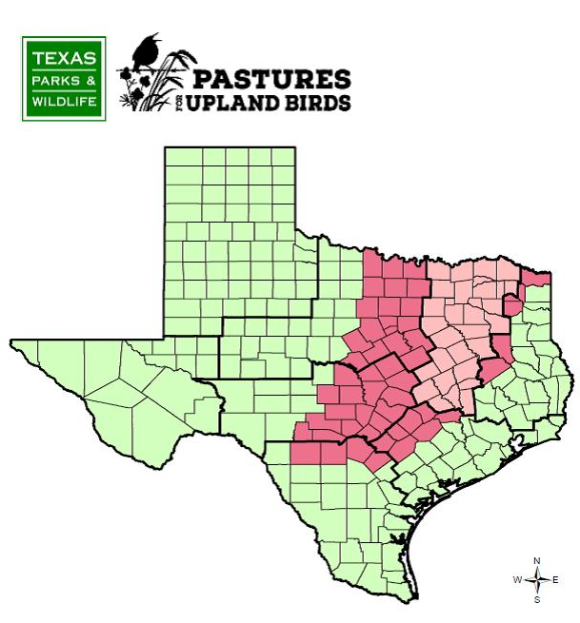
Contact: Your Local TPWD Biologist
Program Admin:
Tim Siegmund, TPWD
903-426-1834
Tim.siegmund@tpwd.texas.gov
Most Effective For:
Converting exotic pasture or cropland back to native cover
Herbicide/Seed/Equipment provided

Slide 9

Contact: Your Local USDA Service Center
or
Will Newman, TPWD
254-718-7684
William.Newman@tpwd.texas.gov
Most Effective For:
Financial incentives to help pay for conservation practices on ag production land
Whole Plan
or
Site Prep
Establishment
Production Infrastructure
Management Practices
Special Initiatives and Funding Pools
-Available anywhere in Texas
-Registration as a USDA cooperator is required
-Competitive ranking process
-Local Working Groups determine ranking priorities
-Landowner/Producer goals lead planning process
-Wide range of practices available
-Must follow USDA specifications
>$110 million spent in Texas annually!

Slide 10
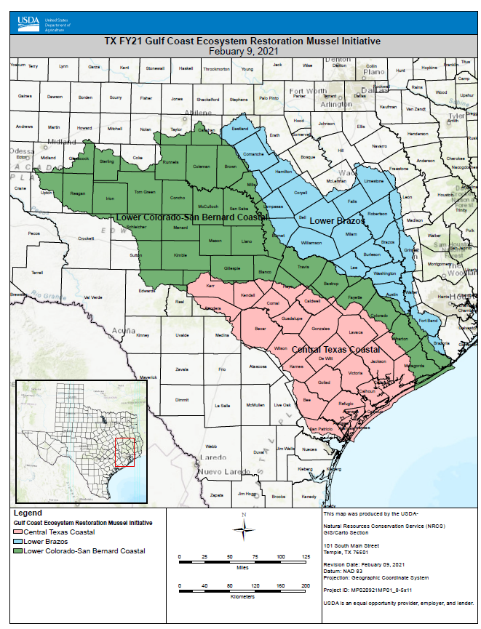
Contact:
Your Local USDA Service Center
or
Will Newman, TPWD
254-718-7684
William.Newman@tpwd.texas.gov
Most Effective For:
- EQIP special funding in a focal area

Slide 11
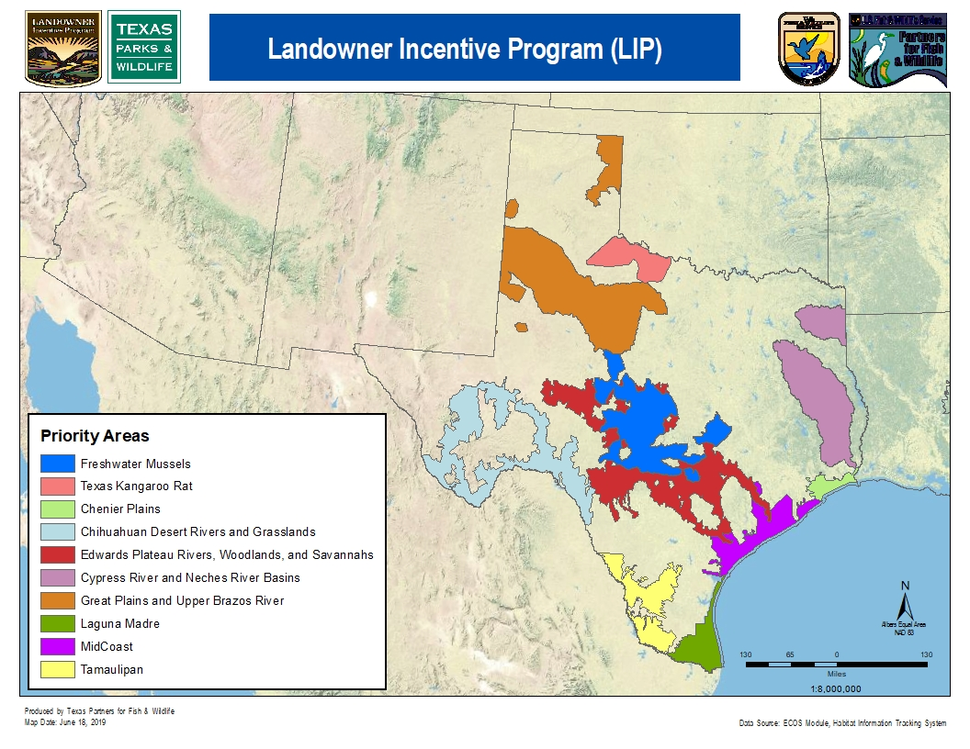
Contact: Your Local TPWD Biologist
Program Admin:
Arlene Kalmbach, TPWD
512-924-6987
Arlene.kalmbach@tpwd.texas.gov

Slide 12

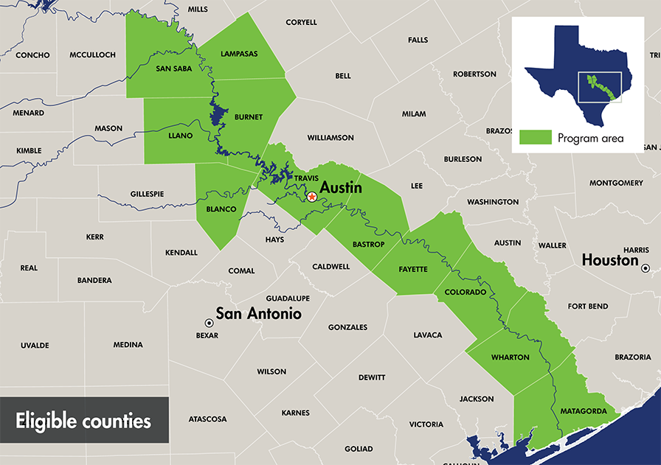
Contact:
Marshall Trigg
830-596-7239
Marshall.trigg@lcra.org
Most Effective For:
practices to reduce soil erosion and protect water resources
EPA grant funded, NRCS Practice Codes

Slide 13
Contact: Your Local TPWD Biologist
Will Newman, TPWD
254-718-7684
William.Newman@tpwd.texas.gov
Most Effective For:
- Financial incentives to help pay for practices that restore grassland habitats

Slide 14
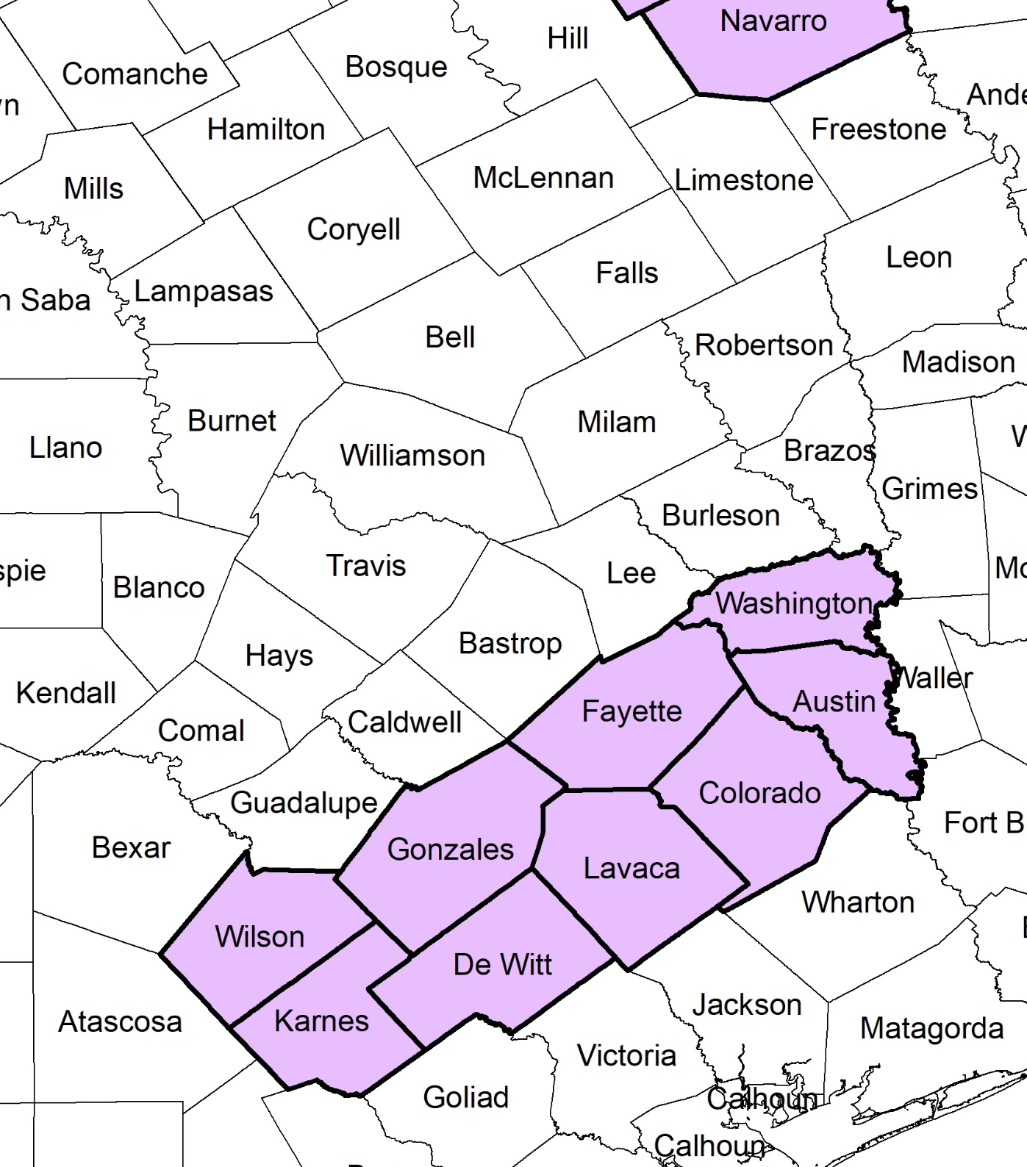
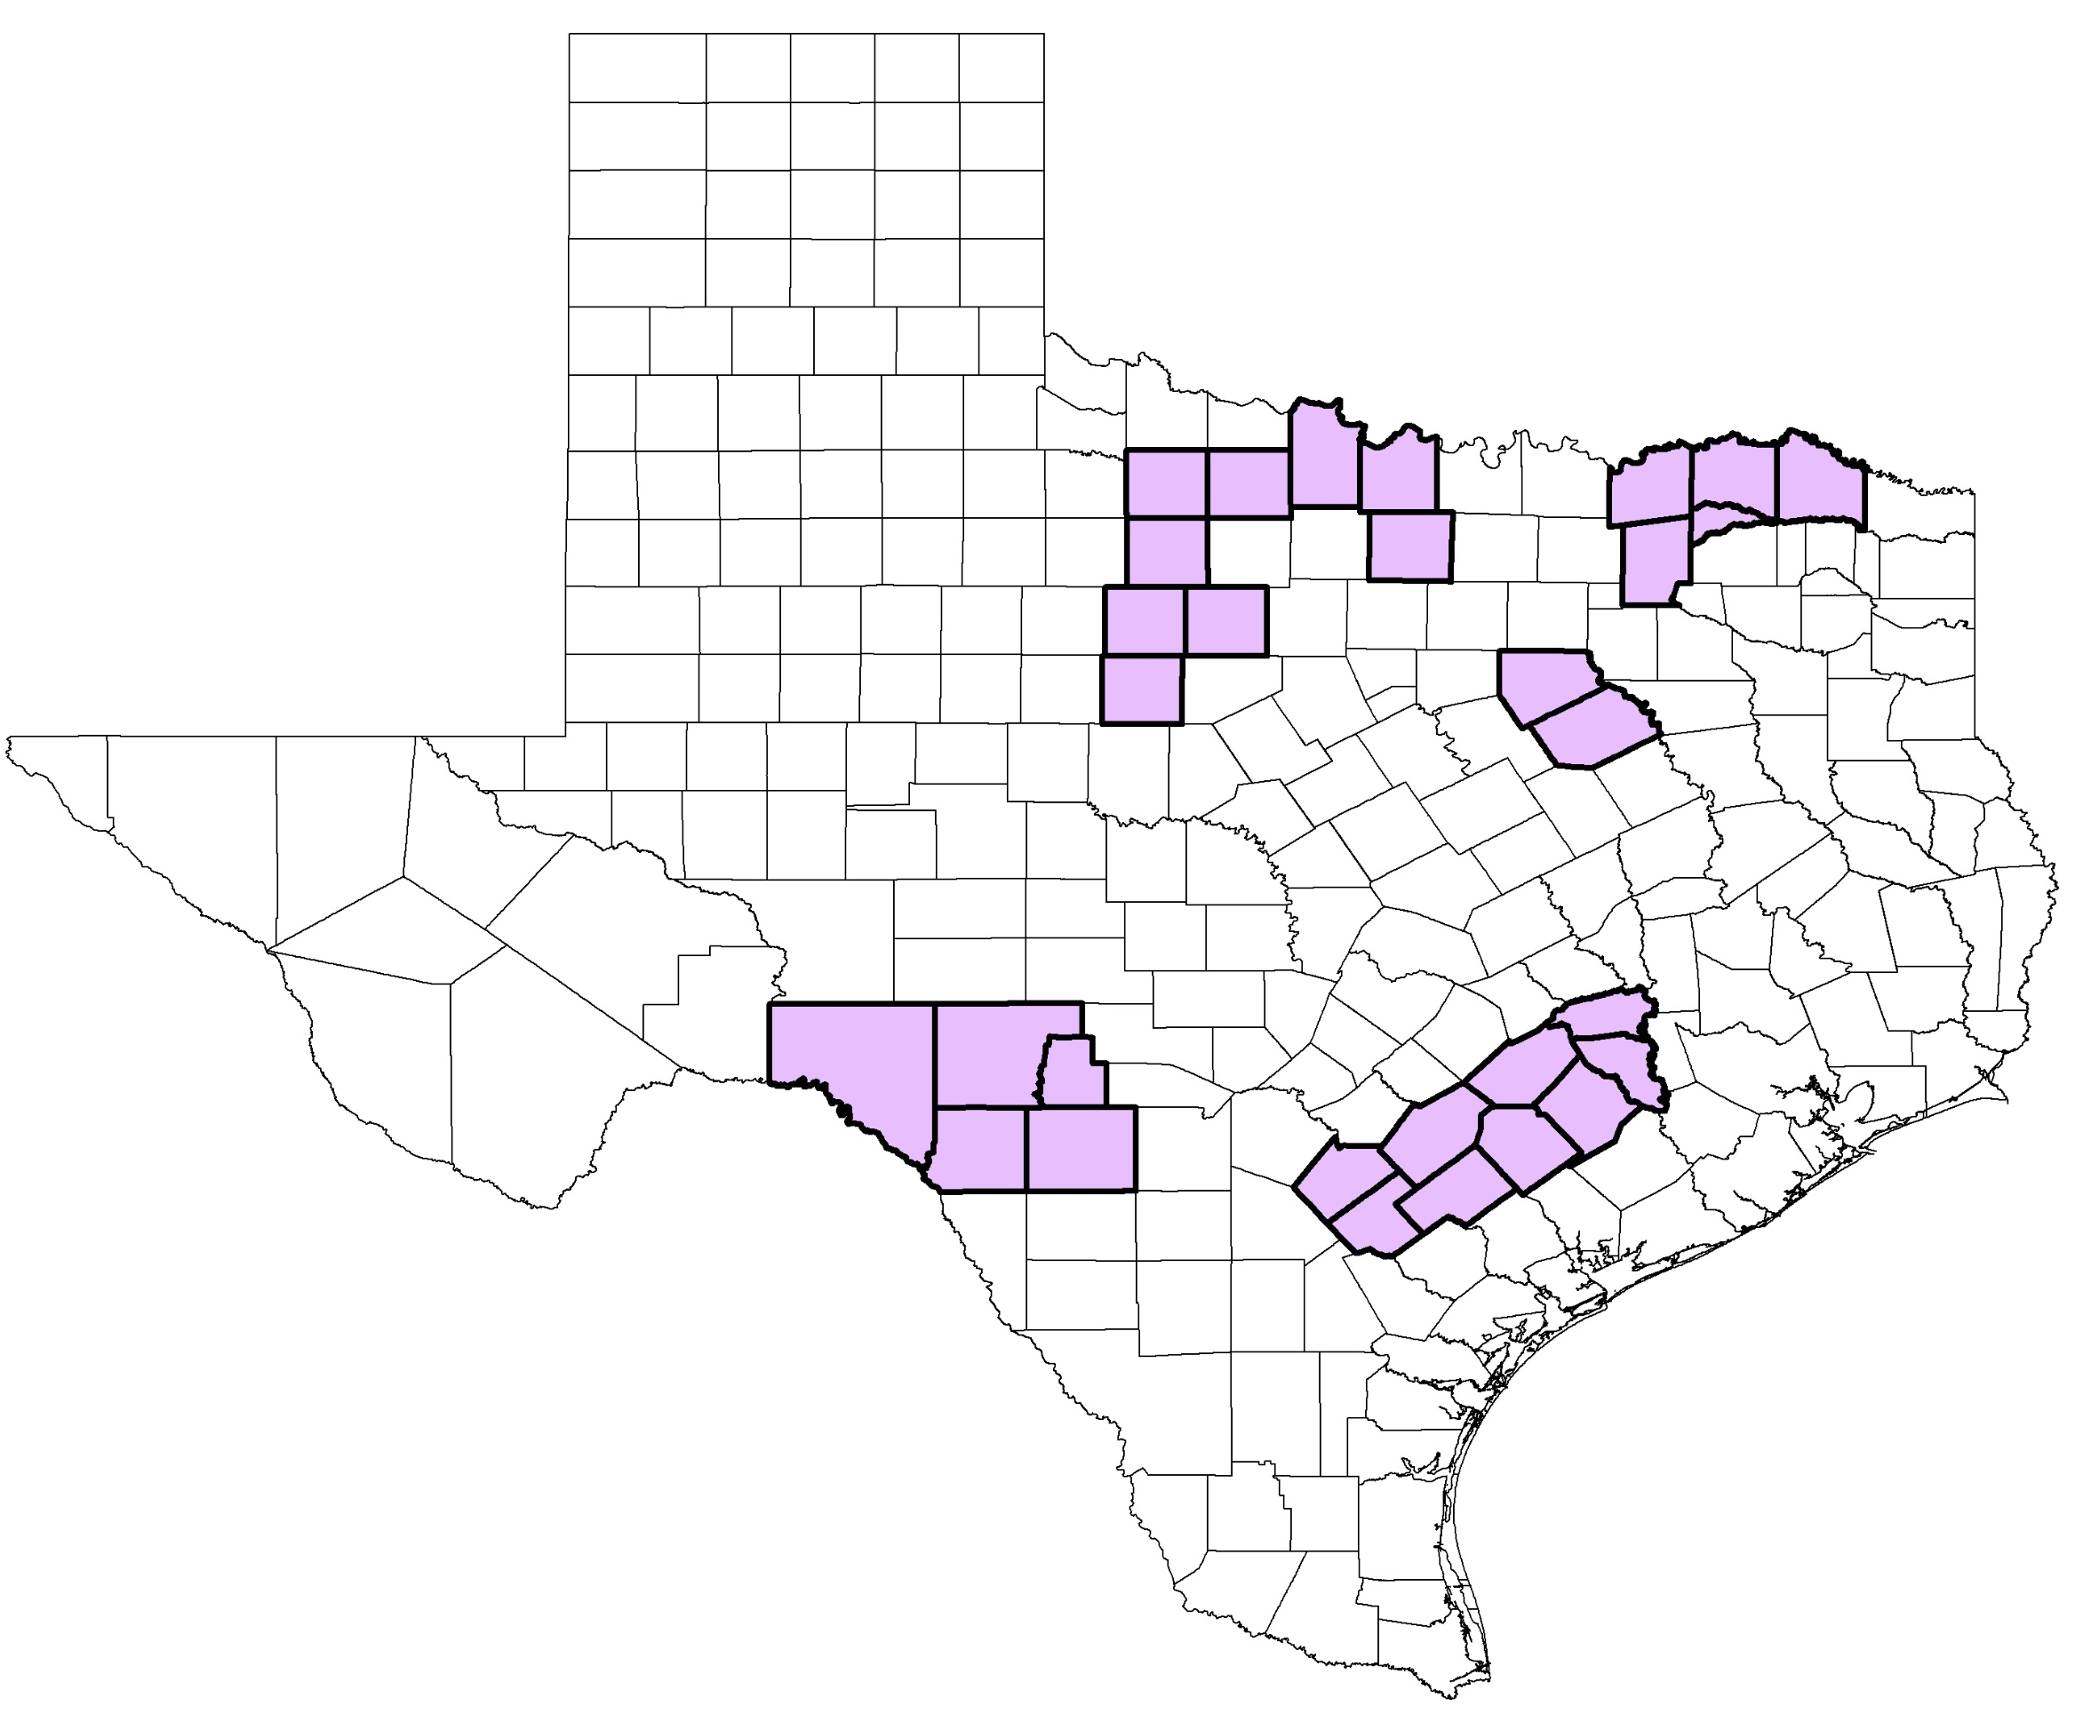
Grassland Restoration Incentives Program (GRIP)
Contact: Your Local TPWD Biologist
or
Ty Higginbotham
936-827-0555
thigginbotham@quailforever.org
Most Effective For:
Financial incentives to help pay for practices that restore grassland habitats
Reimbursement for approved practices

Slide 15
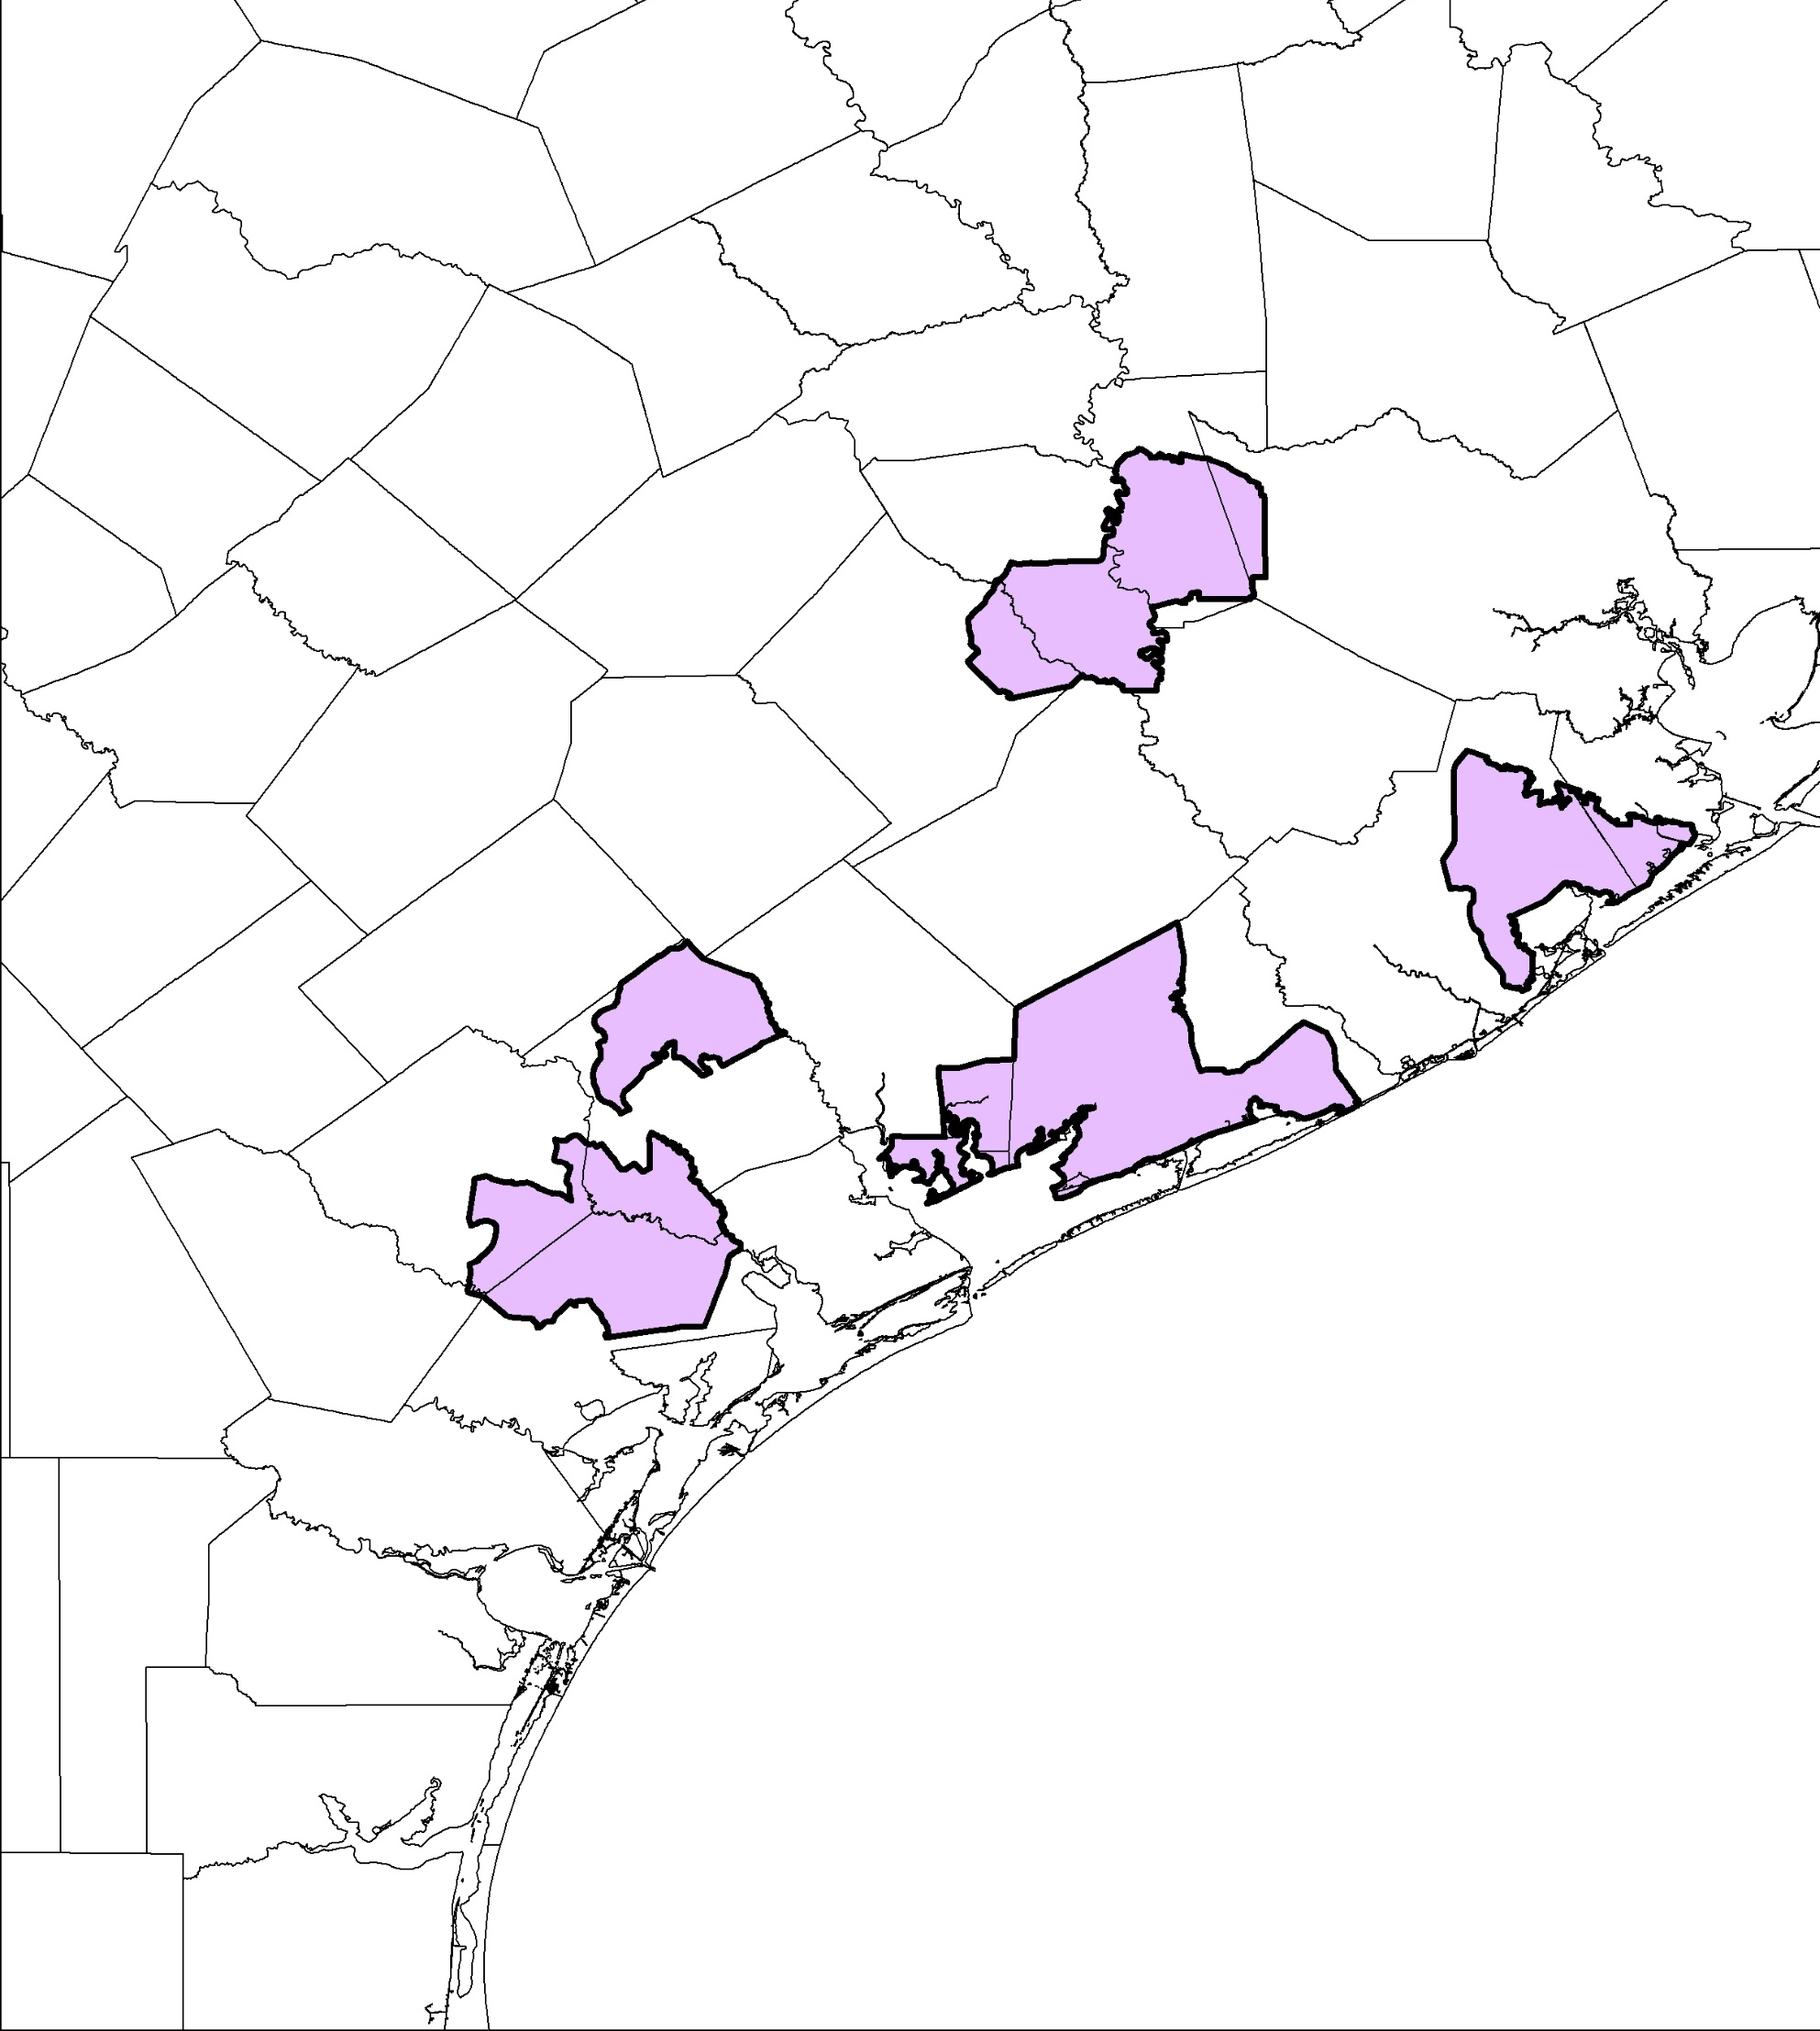
Coastal - Grassland Restoration Incentives Program (C-GRIP)
Contact: Your Local TPWD Biologist
or
Dr. Steve DeMaso
337-262-7012
Steve_demaso@fws.gov
Most Effective For:
Financial incentives to help pay for practices that restore grassland habitats
Reimbursement for approved practices

Slide 16
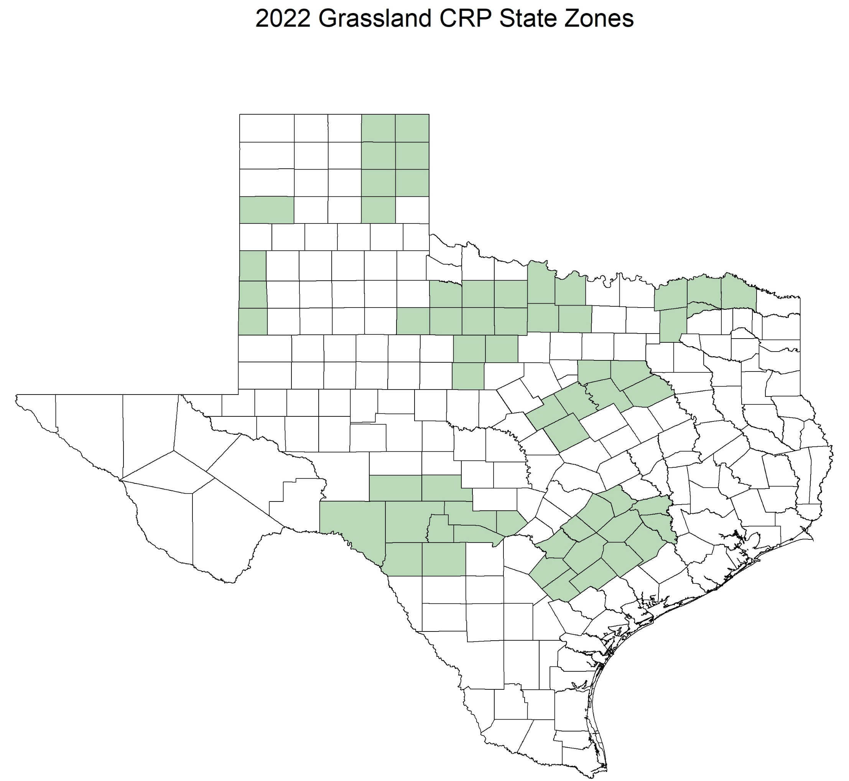
Grasslands Conservation Reserve Program
(Grasslands CRP)
Contact: Your Local Farm Service Agency
or
Will Newman, TPWD
254-718-7684
William.Newman@tpwd.texas.gov
Most Effective For:
Grasslands (<5% woody canopy)
Wildlife, Haying, Grazing under a conservation plan
Restricted use during Primary Nesting Season
15-year contract
Annual Soil Rental Rate Payment per acre (>$13)
50% Cost-share available for some practices

Slide 17

Contact:
Will Burkhead
VPA-HIP Coordinating Biologist
903-327-4277
wburkhead@quailforever.org
Most Effective For:
Annual rental payment for allowing public access
Coordination and support by TPWD

Slide 18
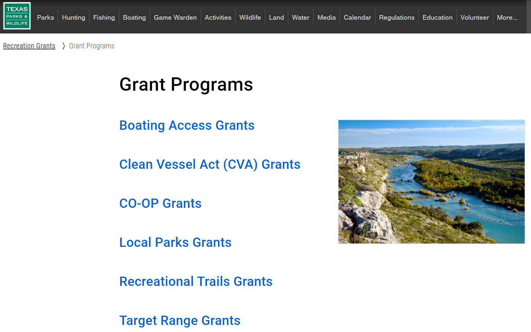

Slide 19
