Slide 1
Management of Prairie Wetland Complexes
Andrew Sipocz
Natural Resource Coordinator, State Parks
Texas Parks and Wildlife Department
andrew.sipocz@tpwd.texas.gov

Slide 2
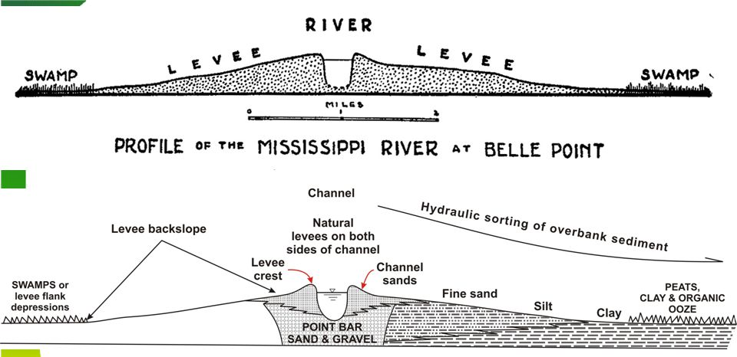
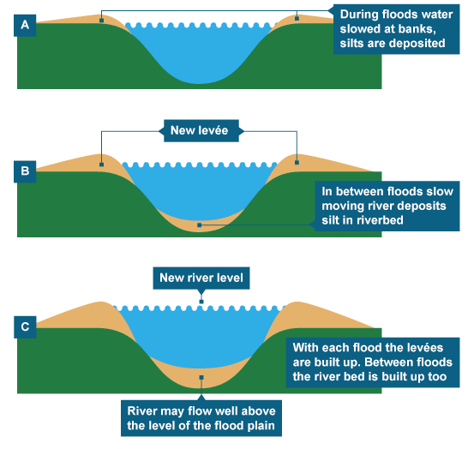
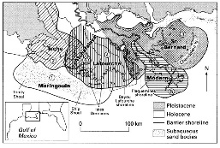
Delta Landforms
Deltas are dynamic landforms, channels are constantly changing shape and being abandoned

Slide 3
Texas Coastal Plain- Overlapping Inland (fluvial) deltas.
3,000,000 years in the making.
From Blum and Aslan, Sedimentary Geology 190 (2006) 177-211.

Slide 4
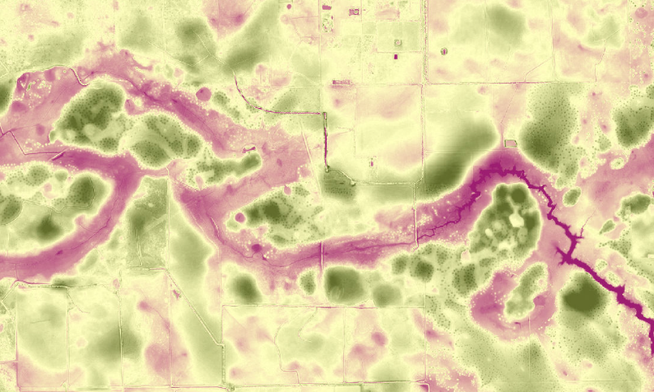
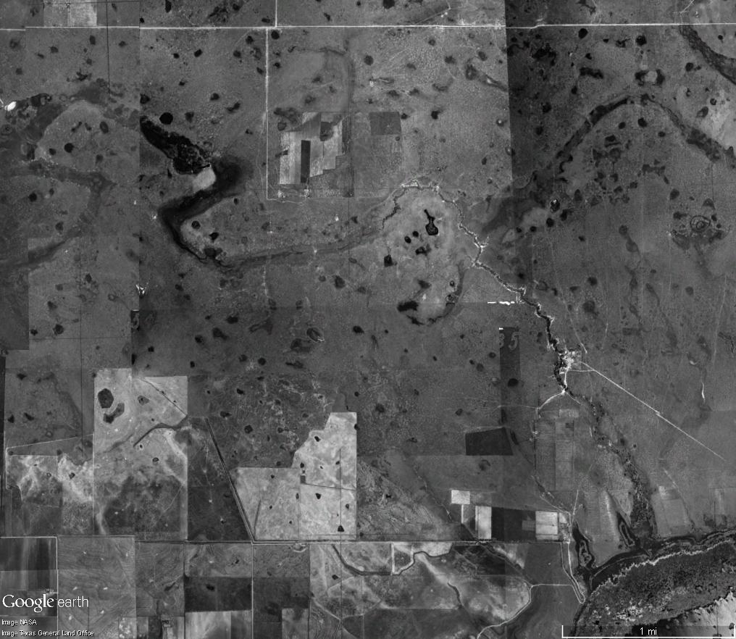
Pleistocene Meander Ridge – Nash Prairie
The Conservation Fund – Michael Schwartz

Slide 5
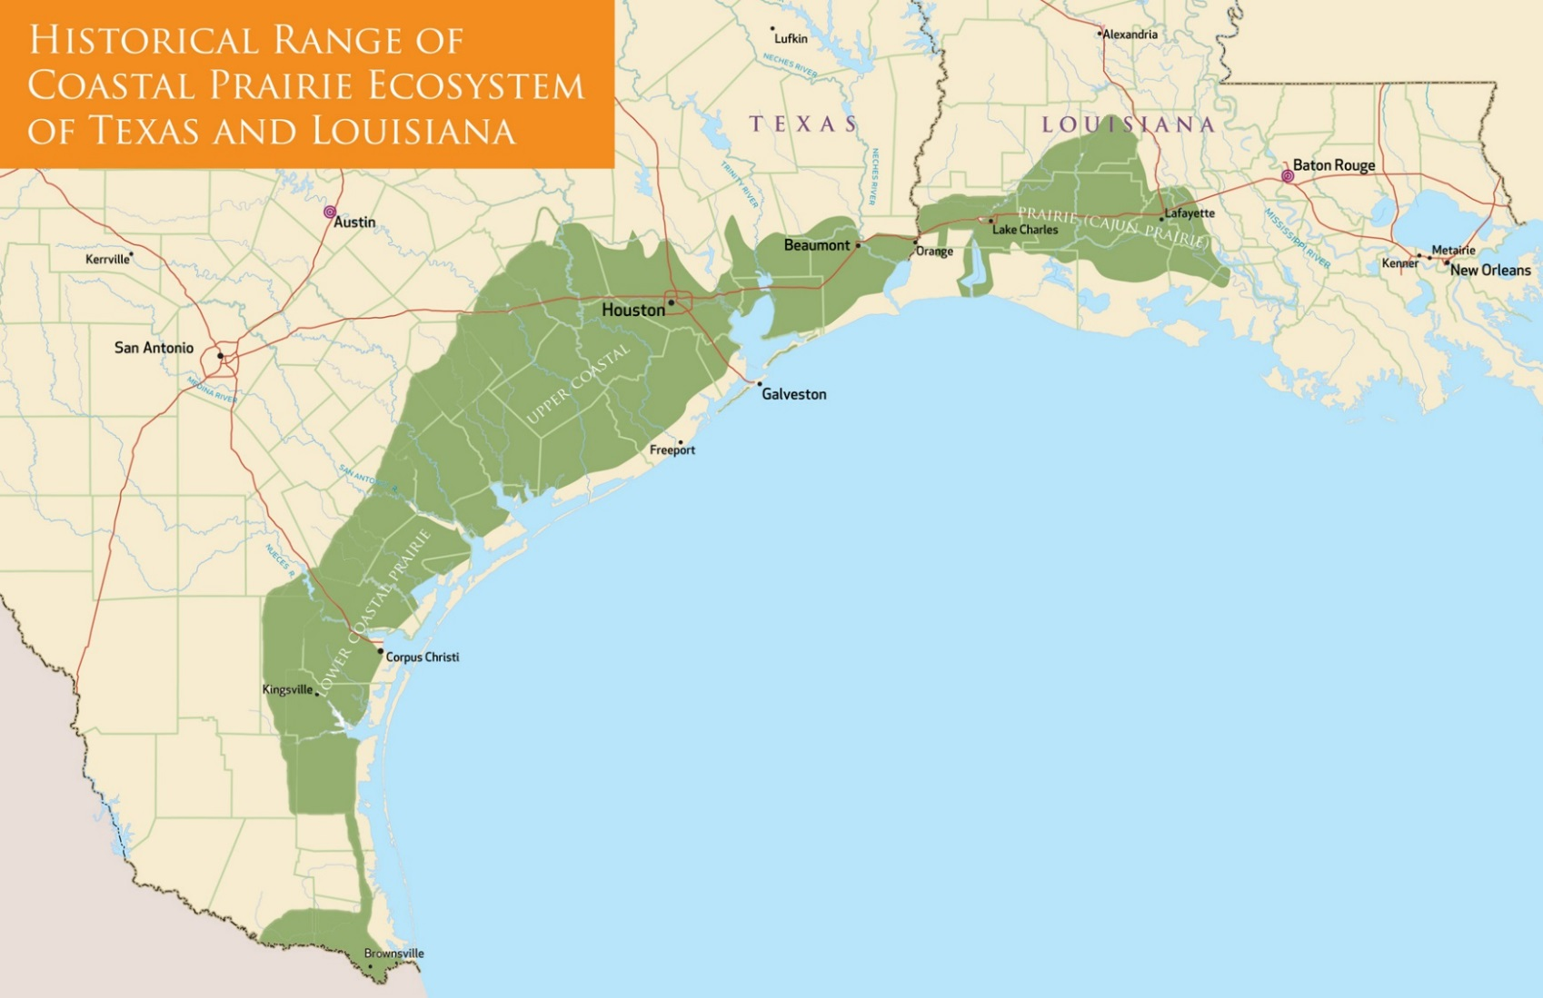

Slide 6
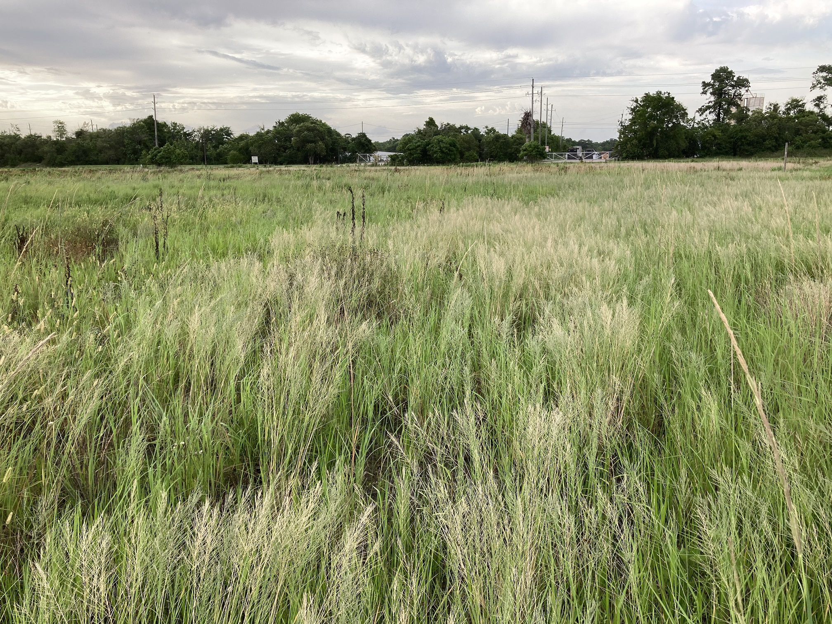
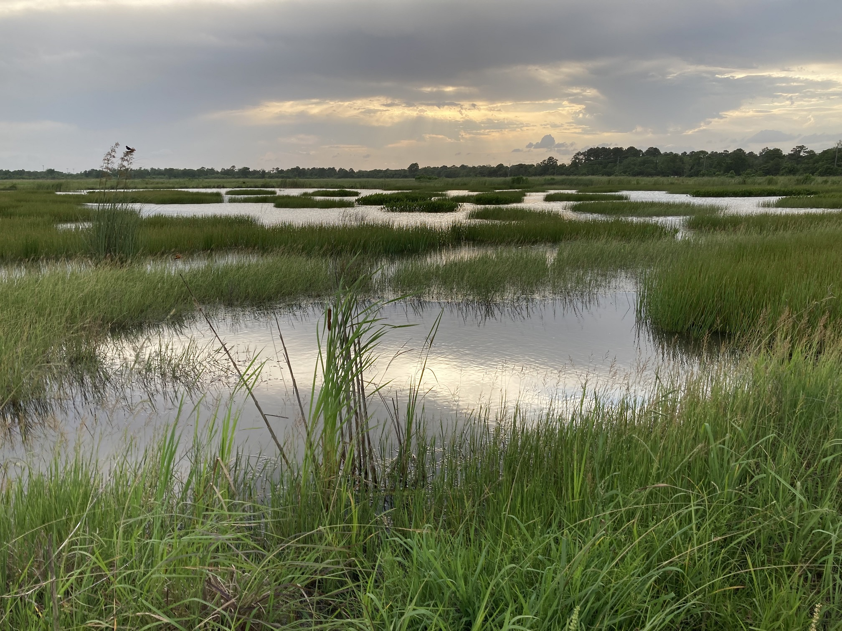
Management Problems with Prairie and Marsh Complexes – Prairie Wetlands

Slide 7
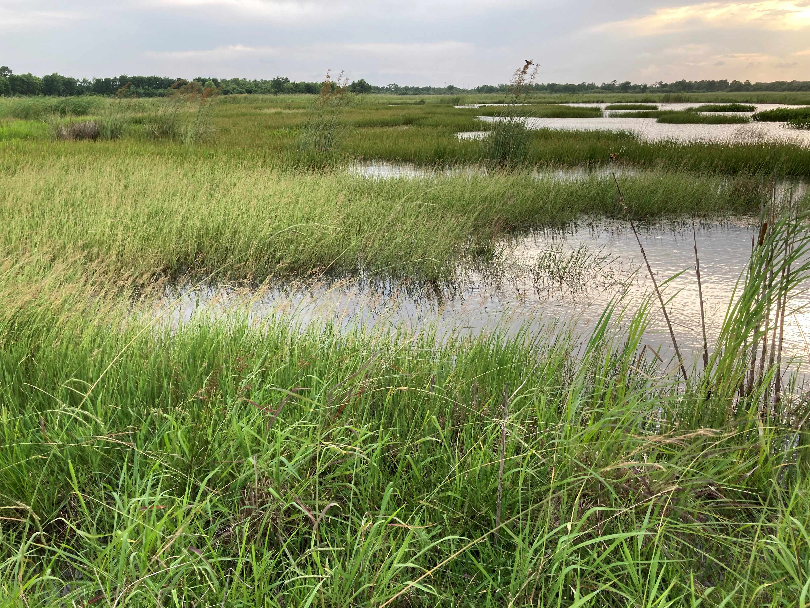
Prairie Wetland – Avoidance of Problem Situations Through Wetland Restoration Design

Slide 8
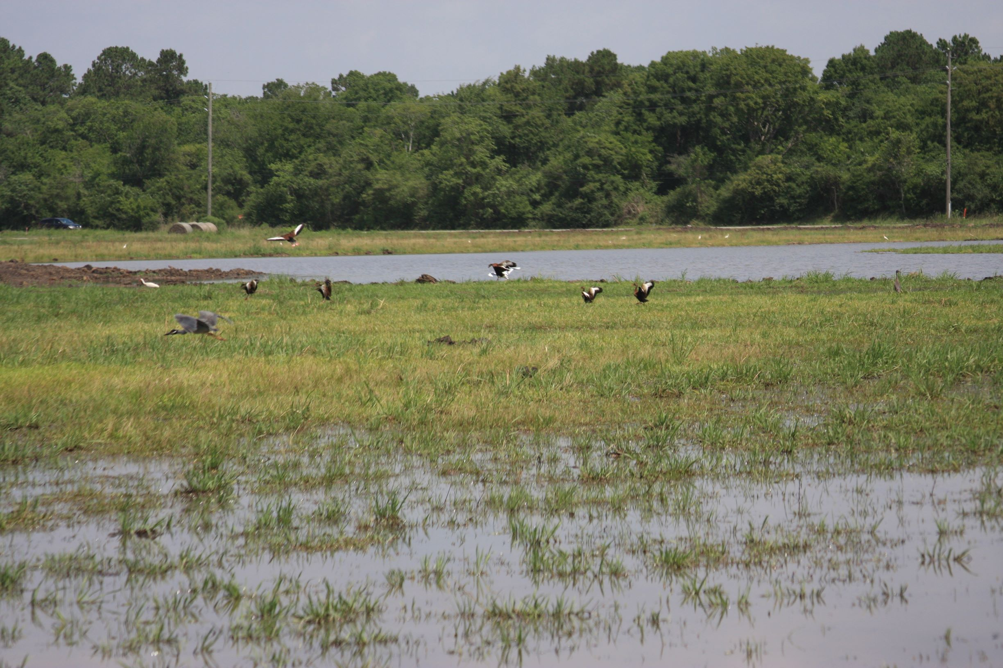
Prairie Wetland Restoration - Seeding
Seed the Bulk of the Site First.
Then Excavate or Levee Wetlands

Slide 9
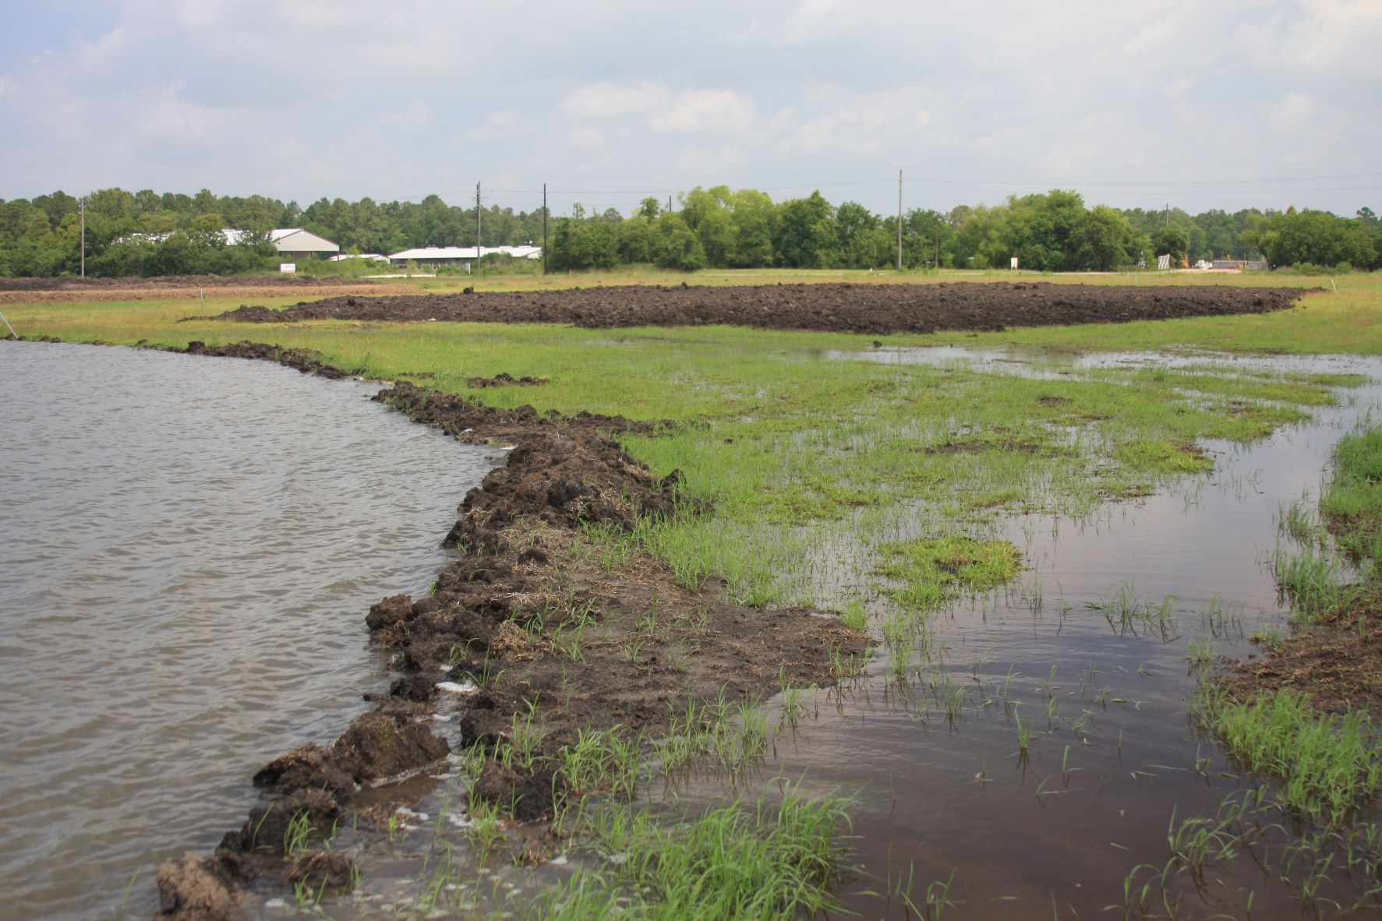
Wetland Border Problems – Levees, Borrow Ditches, Ditches, Roads, Burn Shadows
Design the Wetland to Have Seamless Edges if Possible
Avoid Spoil Mounds
Dozer Pushes
Ruts

Slide 10
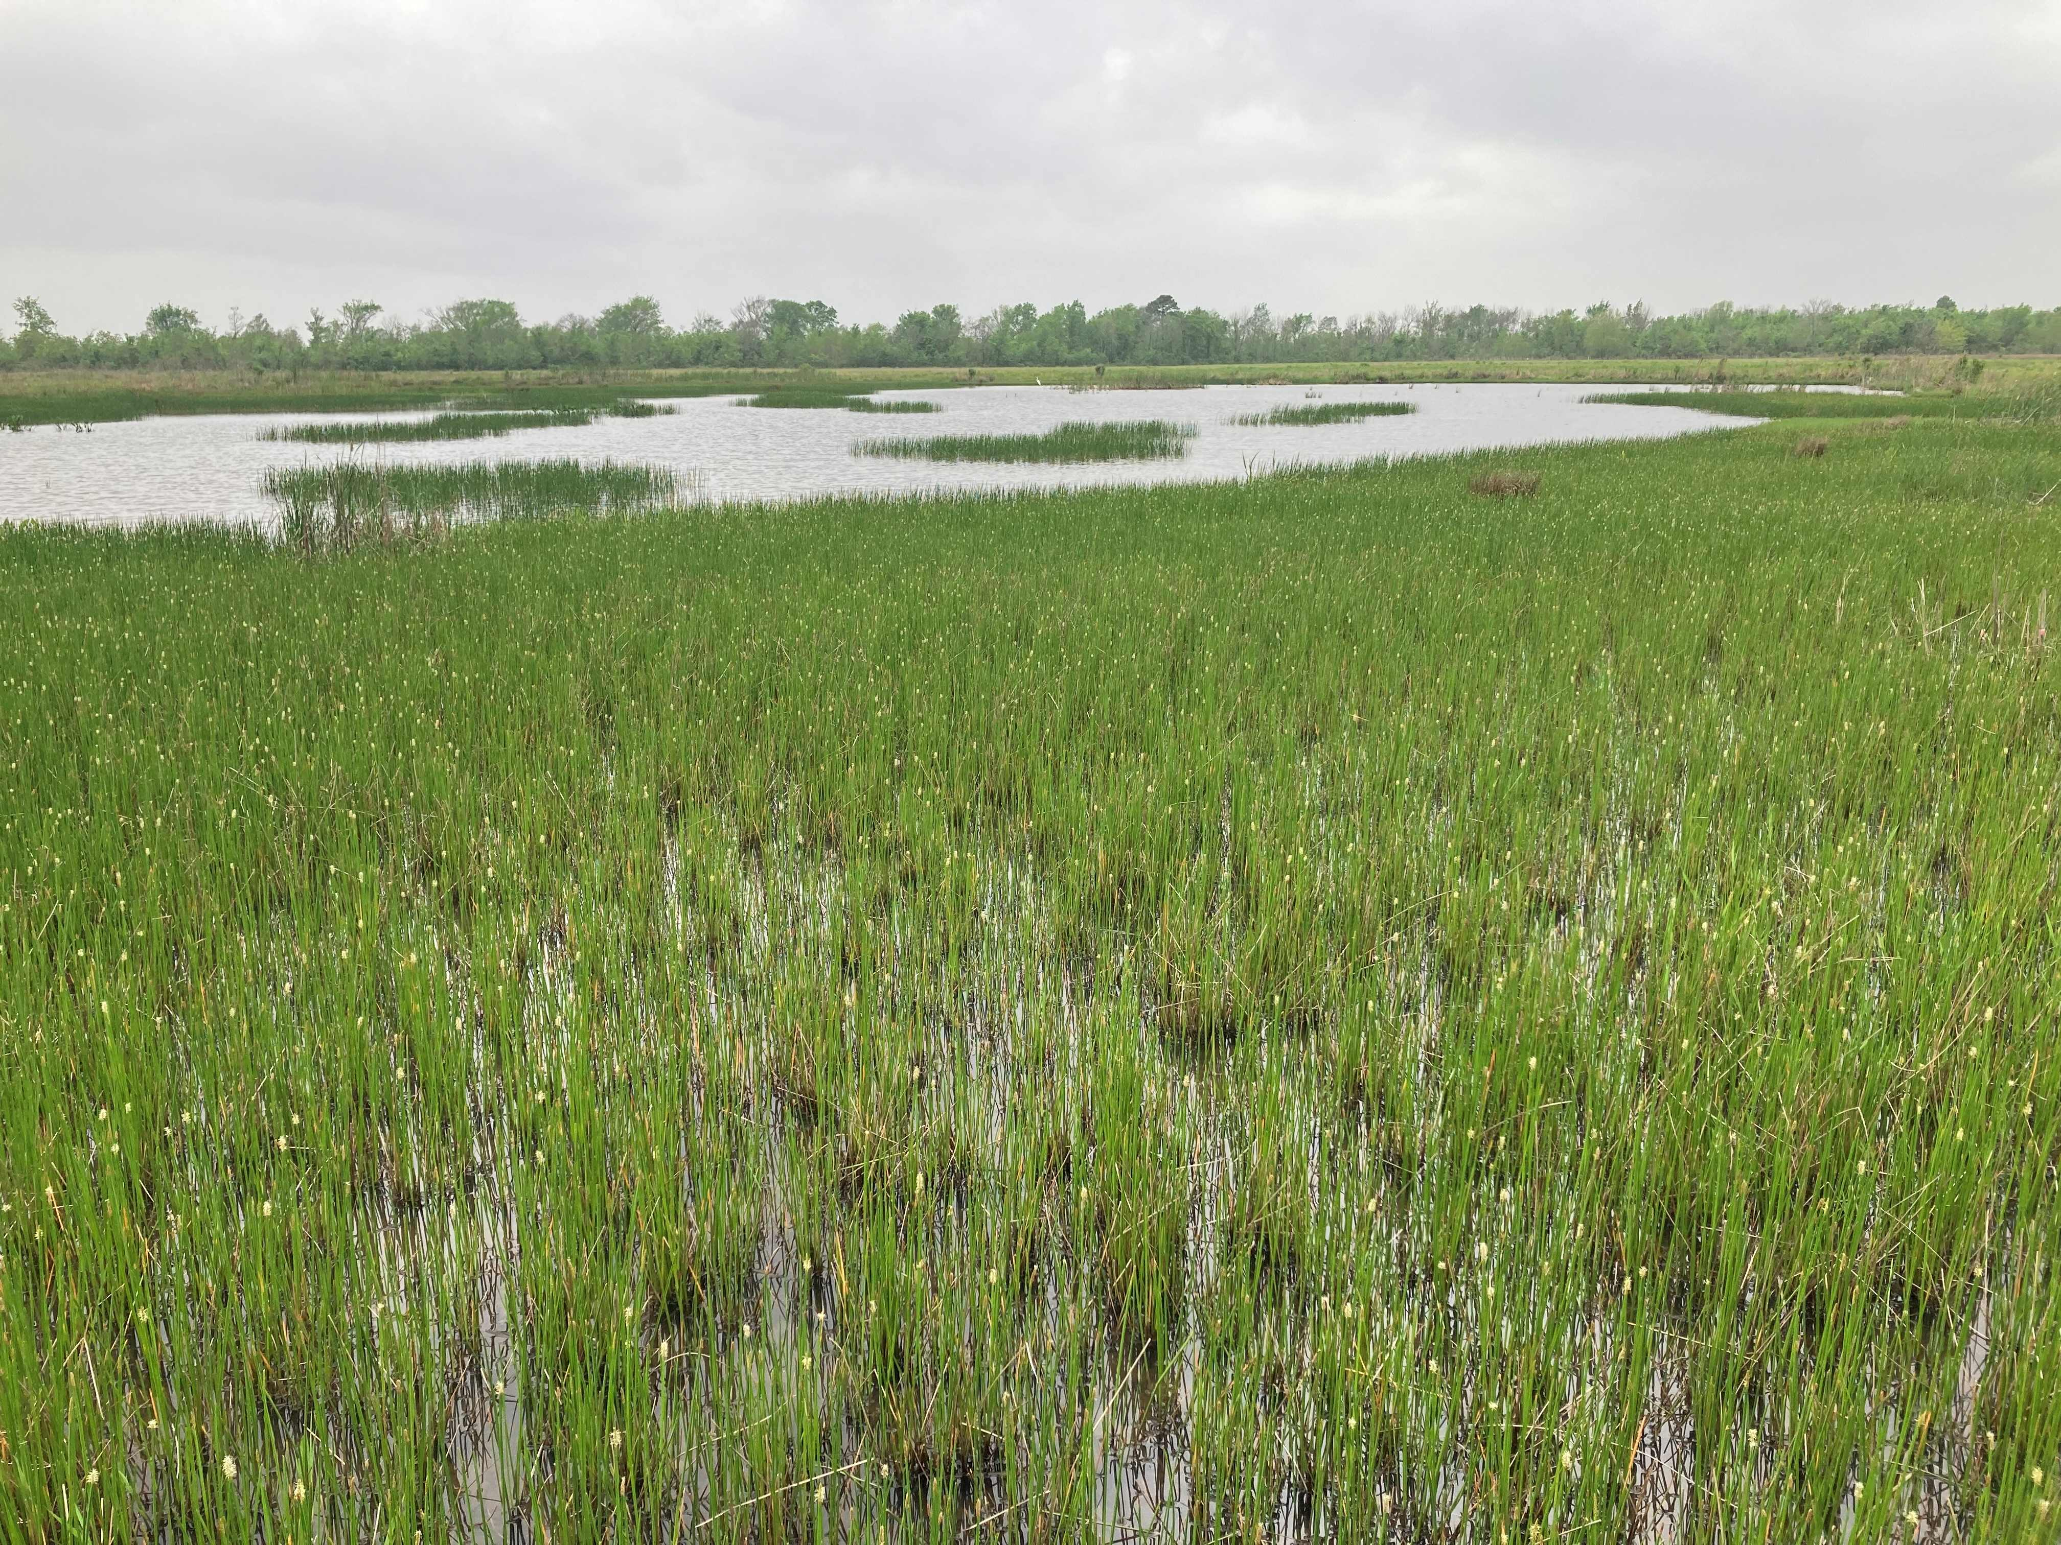
Seamless Wetland Edge – Shallow Water

Slide 11
Management Solutions
Prescribed Fire
Herbicide
Shredding
Haying
Grazing

Slide 12
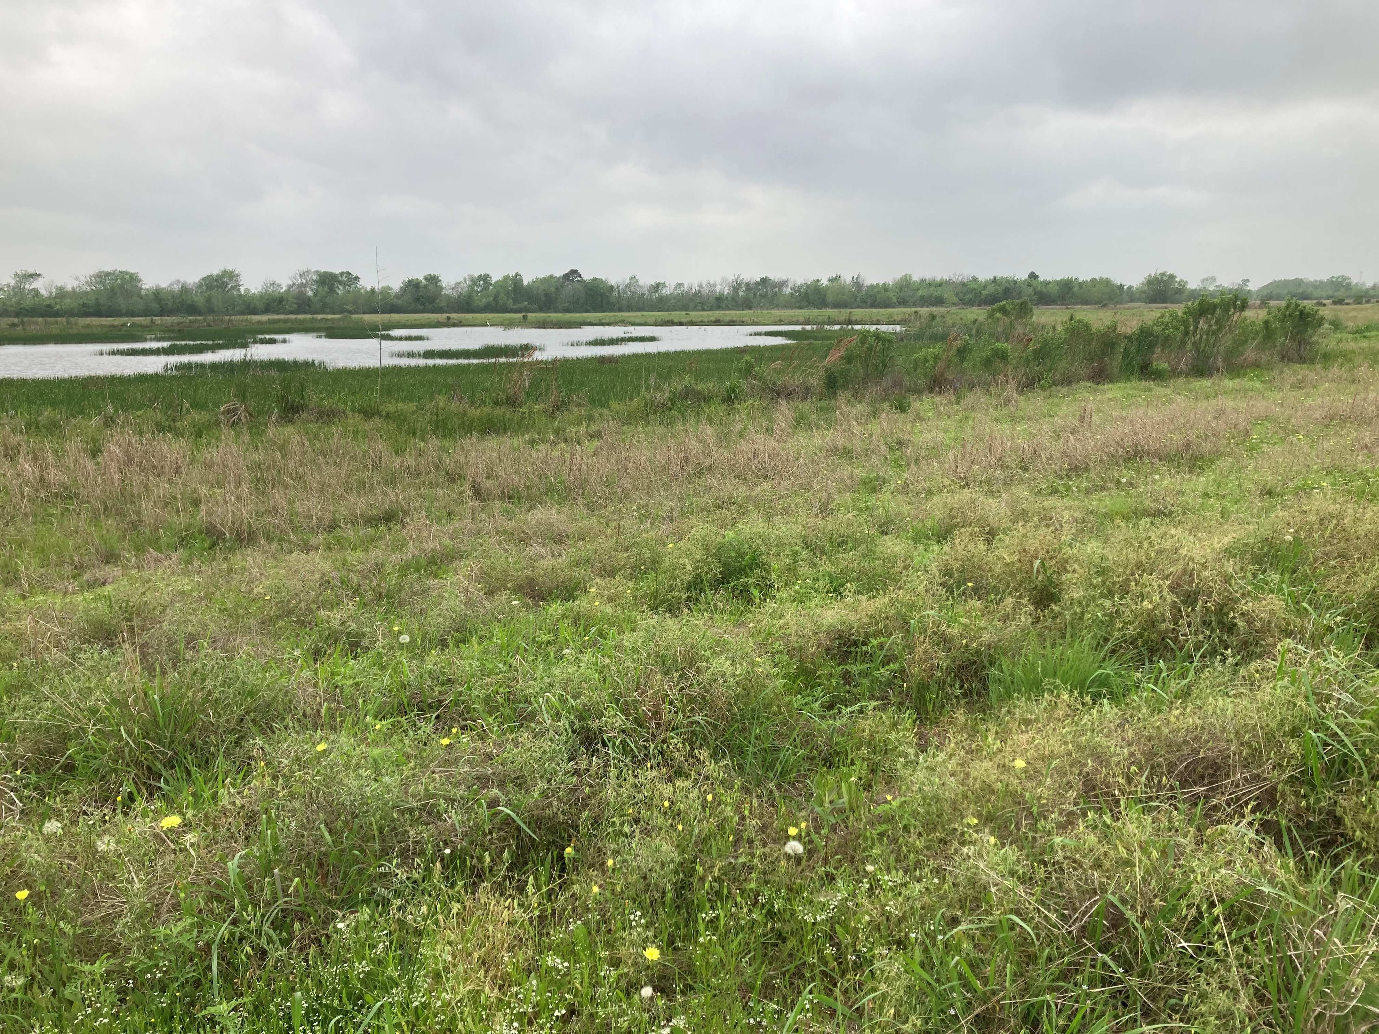
Prescribed Fire
Avoid Burn Shadows
Created by Wetland and Road Edges
Solution – Burn on Different Wind Directions, Different Ignition Strategy
Shredding/Herbicide

Slide 13
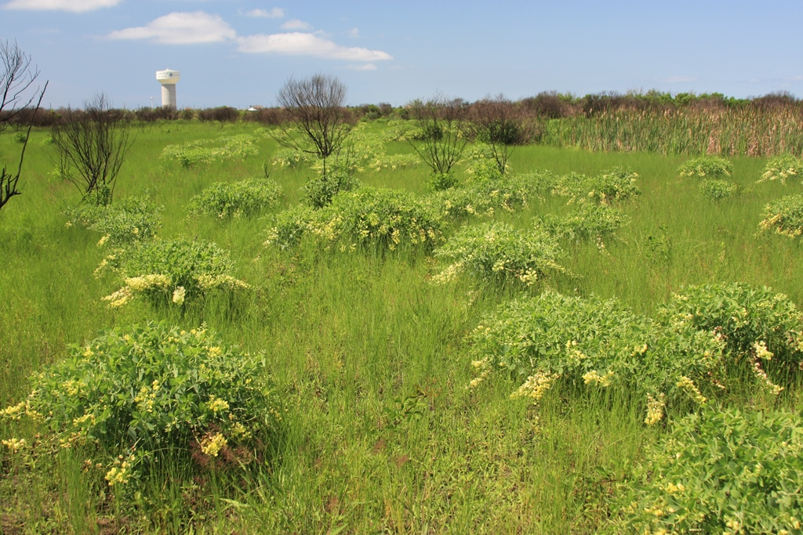

Slide 14
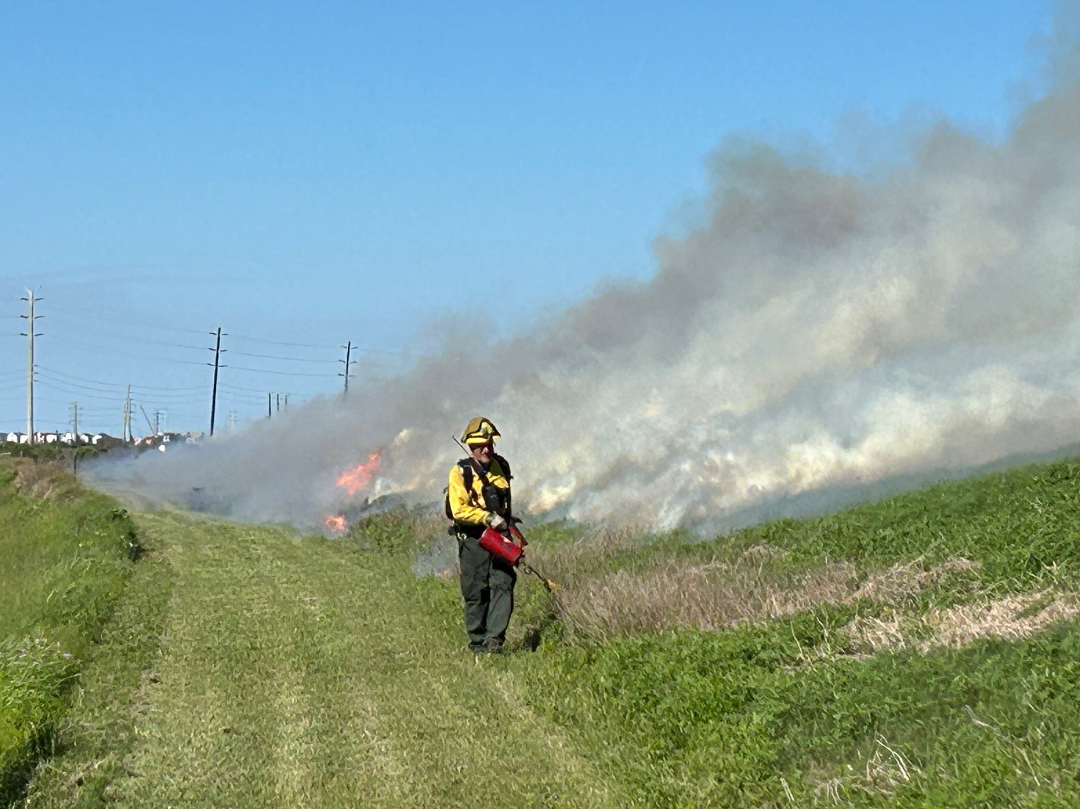

Slide 15
Herbicide
Wetlands Will be Invaded by Chinese Tallow, Black Willow, Cattail Where Fire, Shredding, Haying Isn’t Effective
Local Herbicide Dealer is a Wealth of Information
General – Glyphosate – Defoliates, often not effective on woody growth and many herbs
Broad Leaved – Trichlopyr – Can be applied foliar or basal or hack and squirt – Effective on woody growth but broadcasting will kill prairie herbs
Specialty herbicides – Imazapic, etc. effective on specific weed problems

Slide 16
Shredding
A Technique I Try to Avoid – Thatch is a Problem as is Spread of Invasive Grasses and Forbs
Used to Control Woody Vegetation and Cattails (Robust Emergents)
More Effective Under Drought Conditions
Effective for First Year Growth of Trees
Very Effective for Encouraging Seed Germination During Establishment – Prior to Prescribed Fire
Maintain Fire Breaks – On High Ground

Slide 17
Haying
Very Effective in Maintaining Prairie
Impractical in Most Wetlands

Slide 18
Grazing
Excellent for Managing Robust Emergent Growth in Wetlands
Difficult to Overgraze Our Wetlands
Use in Place of Discing or Other Disturbance
Between Bison and Geese Our Wetlands Were Grazed a Lot
Difficult to Manage on Upland Prairie as They Require Less Grazing Duration Than Wetlands
Some Wetland Birds Need Dense Cover in Both Prairie and Wetland
Should be Looked at as a Tool – Not Free or as an Income Stream
Invasive Species Introduction and Spread can be a Real Problem

