Slide 1
Candy Abshier WMA Coastal Prairie Restoration Project
Philip Pauling, TPWD

Slide 2
Candy Abshier Wildlife Management Area
Approximately 209 acres in size
Purchased by Texas Parks and Wildlife Department in 1989
Named after a dedicated former TPWD employee Catherine “Candy” Cain Abshier in 1991
Located near the community of Smith Point in Chambers County, Texas
Sits along the shore of Galveston Bay
Part of the Upper Coast Wetland Ecosystem Project administered by TPWD

Slide 3
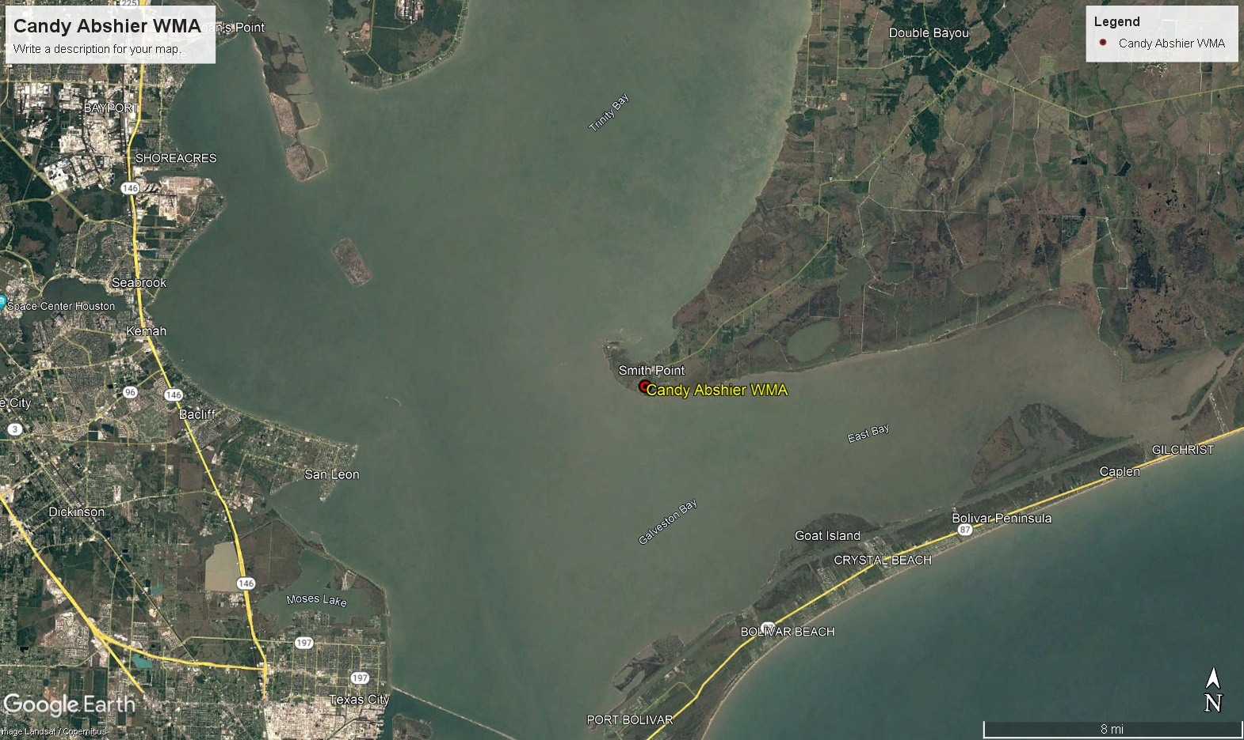

Slide 4
Purpose
The WMA is dedicated to the management and preservation of coastal prairie and oak motte habitats
These habitats are crucial for resident and migratory wildlife species
Area is heavily utilized by migrating neo-tropical passerine species as a stop-over point during the fall migration
Gulf Coast Bird Observatory conducts a Hawk Watch from Aug. 15 – Nov. 30 each year.

Slide 5
Habitat Features
Oak Mottes
Wetlands
Pimple mounds and inter-mound prairie areas in the center of the WMA
High prairie on the north end of the WMA along F.M. 562

Slide 6
Native Vegetation
Oak mottes
  Live Oaks
Prairie areas
  Little bluestem
  Brownseed paspalum
  Bushy bluestem
  Smutgrass
  Carpetgrass
  Wax myrtle
  Rattlebox
  Wild indigo

Slide 7
Changes in Habitat over time
Oak mottes
  Oak mottes have greatly expanded in size and species composition. Pine trees, Chinese Tallow trees, Yaupon holly, and Laurel cherry now make up a significant portion of the mottes and areas between the historical mottes
Pimple mounds and inter-mound areas
  Pimple mounds are now heavily dominated by thick stands of Yaupon holly. Inter-mound areas are dominated by a mix of Marsh hay cordgrass, Chinese tallow trees, Yaupon holly, and Groundsel trees
High prairie
  This area has become dominated with Gulf coast cordgrass, Marsh hay cordgrass, Groundsel trees, Chinese tallow trees, and news stands of Live oaks

Slide 8
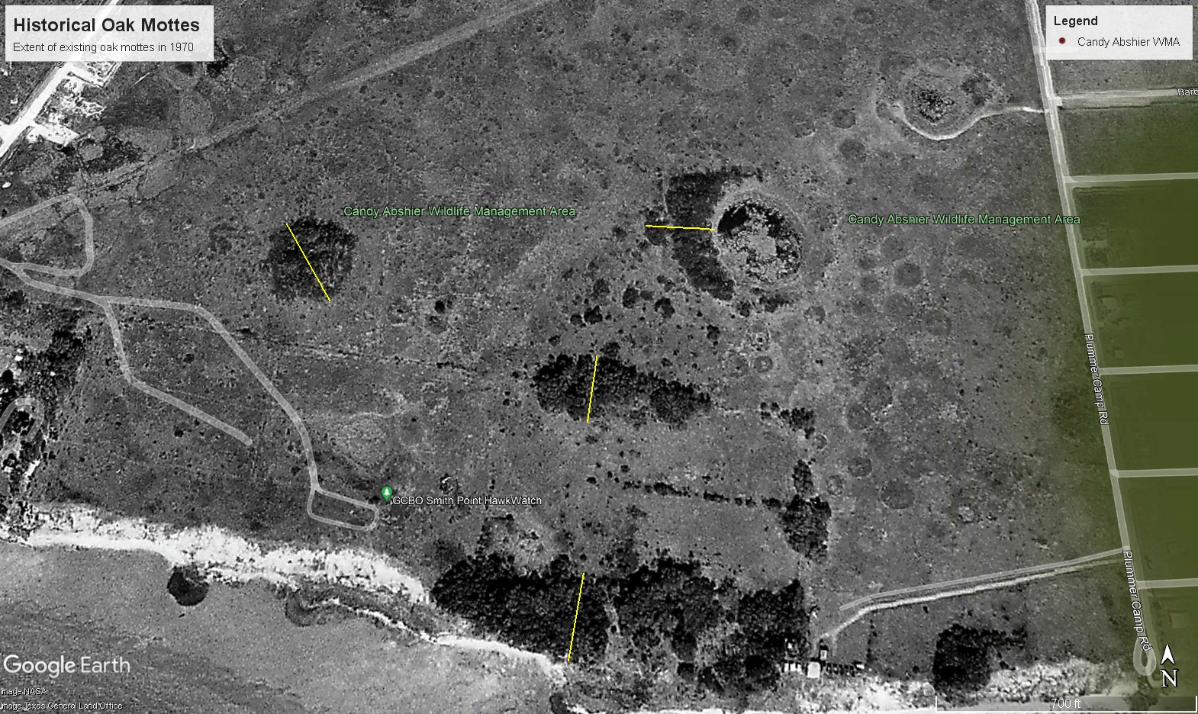
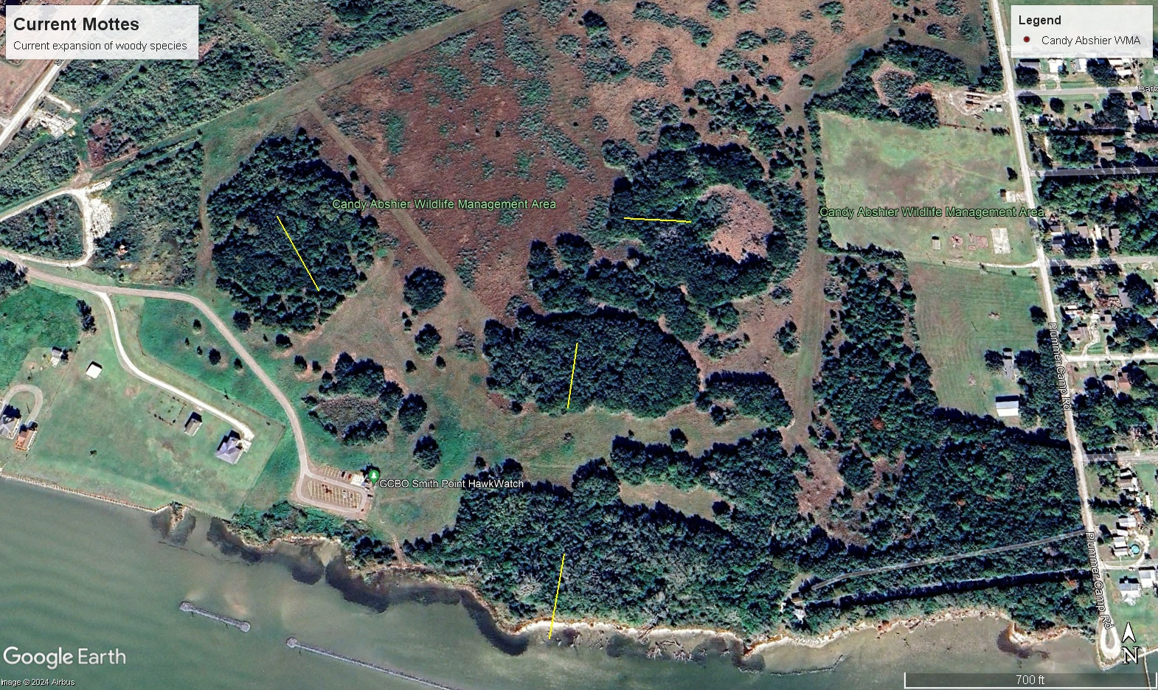
Changes over time
1970
November 2023

Slide 9
Past Management Actions
1989-2001
  Mowing
  Cattle Grazing – ended in 2001
2001 – Present
  Sporadic mowing when equipment and conditions allowed
  2014 – early 2019 was a very wet period for the wma that made mowing virtually impossible. Saw a significant increase in size and area coverage of woody species during this period
2019
  Brush and tree mulching over an area encompassing approximately 85 acres
March 2021
  Conducted a prescribed burn on approximately 70 acres that was previously mulched

Slide 10
Prairie Restoration Efforts
May – June 2019
  Established 4 photo stations to track before and after results
  We used 2 rented track loaders with brush cutting attachments along with a amphibious marsh buggy with a mower deck to clear small trees, brush, and cordgrass
  Initially focused on areas around the historical oak mottes and pimple/inter mound areas covered in small oaks, pine trees, yaupon holly, chinese tallow, and groundsel trees
  Pimple mounds with thick yaupon holly proved difficult for the machines and took considerable time to clear
  Towards the end of our rental period we shifted our focus to creating a good perimeter to use for a future prescribed burn and clearing more of the inter-mound areas which the machines were able to clear at a quicker rate

Slide 11
Prairie Restorations Efforts Cont.
Post Mulching Observations
  Mulching disturbed and exposed the top layer of soil within a large portion of the area
  The response of the native seed bank to the soil disturbance was quick and impressive
  By fall we had seen a significant increase in the amount of native grasses within the mulched area

Slide 12
Prairie Restoration Efforts Cont.
February 2021
  Prepared firebreaks around the perimeter of approximately 70 acres using a combination of a tractor on drier areas and amphibious marsh buggy in the wetter areas.
  Mowed and disced to create fire breaks.
March 2021
  A prescribed burn was conducted on the 70 acres that was prepared the month before.
  Observed good fire behavior within finer fuels and stands of Yaupon holly
  Saw good fuel consumption in areas cleared of brush in 2019

Slide 13
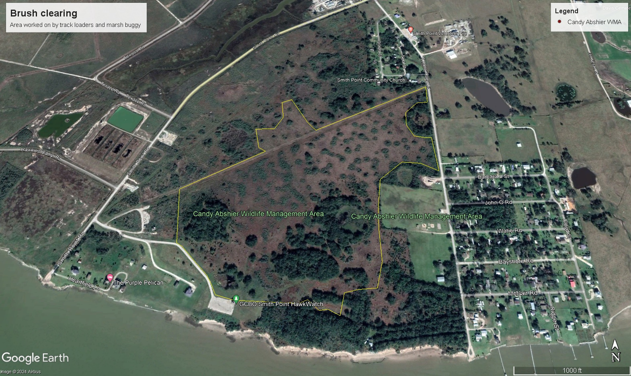
Mulched Area

Slide 14
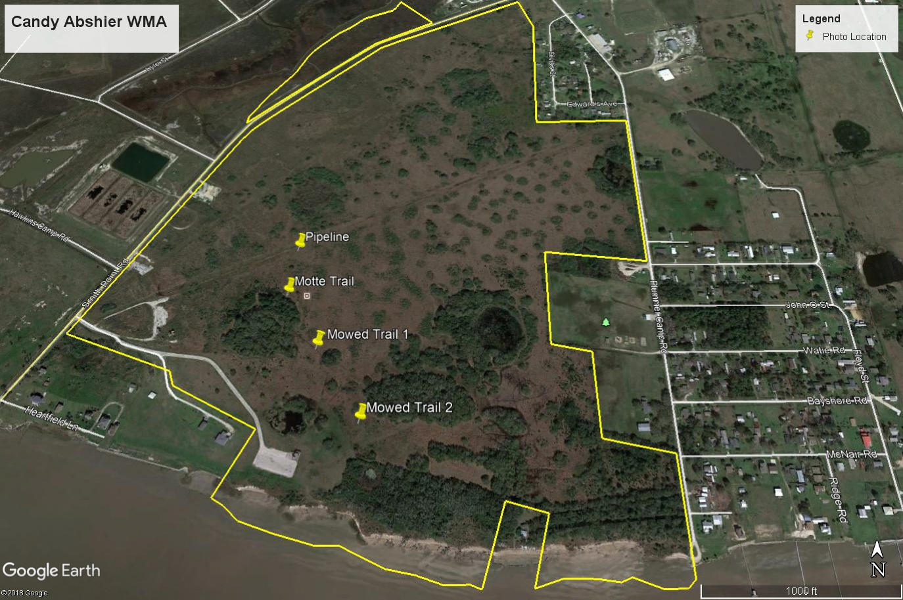

Slide 15
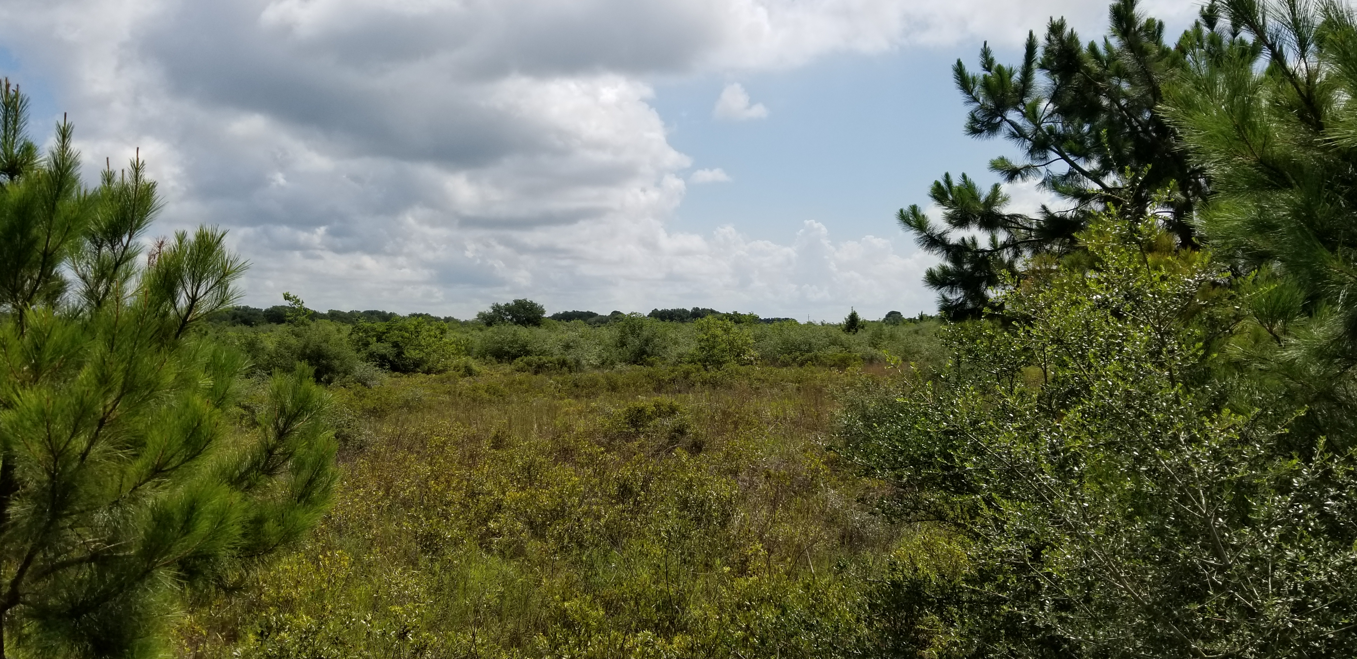
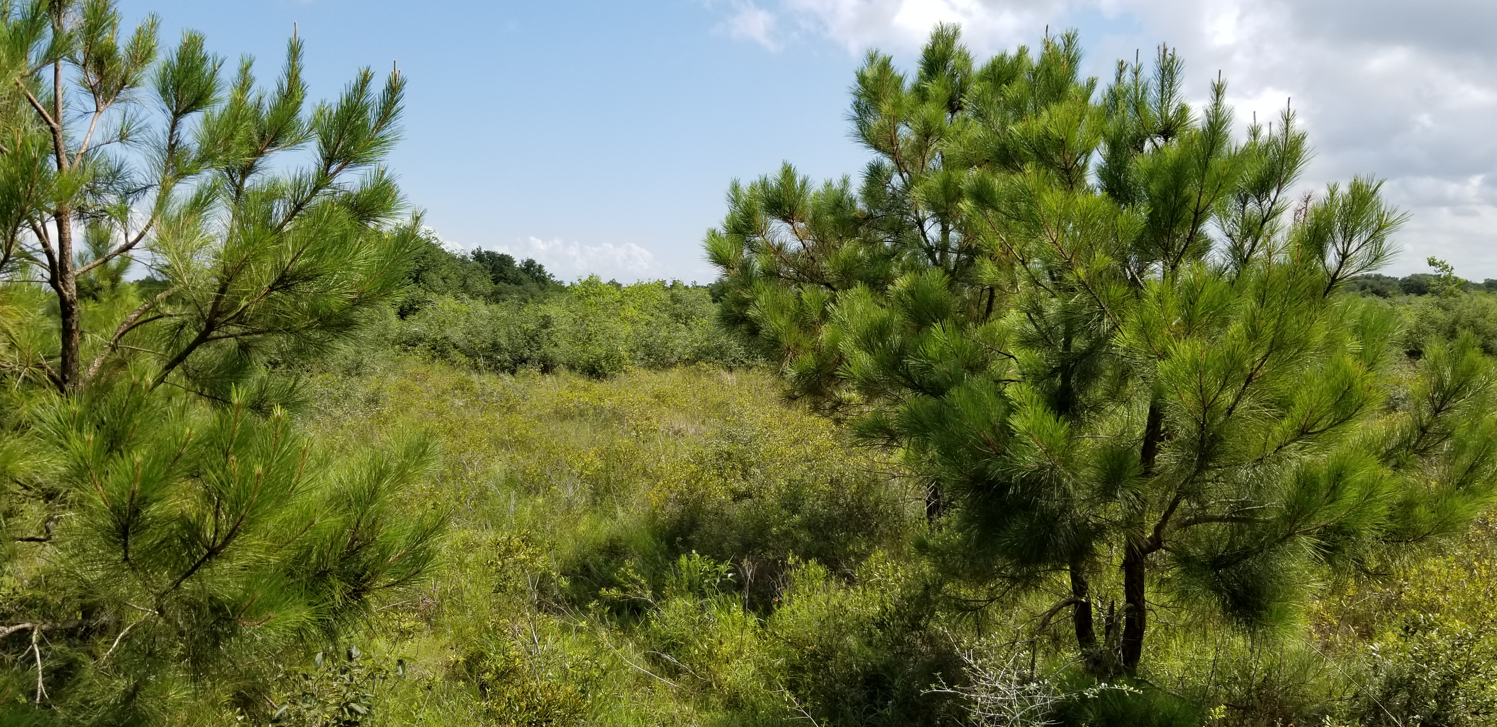
Motte Trail Pre-Mulching

Slide 16
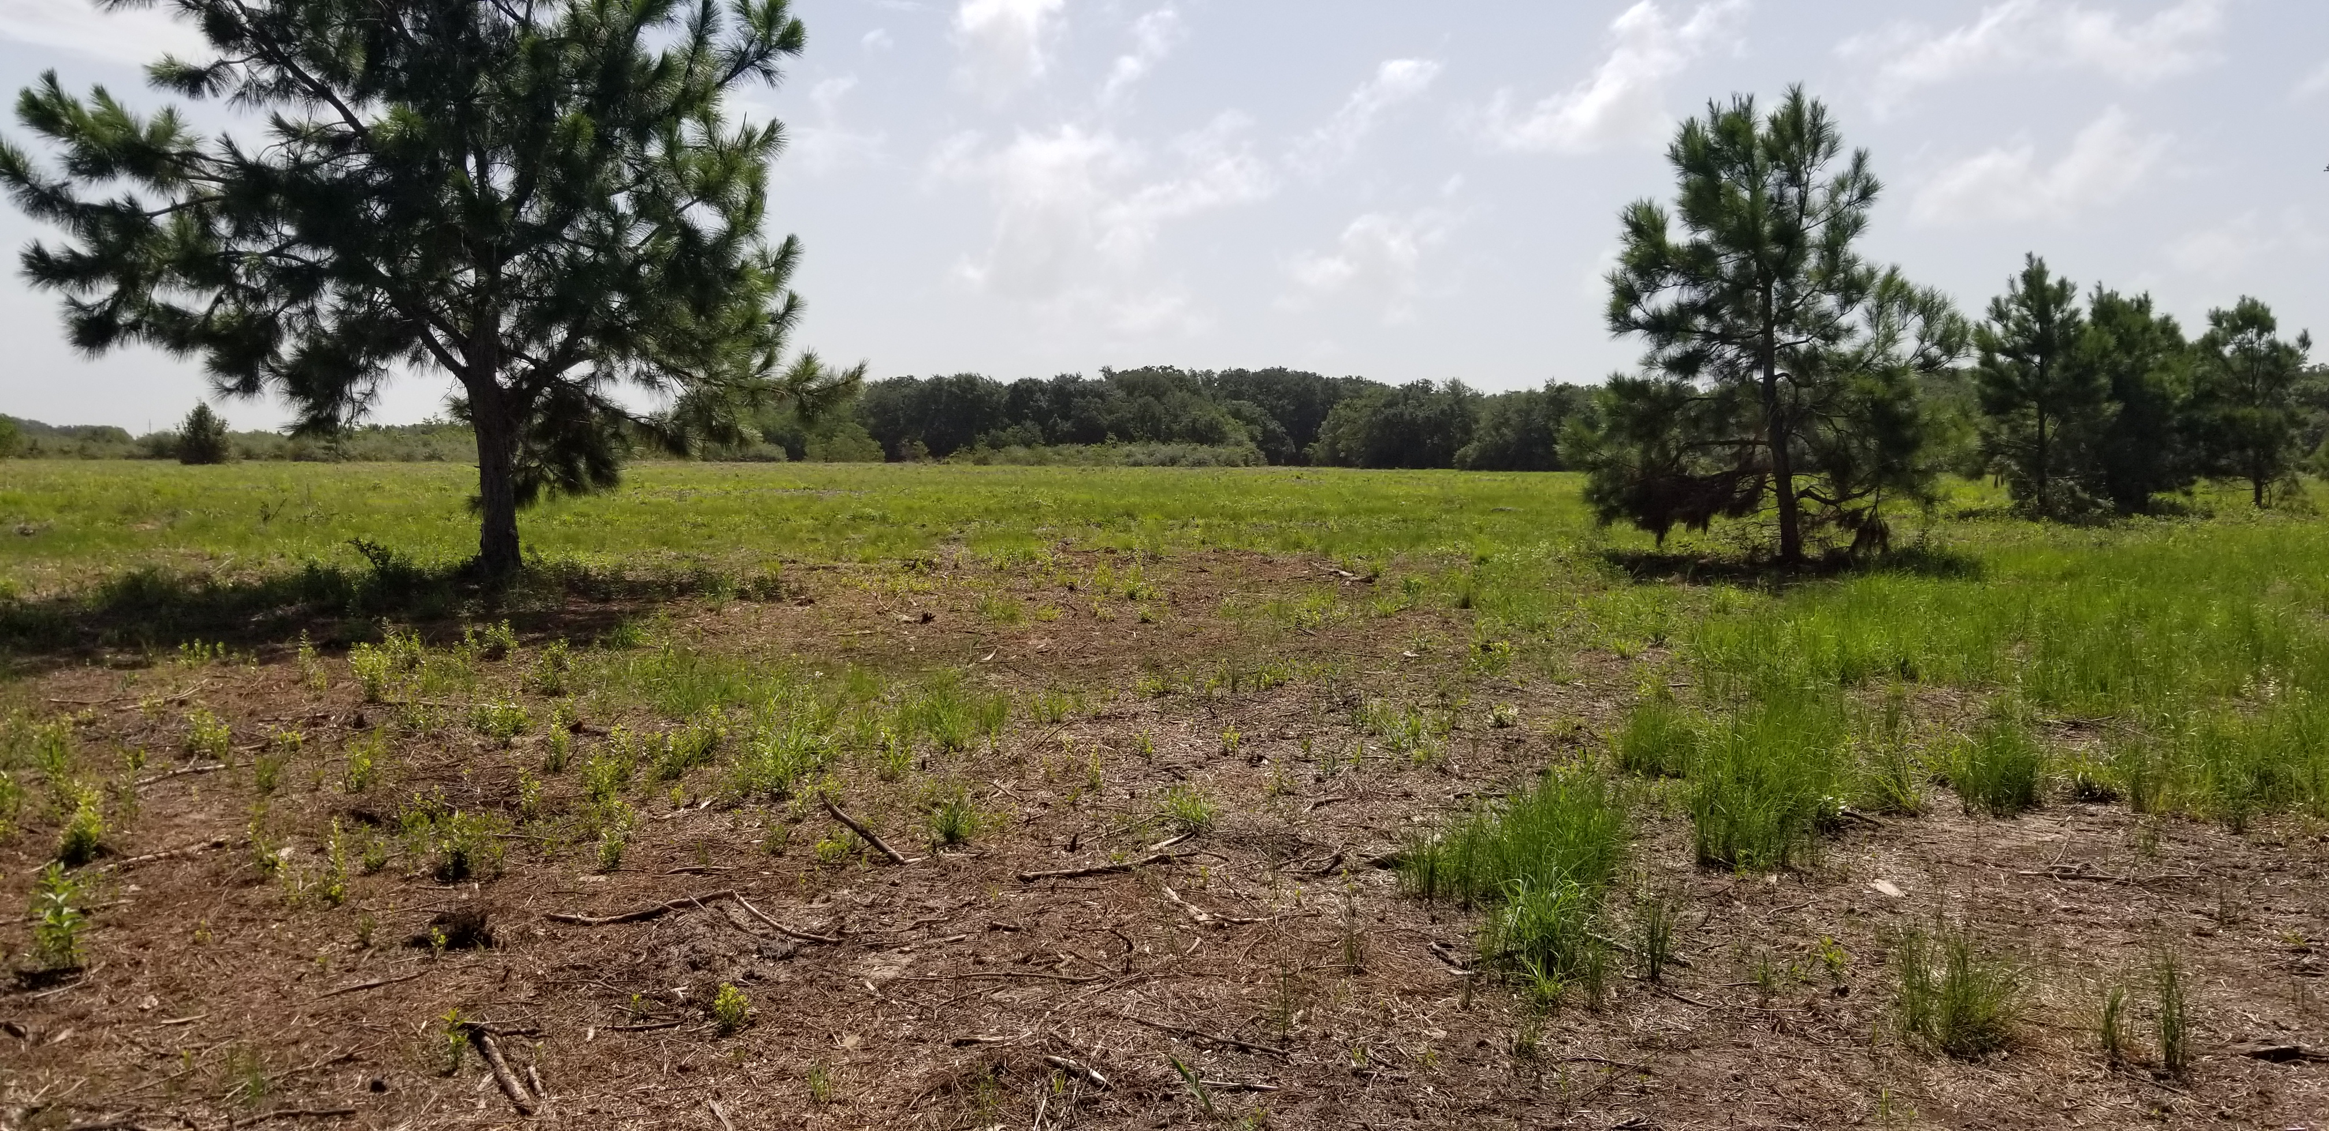
Motte Trail Post-Mulching (4 week)

Slide 17
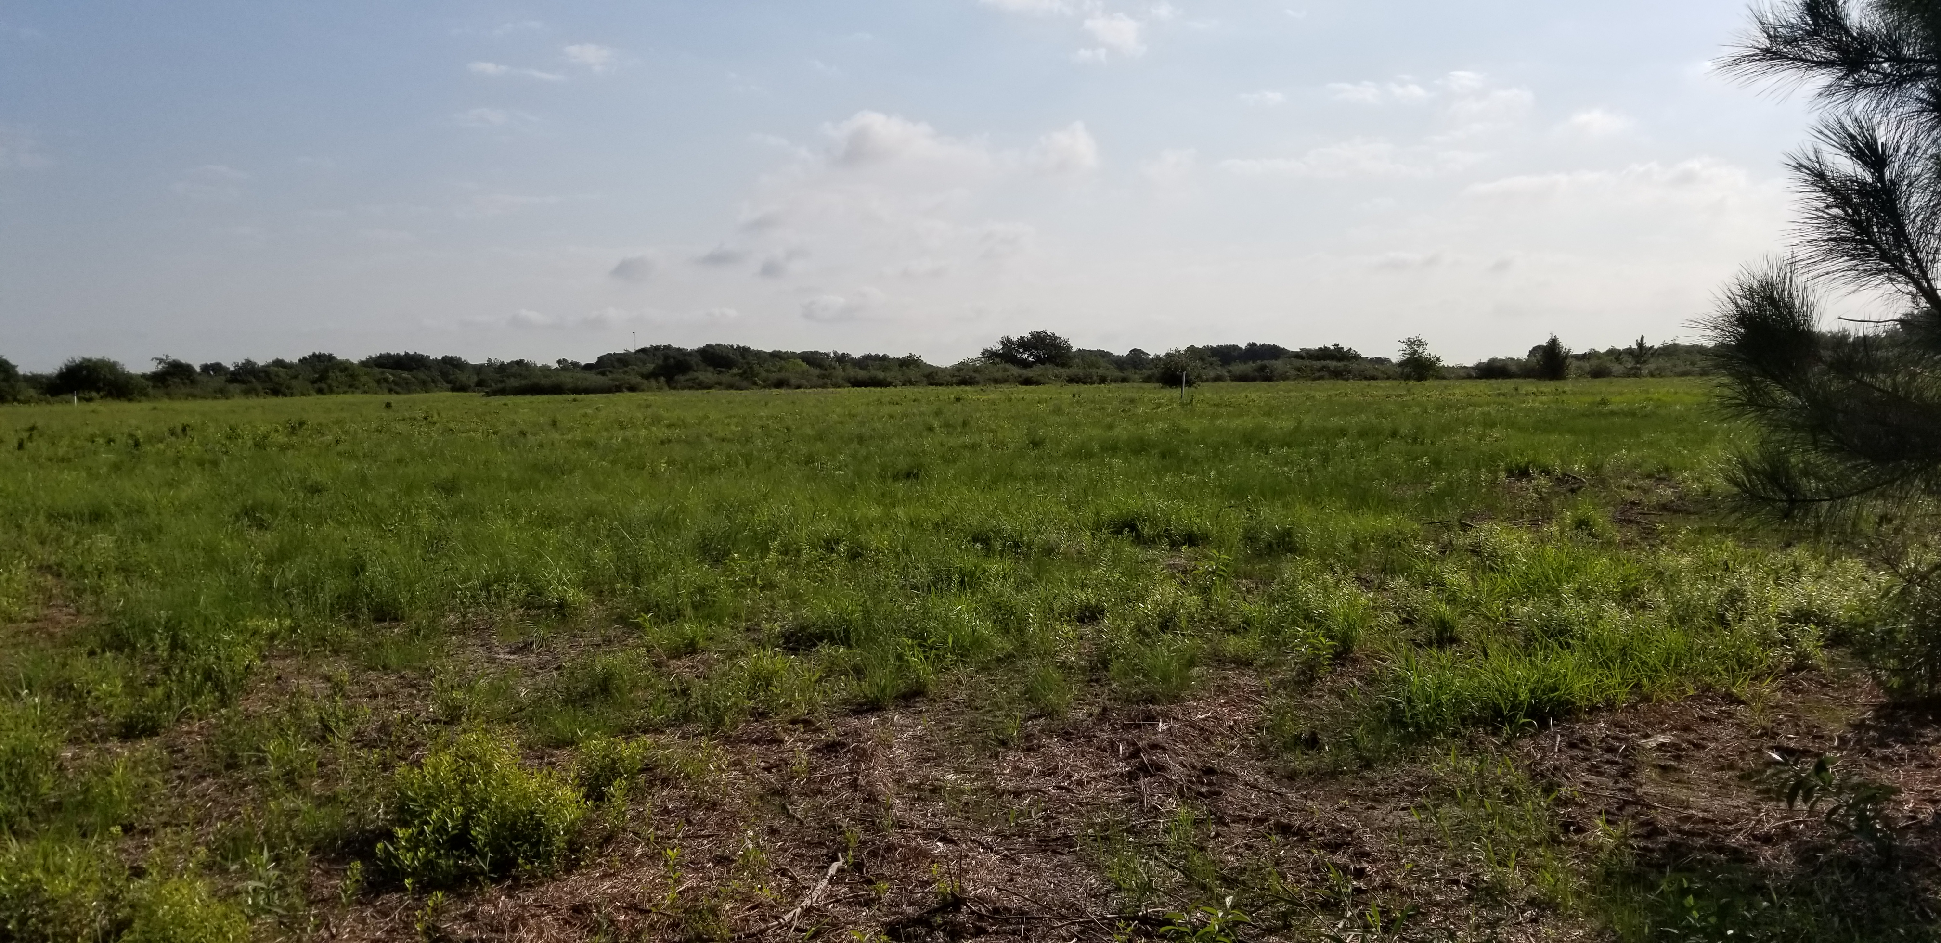
Motte Trail Post-Mulching (8 weeks)

Slide 18
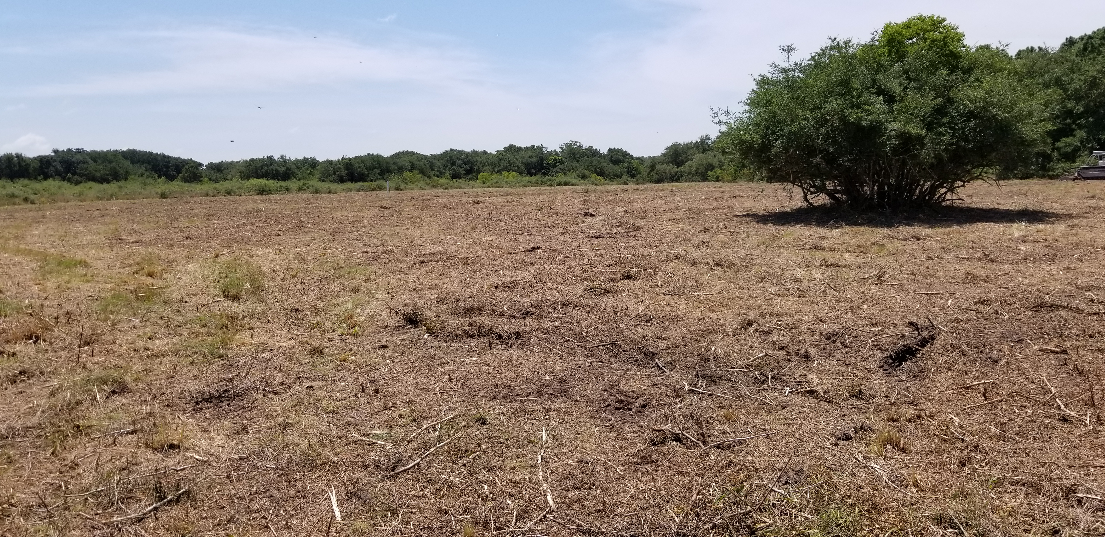
Pipeline Post Mulching (1 week)

Slide 19
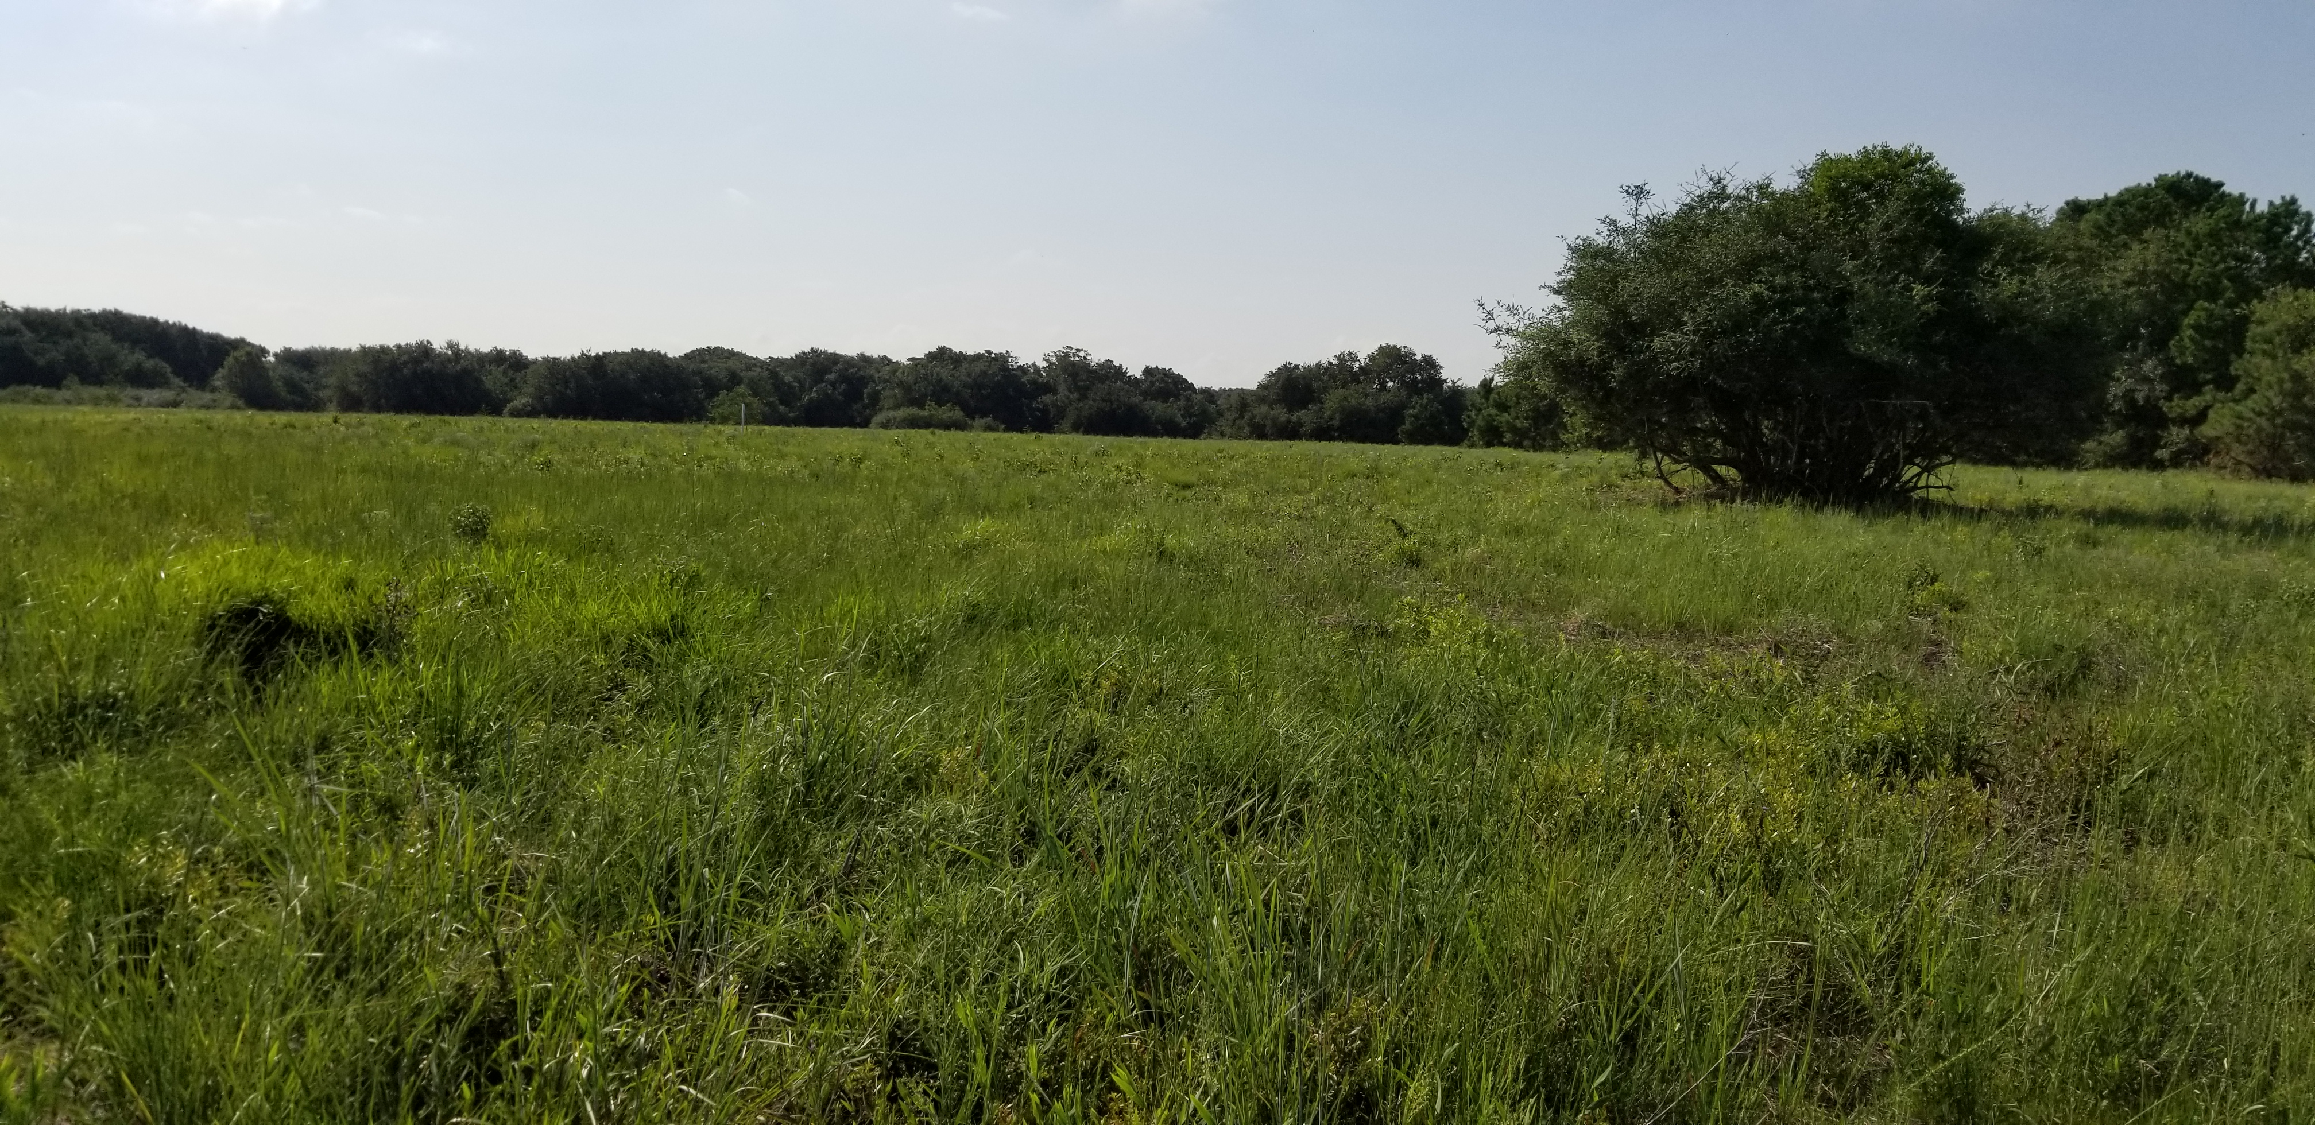
Pipeline Post-Mulching (8 weeks)

Slide 20
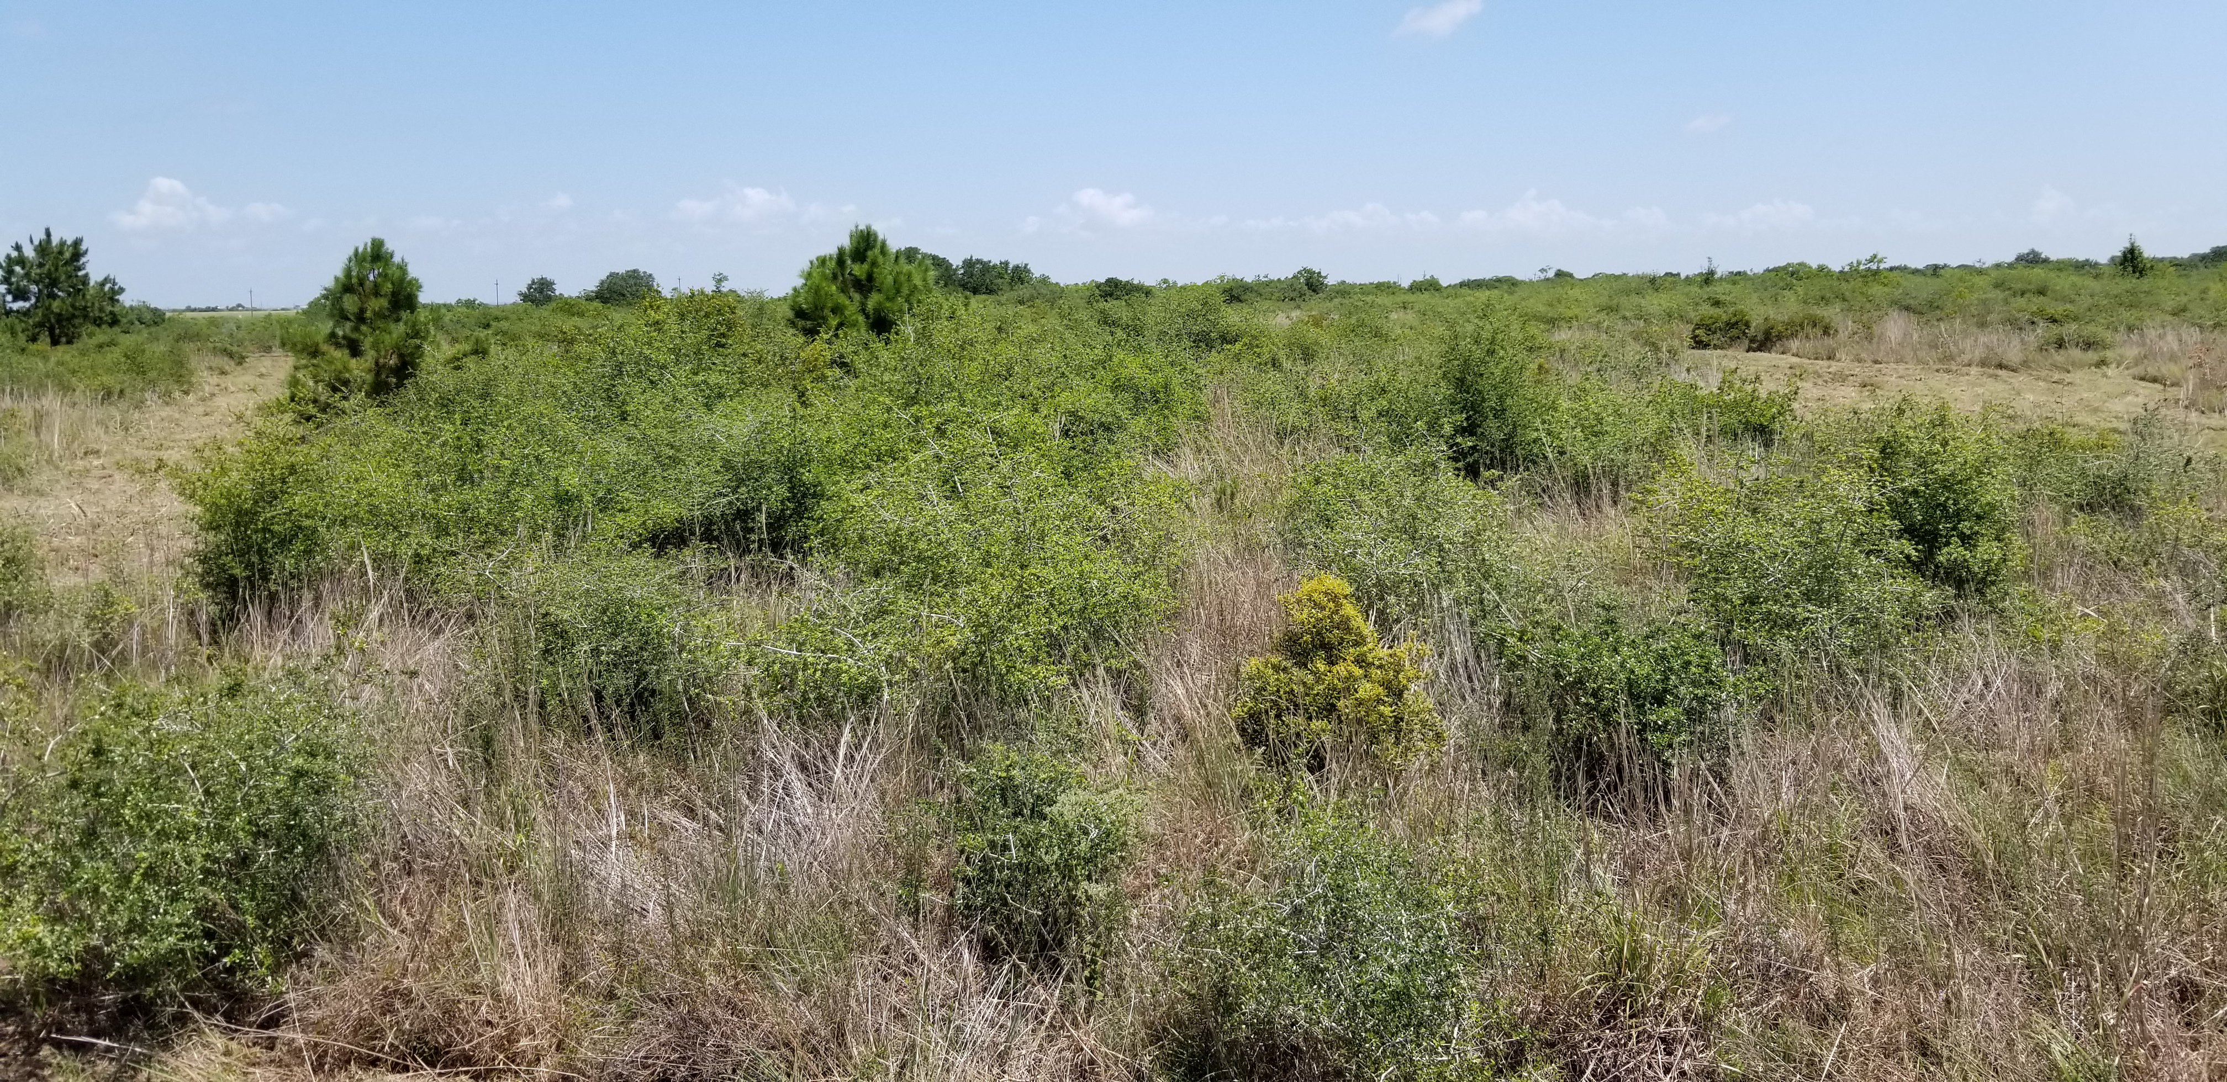
Mowed Trail 1 Pre-Mulching

Slide 21
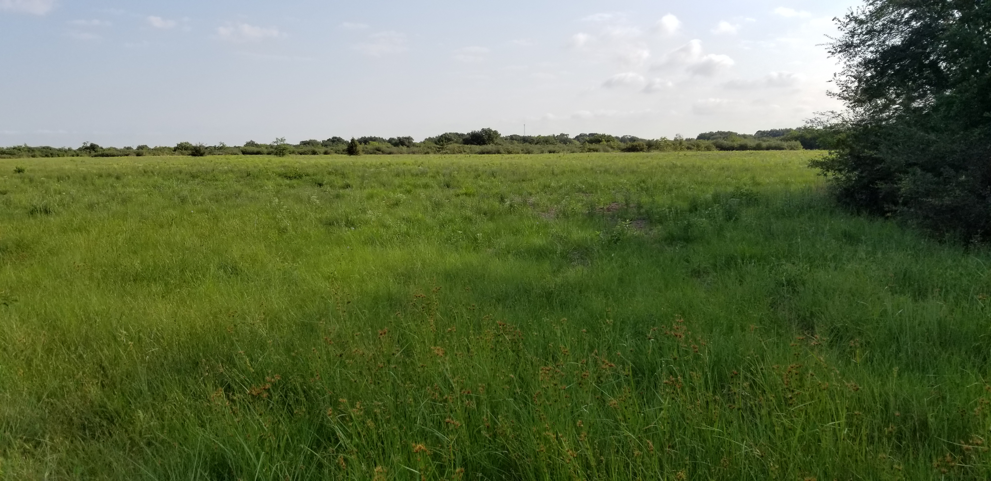
Mowed Trail 1 Post-Mulching (8 weeks)

Slide 22
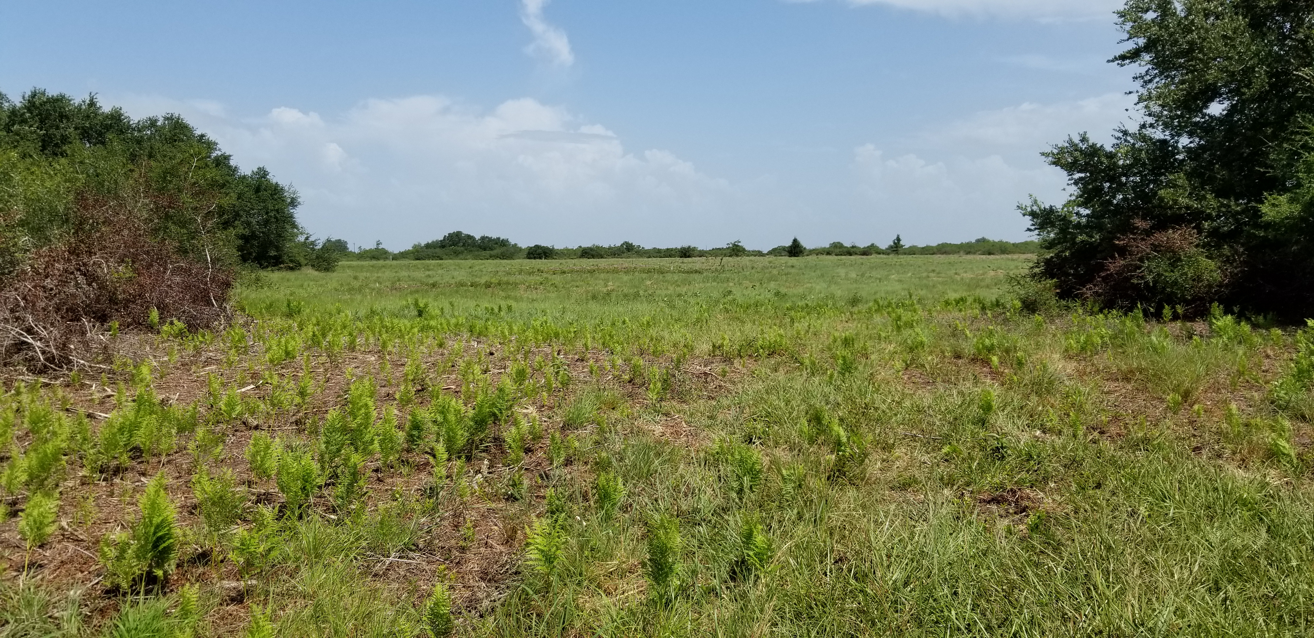
Mowed Trail 2 Post-Mulching (4 weeks)

Slide 23
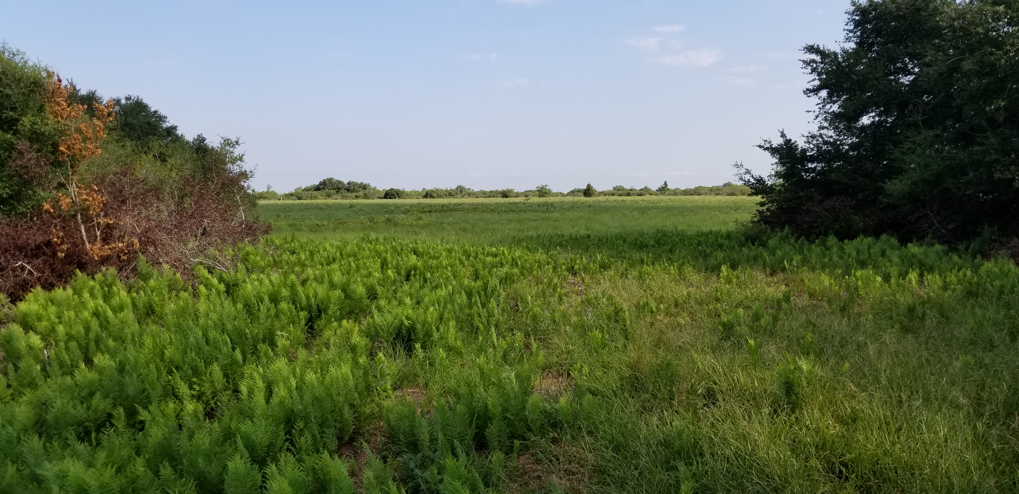
Mowed Trail 2 Post-Mulching (8 weeks)

Slide 24
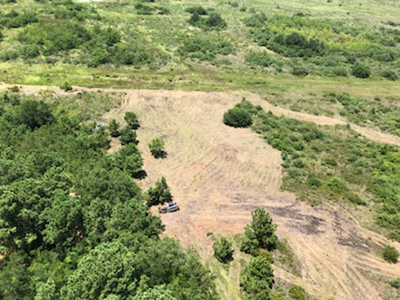
Aerial Image

Slide 25
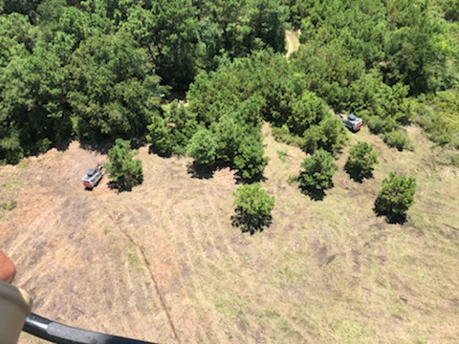
Aerial Image

Slide 26
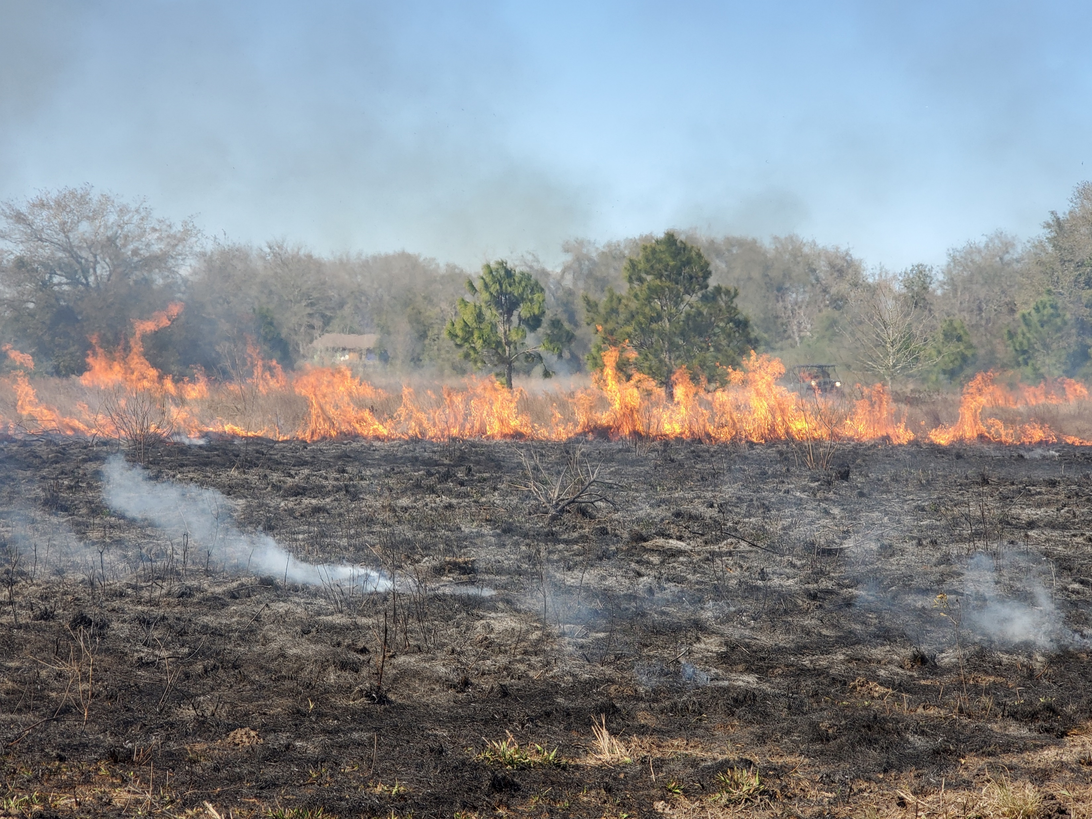
March 2021 Prescribed Burn

Slide 27

Pre-Mulching 2017

Slide 28
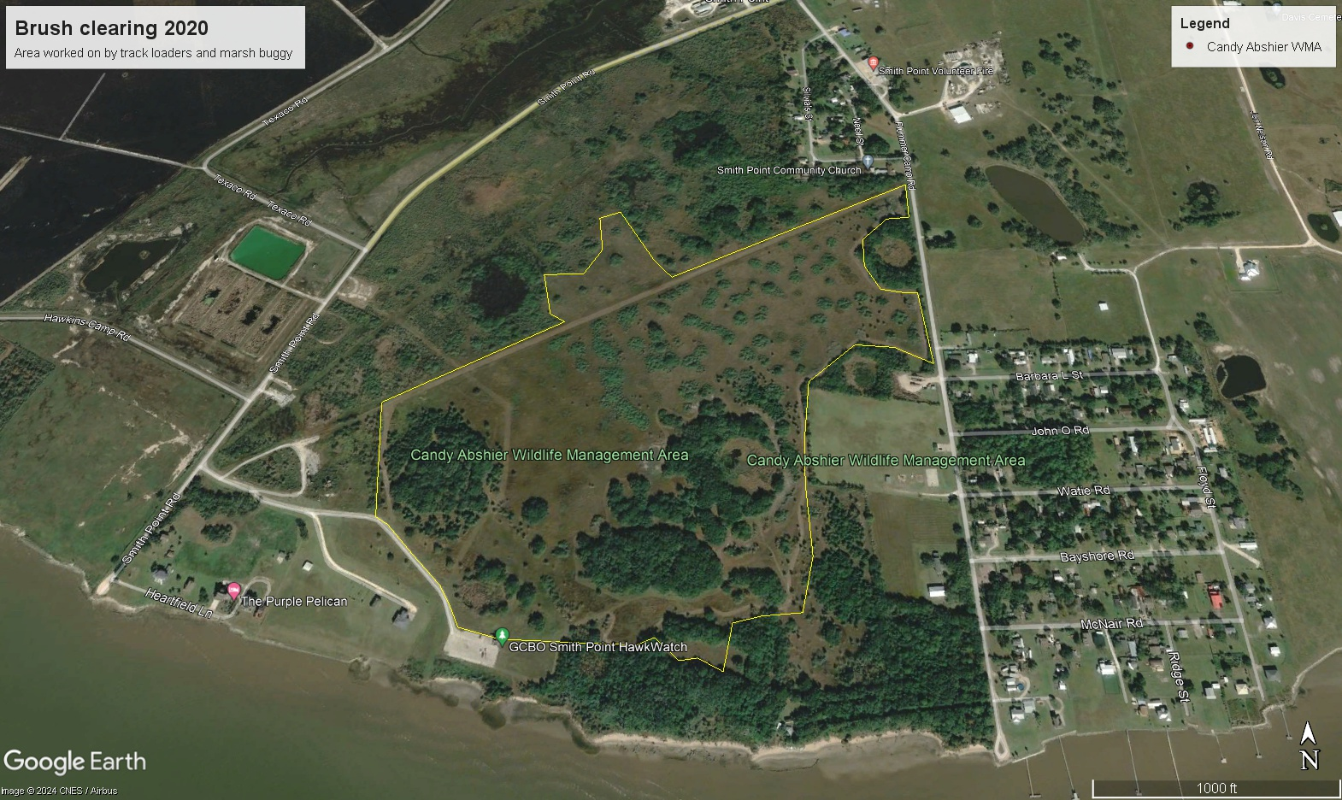
Post Mulching 2020

Slide 29
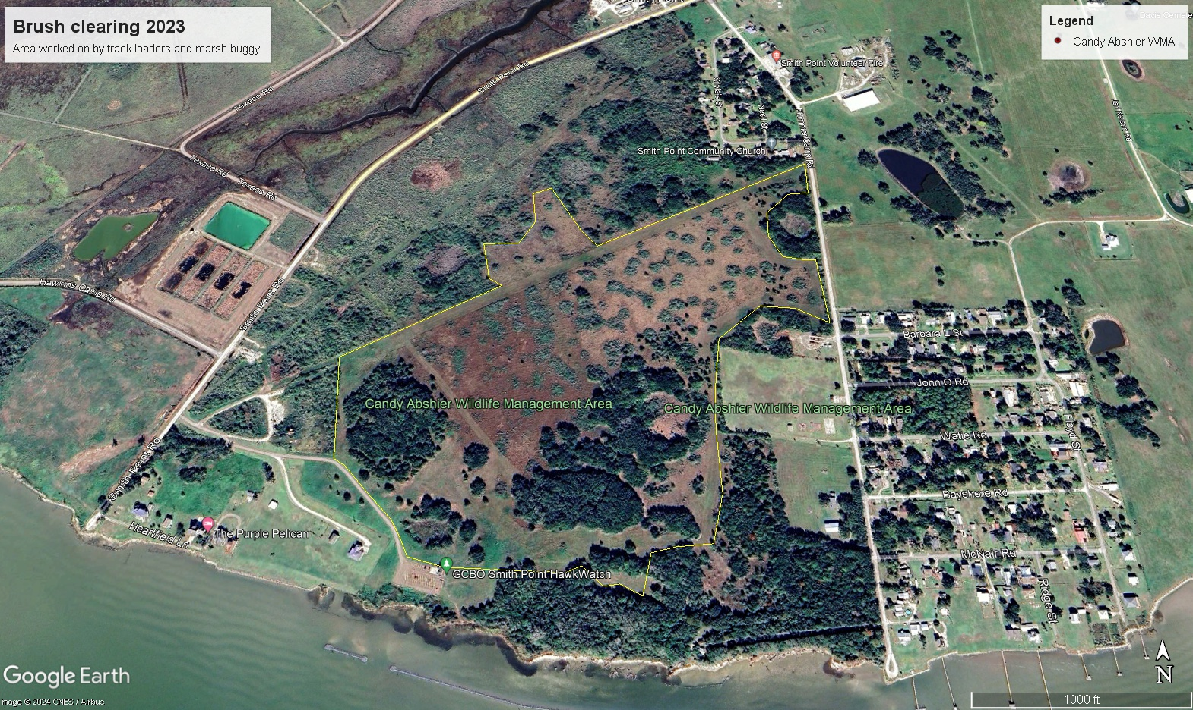
Post Mulching 2023

Slide 30
Challenges to Management Going Forward
Distance
  Candy Abshier WMA is approximately 1hr. 10 min drive from main UCWEP headquarters by vehicle or up to 1hr. 30 min when hauling equipment
Lack of facilities
  There are no facilities within the WMA to store equipment
  All equipment has to be trucked to and from the WMA
  Equipment has to be parked out of sight overnight or on neighbor’s property if allowed
Soil conditions
  Sandy loam soils often become very soft during wet periods and low areas can hold water for months at a time if rainfall continues

Slide 31
Challenges to Management Going Forward
Equipment Limitations
  Aging equipment and frequent breakdowns
  Tractors work well during dry periods but easily become stuck during periods of frequent rainfall.
  Amphibious marsh buggies works well during wetter periods but only for small areas
  Limited amount of equipment and competing needs with other parts of the UCWEP

Slide 32
Challenges to Management Going Forward
Use of Fire
  Given the close proximity of residences, roads, businesses, and oil infrastructure to the WMA prescribed burning can be problematic. Weather parameters for burning are very narrow due to nearby residences
  Current burn plan calls for due north winds to carry smoke over Galveston Bay and Gulf of Mexico
  Some neighbors initially supportive of burning are now apprehensive due to smoke impacts from March 2021 burn.
  Personnel needs

Slide 33
Challenges to Management Going Forward
Use of Herbicides
  We have not used herbicides to a large degree on the WMA to this point
  Due to nearby residences there is increased potential for unintended impacts from herbicide drift especially using aviation
  We also do not want to have unintended impacts on the historical oak mottes
Grazing
  WMA currently does not have a fence system in place that can hold cattle or other livestock
  Perimeter fences have fallen into state of disrepair over the years or have been actively cut to facilitate access for atvs and utvs
  WMA perimeter would need to be cleared and new fencing installed to implement a grazing program

