Slide 1
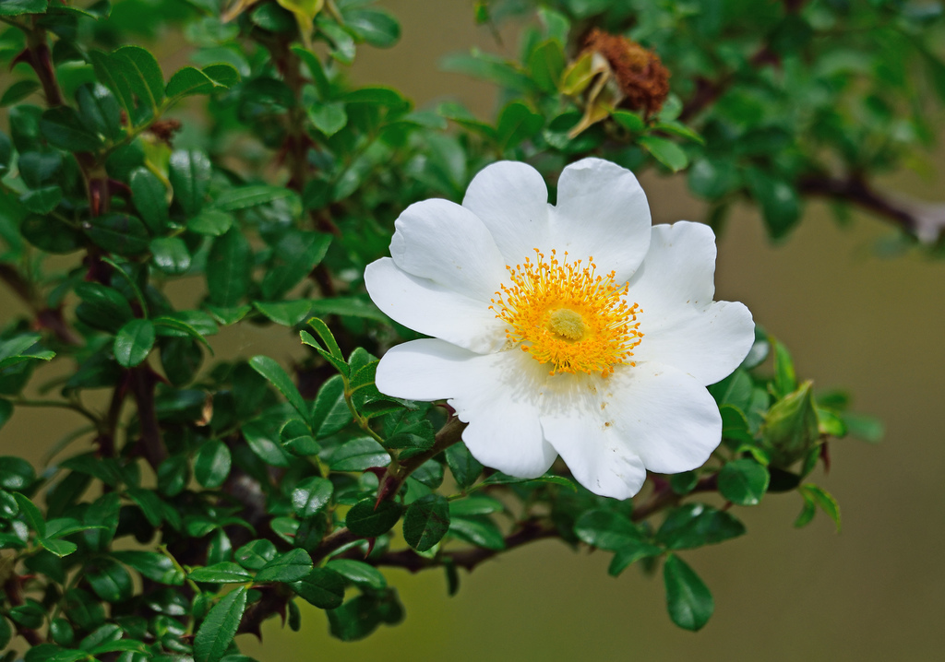
Macartney Rose Management

Slide 2
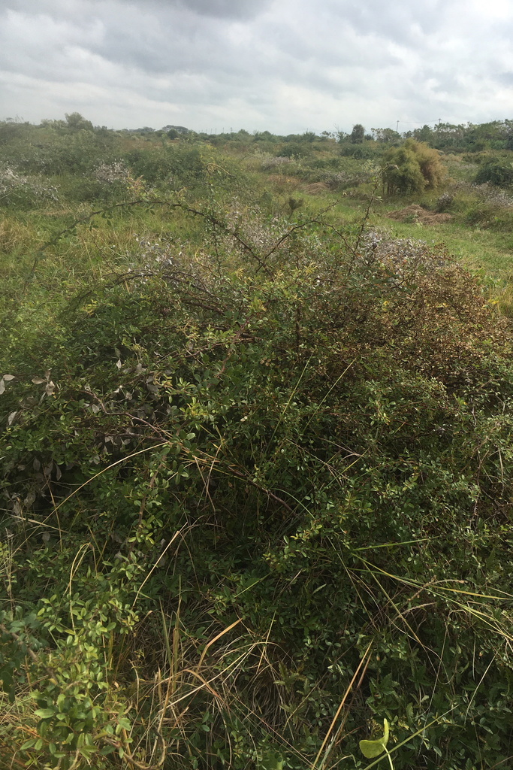
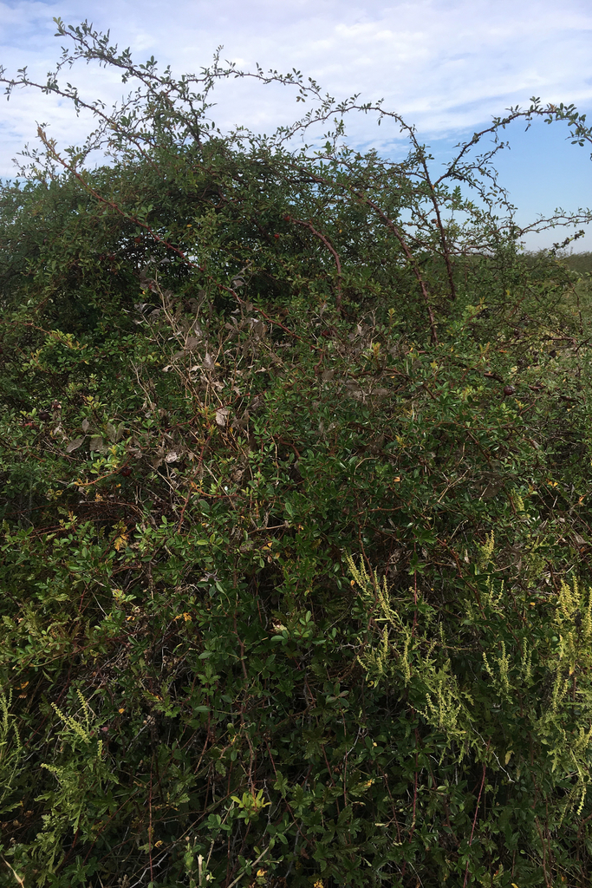

Slide 3
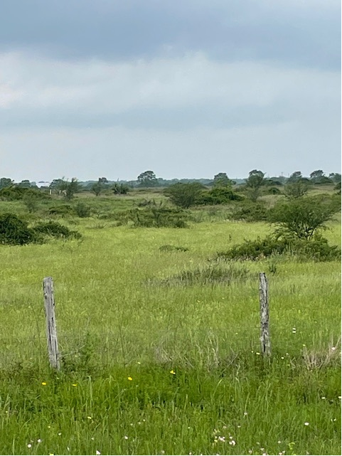
Lower more manageable density

Slide 4
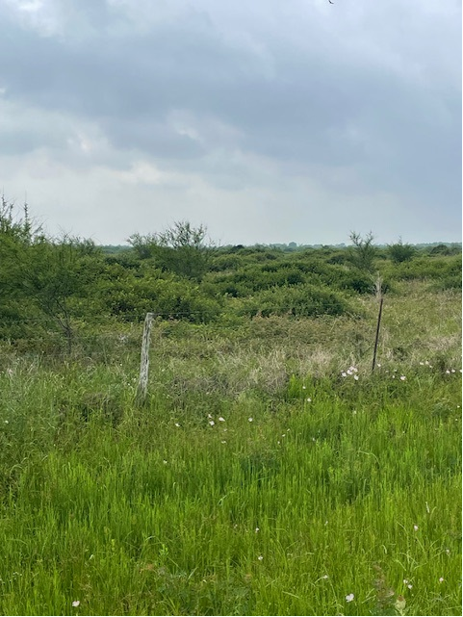
High density

Slide 5
Treatment methods.
Foliar
Picloram:2,4-D (1:4) herbicide 1%
Surfactant .25%
Dye .25%
Undisturbed
Disturbed
12 -36 months after disturbance
For best results, do not spray when:
Rains have stimulated new growth at the end of stems
Leaves are wet from rain or dew
Plants are less than 3 feet tall after mowing
Foliage shows damage from hail, insects, or disease
Working upwind of desirable trees, shrubs, or crops
Flowers or fruits are present
Soil temperatures are below 75°F

Slide 6
Recent debate
Aerial or IPT – that is the question…
At what point do you switch to aerial application

Slide 7
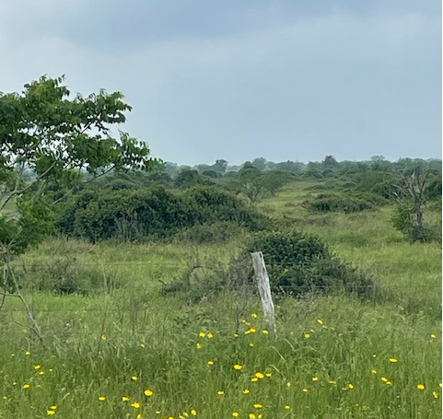
We don’t want to lose forb diversity.

